Slide 1
CCWG Accountability
Icann 52 | 12 February 2015

Slide 2
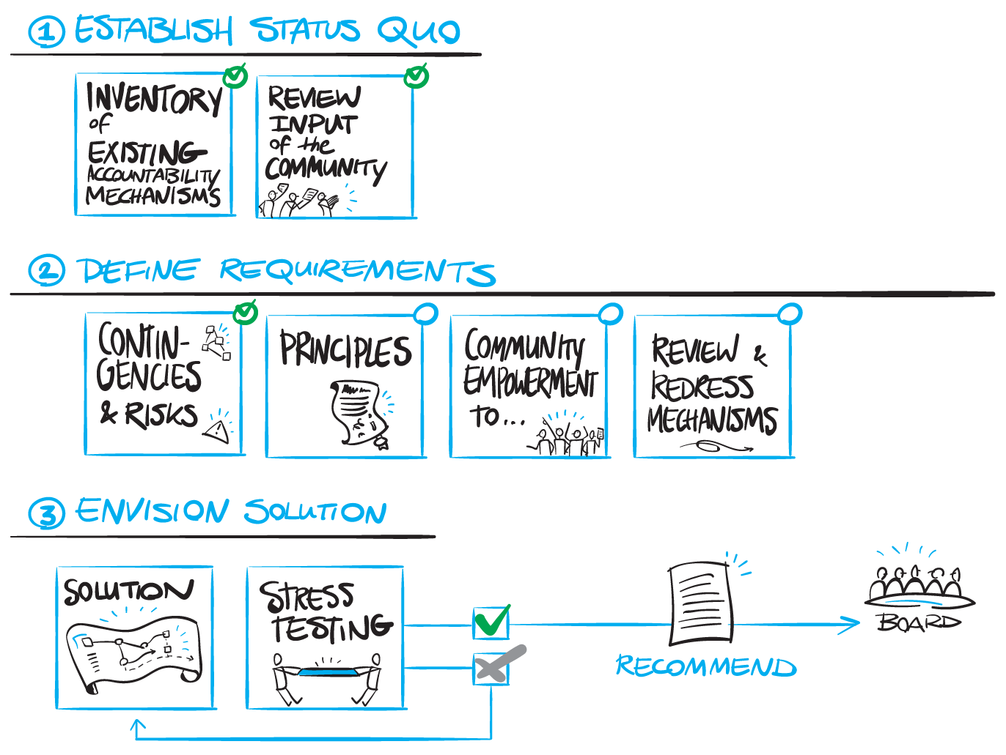
Storyboard of CCWG
Notes:
Use this slide for diagrams or other graphic elements.

Slide 3
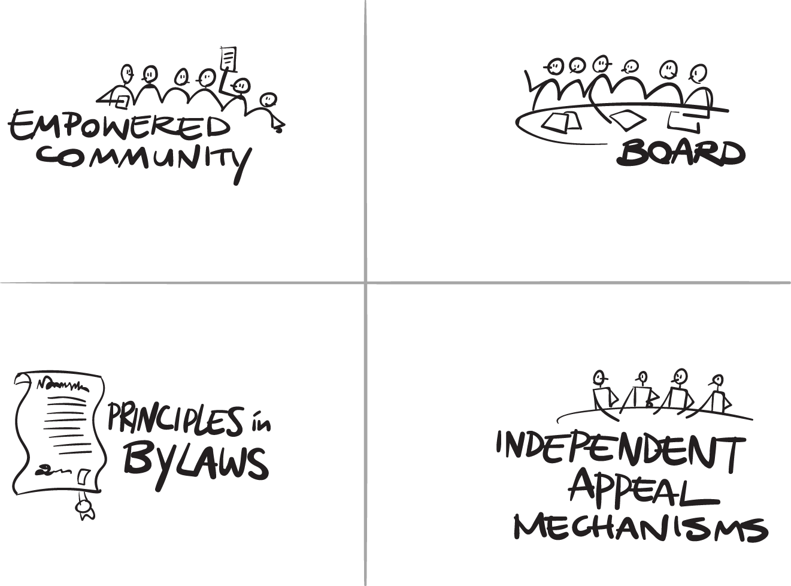
Key components
Notes:
Use this slide for diagrams or other graphic elements.

Slide 4
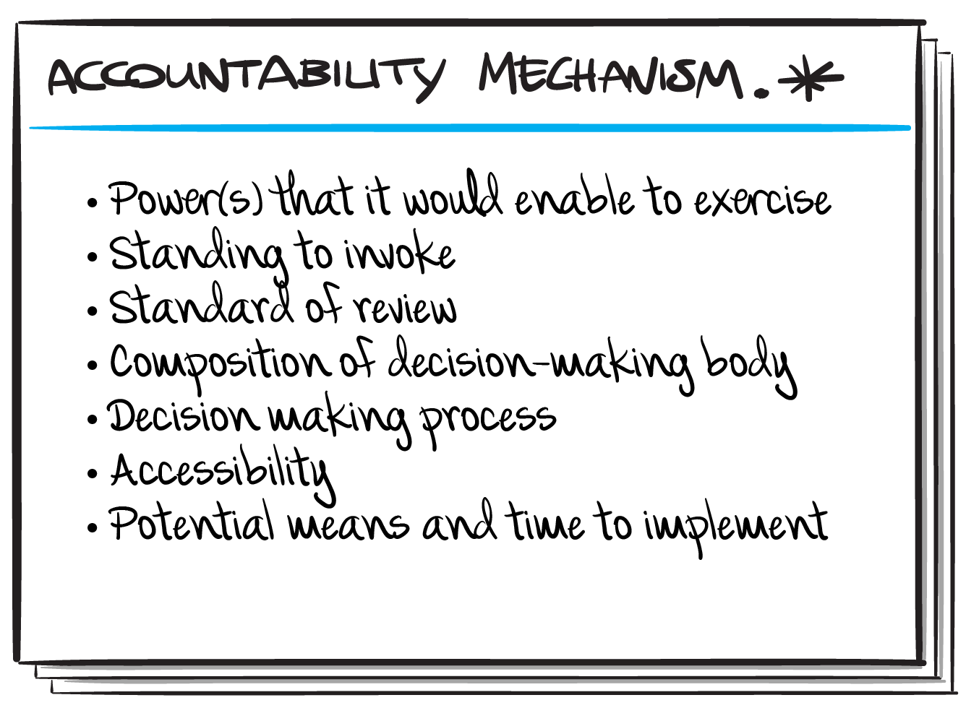
Template for mechanisms
Notes:
Use this slide for diagrams or other graphic elements.

Slide 5
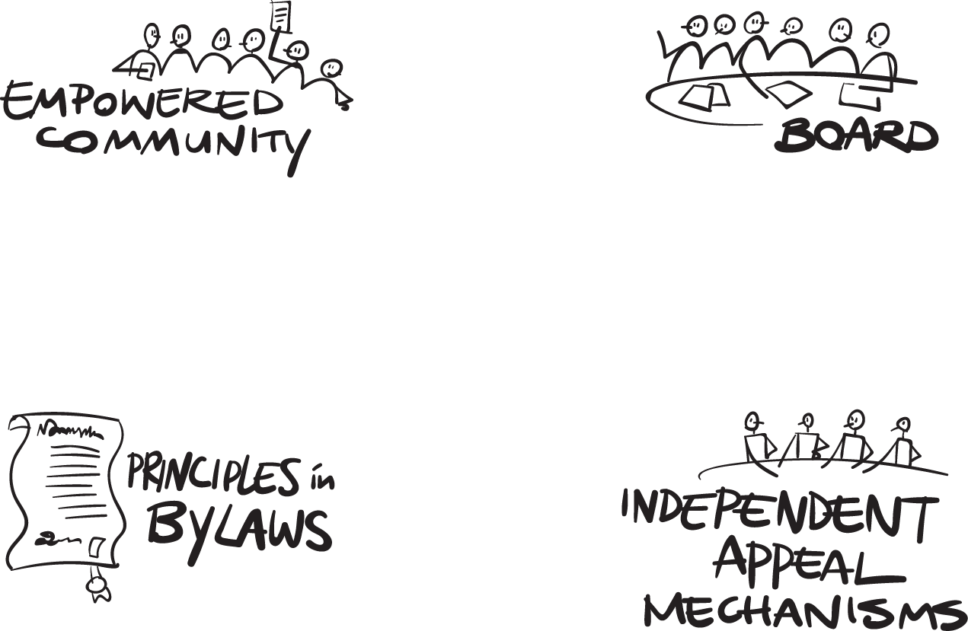
Notes:
Use this slide for diagrams or other graphic elements.

Slide 6
Structure of deliverables
Mechanisms
Powers
Principles

Slide 7
Principles
See Becky’s strawman proposal from Monday meeting:
Mission
Core Values
Mandate
To be refined as we make progress on mechanisms

Slide 8
Powers
From the requirements
Expected description
Approve / reject budget / strategic plan
Approve / reject bylaw changes
Review & redress Board decisions
Review & redress management decisions
Initiate action against Board inaction
Prevent action outside of Icann’s mission
Remove Board member(s)
Description of outcome expected (including examples)
Why is this important ?
What value does it bring ?
And/or what problem does that solve
And/or which contingency does that mitigate ?

Slide 9
WP1: non triggered
WP2: triggered
Budget & strategic plan process
Structural reviews
AoC
Board member election
ATRT review teams
IRP
Reconsideration process
Bylaw change process
Action against Board inaction
Board member removal

Slide 10
Level of description expected
Power(s) that it would enable to exercise
Standing ?
Conditions of standing (ie « last resort »)
Who has standing ?
What is the standard of review ?
Composition :
Numbers
Election or appointment process
Independence conditions
Recall mechanisms
How does it come to a decision ?
consensus, vote…
Is the decision bound by mandates of electors ?
Accessibility
Cost
Delays, …
Potential means to implement

