Slide 1
CCWG-Accountability Marrakesh Face to Face
4 March 2016

Slide 2
Agenda
08:00 - 08:30 – Welcome 08:30 -09:30 -- WS1 recommendation: 09:30 -10:30 – Planning for WS1 implementation 10:30-10:45 – Coffee break 10:45-12:00 – WS2 Kick-off 12:00-13:00 Lunch break 13:00-15:00 – Exchange of views regarding WS2 items scopes 15:00-15:30 – Coffee break 15:30-16:30 – Resources and facilitation for WS2 16:30-17:00 – AOB and Closing Remarks

Slide 3
WS1 Implementation – role of CCWG
Implementation oversight role is not specifically detailed in our Charter.
Our working group should continue in its current form and with the responsibility to monitor the implementation and provide input where needed.
As an example, CWG-Stewardship has remained active.
=> Seek confirmation from Chartering Organizations

Slide 4
WS1 Implementation – bylaw drafting
Lawyers have already produced first drafts (to be reviewed to check compliance with Supplemental report):
AOC Reviews (delivered on 23 December 2015)
IRP related bylaws (delivered on 21 December 2015)

Slide 5
WS1 Implementation – Bylaw drafting process
Initial drafting
Driven by Lawyers
Asking for directions if need be
OIT review
Compliance check with Recommendations
CCWG Approval
Plenary
OIT acts as « rapporteur »
Involves Board and Icann Legal
Board approval
Public comment
Any change referred back to CCWG for approval

Slide 6
WS1 Implementation – Bylaw drafting process
One group or subgroups (IRP, EC, Mission…) ?
To be confirmed with Board
Initial drafting
Driven by Lawyers
Asking for directions if need be
OIT review
Compliance check with Recommendations
CCWG Approval
Plenary
OIT acts as « rapporteur »
Involves Board and Icann Legal
Board approval
Public comment
Any change referred back to CCWG for approval
Which lawyers ?

Slide 7
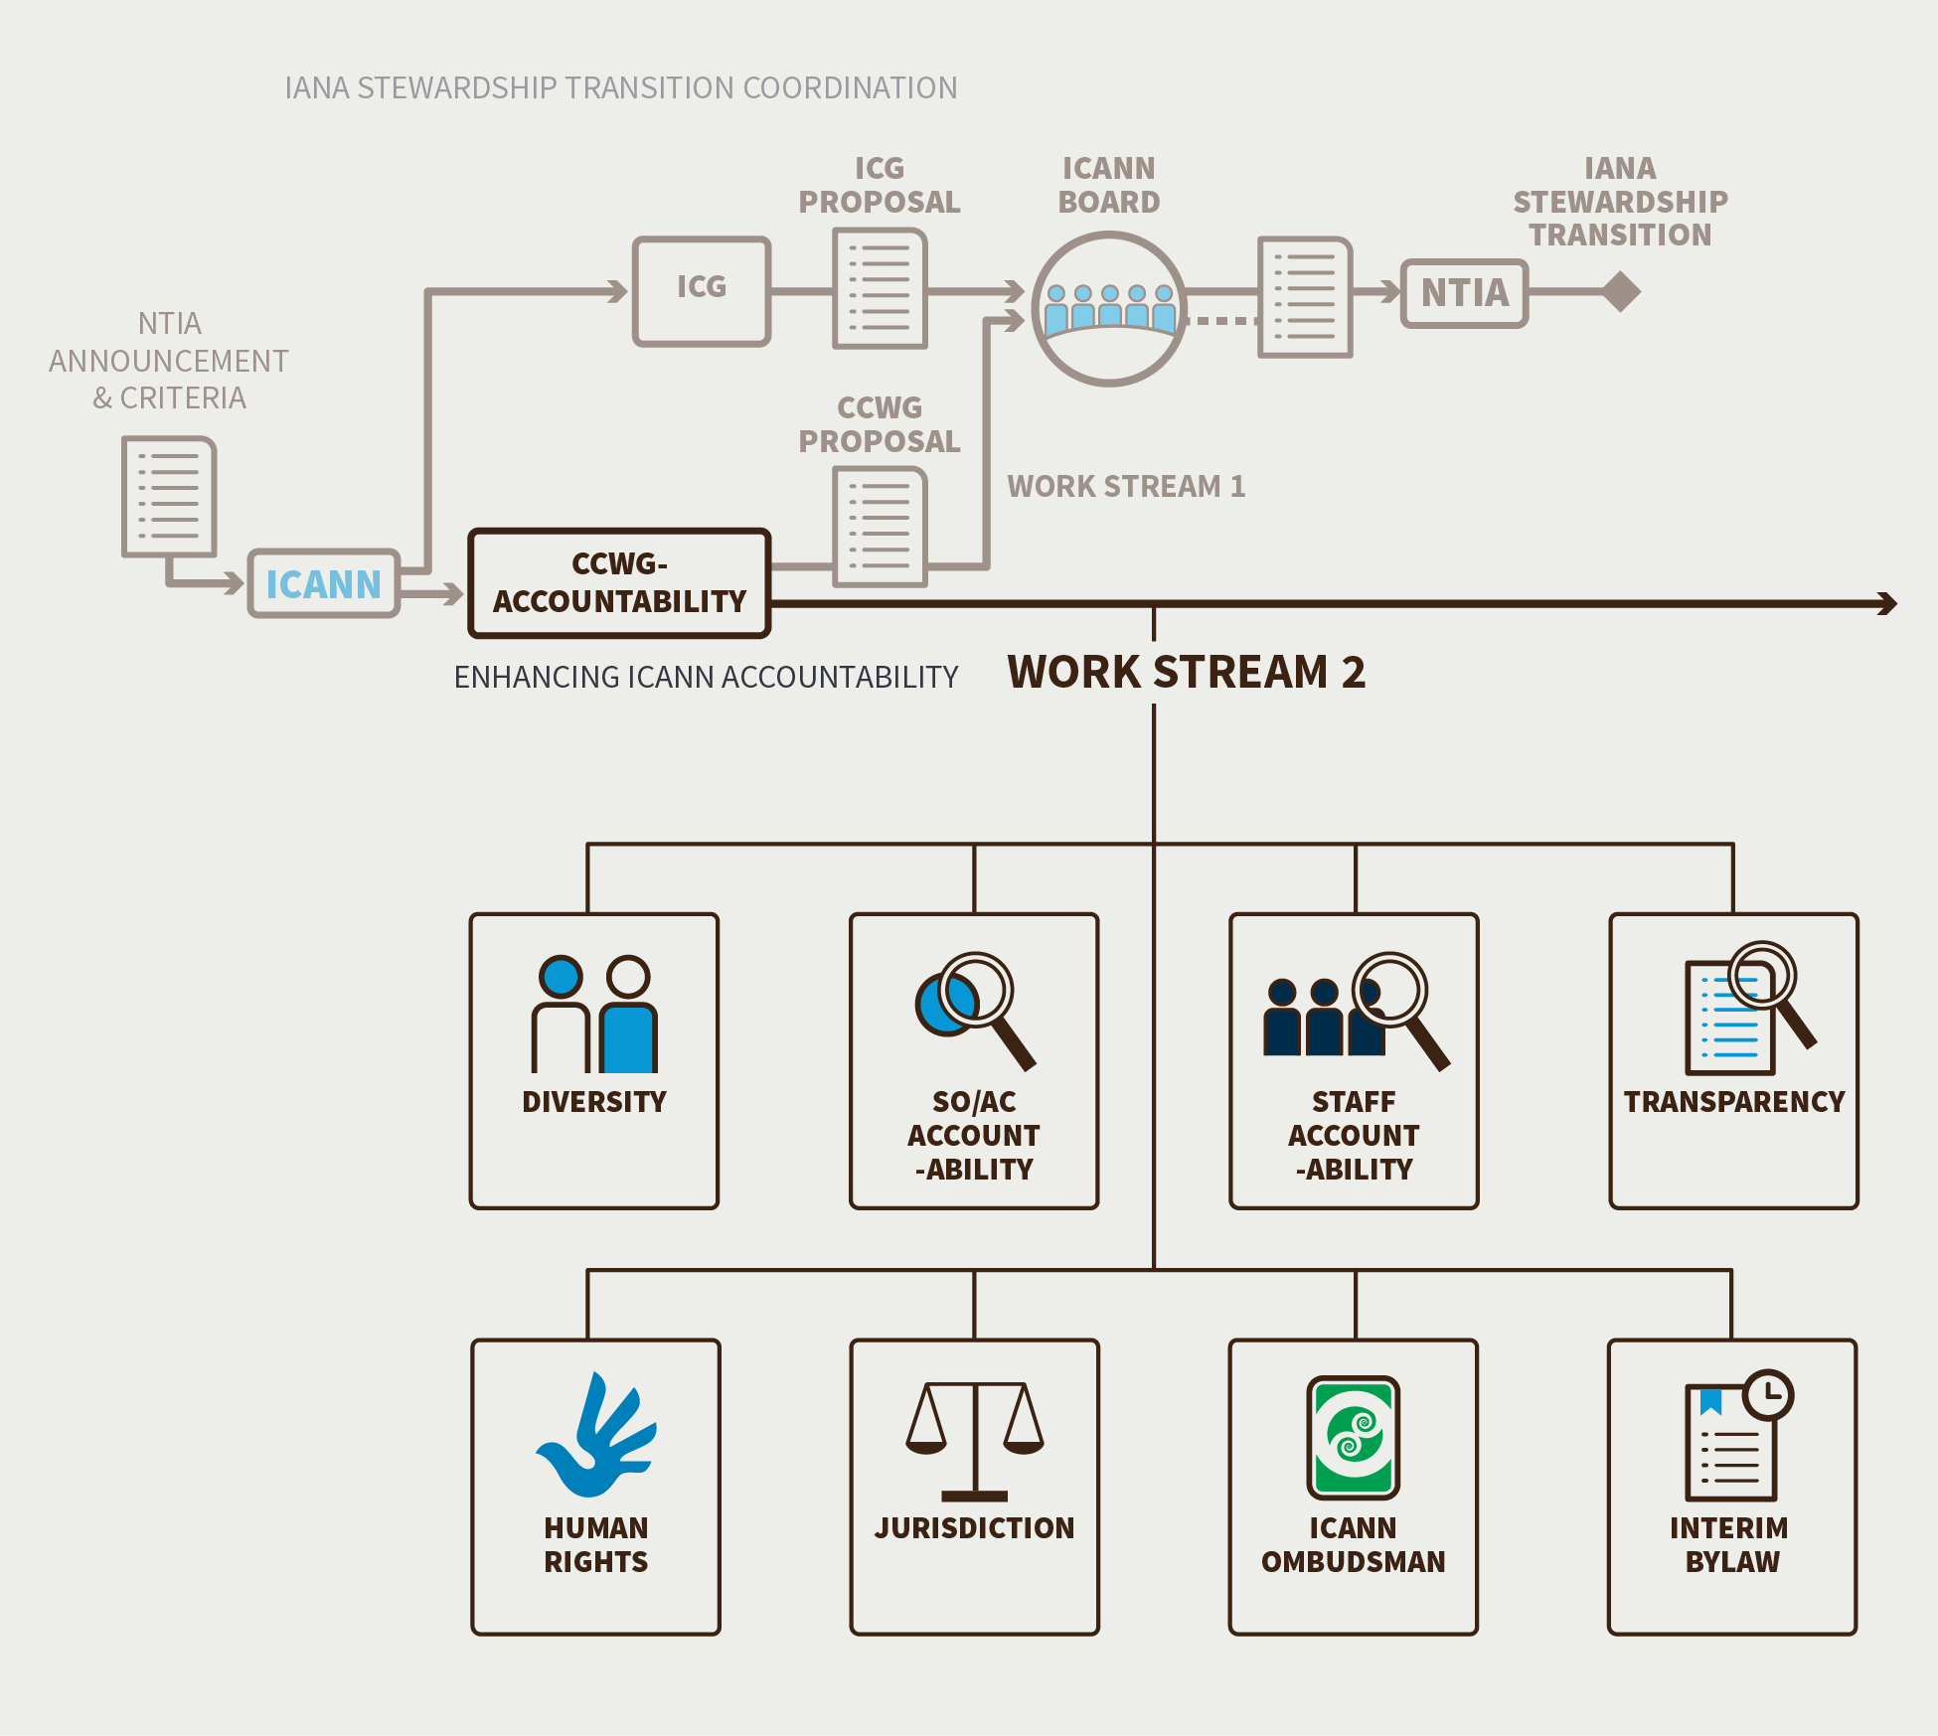
WS2 Kick-off

Slide 8
The Work Ahead…
Work Stream 1
IRP Implementation Team
Implementation Oversight Team
Work Stream 2
Diversity
Human Rights Framework
Jurisdiction
SO/AC Accountability
Staff Accountability
Transparency
Ombudsman

Slide 9
Staff Reflections
The topics outlined in Work Stream 2 are continuous improvements to the organization’s accountability and transparency.
To make the most of Work Stream 2, we need to develop specific and measurable recommendations so that these can be implemented most effectively.
Keep in mind existing work and upcoming reviews. Outcomes can be fed into these efforts, if well timed.

Slide 10
Reviews: what is coming up
JUL 2014
GNSO2
Lines represent the Planning, Conducting, and Implementation phases of the Review process
OCT 2015
CCT
APR 2016
At-Large2
JUN 2016
SSR2
OCT 2016
WHOIS2
JAN 2017
ATRT3
FEB 2017
NomCom2
APR 2017
RSSAC2
MAY 2017
ASO2
JUN 2017
SSAC2
JUL 2017
ccNSO2
Q1
Q2
Q3
Q4
Q1
Q2
Q3
Q4
Q1
Q2
Q3
Q4
Q1
Q2
Q3
Q4
2016
2017
2018
2019
TODAY
LEGEND:
AoC REVIEW
ORG REVIEW

Slide 11
Adopting a distributed, design team approach
Method used by CWG-Stewardship
The output of a Design Team is input to the CCWG-Accountability, not a final document.
Each Design Team must provide regular reports on the larger WS2 calls.
How do we organize this work?

Slide 12
Key milestones for WS2 teams
Scoping and issue framing
Approved by CCWG
Elaborate recommendations
Team
Assess consensus on recommendations
CCWG
ICANN56 at latest
Before ICANN57
ICANN57
Public comment
By end 2016
(Tentative timeline)
One public comment per issue or joint WS2 public comment ?

Slide 13
Consequences for resources and work plan
Team meetings and work plans organized upon requests by teams
CCWG meetings could become monthly (with special meetings when appropriate)
F2F CCWG meetings before ICANN56 and ICANN57 opportunities to scope and finalize recommendations.

Slide 14
Let’s get WS2 started !

Slide 15
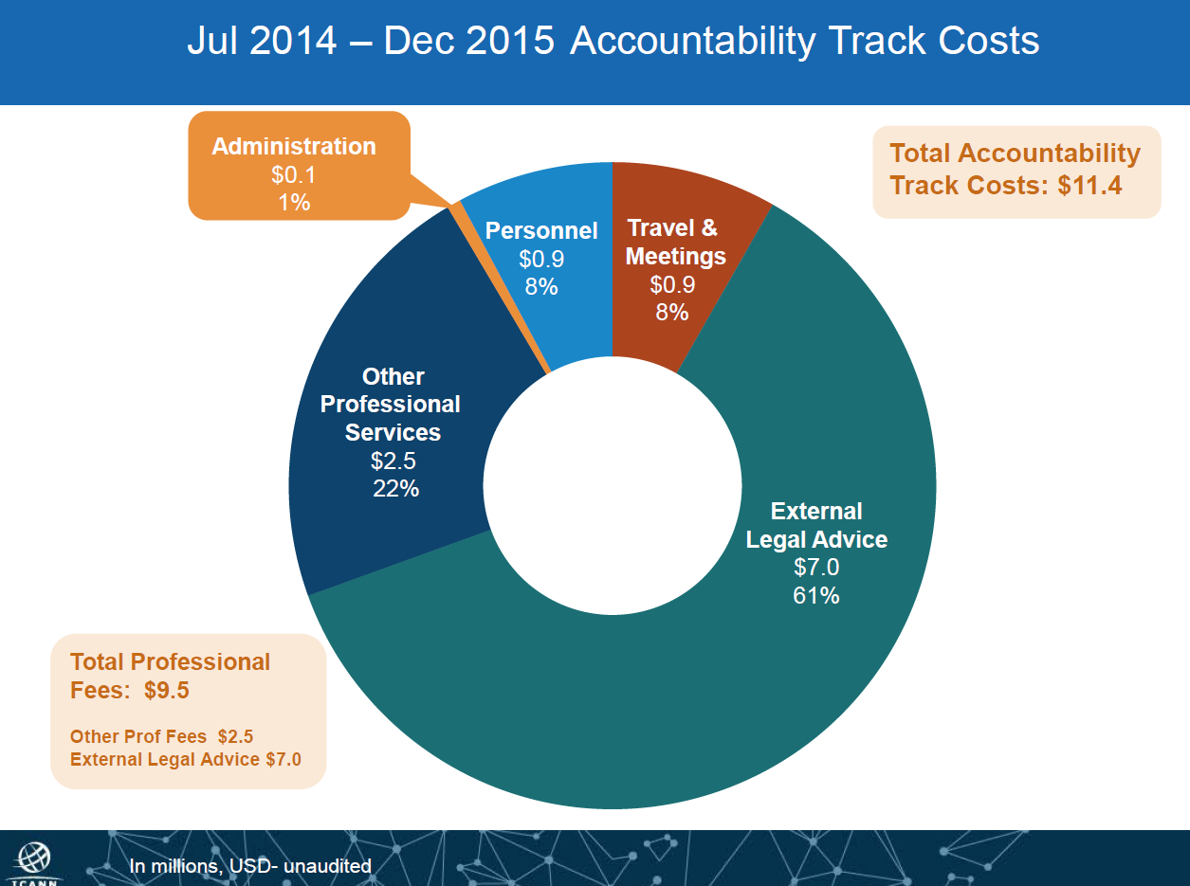
Resources and facilitation

Slide 16
Board pilot proposal
Work on reliable estimates
Pilot Project Cost Support Team to undertake step 1
Support function to co-chairs
Project manager, legal manager, financial planner, project administrator
Selected by ICANN CEO

Slide 17
Resources and facilitation for WS2
Staff support continuation for Teams, CCWG plenary, public comments and communication
F2F before ICANN meetings
Legal Advice

Slide 18
Legal advice for WS2
Some WS2 items will require legal advice
Costs can be optimized :
Intensity of legal advice requests is expected to be lower than WS1
Time constraints should be lower : urgent requests should become the exception
Some requests may be handled by ICANN Legal when no independent view is needed
Proposed WS2 Legal support principles :
Each team may request Legal Advice (including briefings on terminology or issues) to ICANN Legal or Independent CCWG Legal.
Written requests shared on CCWG list (and tracked using existing wiki repository of legal requests) and forwarded by co-chairs
Turnaround time left to Lawyers

Slide 19
Iterative approach to cost management of CCWG-related costs
Iteration cycle could be from ICANN meeting to ICANN meeting
CCWG defines goals and required support for upcoming period
Chartering Orgs provide feedback
ICANN Board allocates resources or not
CCWG reports on achievements and expenses incurred
Staff support in tracking expenses

