Slide 1
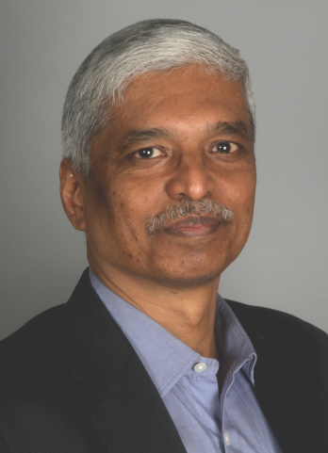
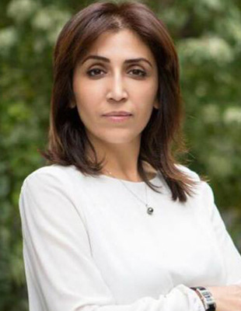
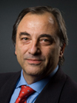
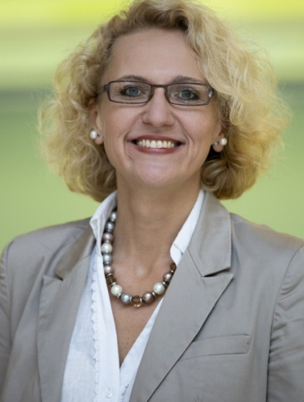
At-Large Capacity Building Webinar
Universal Acceptance:
How It Affects End-Users,
Language Communities and ICANN At-Large
16 June 2020 at 14:00 UTC for 60 min
The Guest Speakers:
Satish Babu, APRALO Chair Lianna Galstyan, APRALO Vice-Chair
Roberto Gaetano, Chair of EURALO Individuals’ Association Moderator: Joanna Kulesza, EURALO ALAC Member
Language of webinar - English

