Slide 1
CGP Updates
Wei WANG & Kenny HUANG | ？？ March 2016

Slide 2
CGP Updates
Wei WANG & Kenny HUANG
?? March 2016
Notes:
Breakup your presentation, divide it into sections. This is especially useful if most of your presentation is text.

Slide 3
CGP Repertoire and CDNC2015
MSR
In July 2015, CDNC Taiwan meeting urged to add all CDNC chars into CGP repertoire, to reach consistency between the CDNC SLD operation and future TLD operation.
Compared with original CDNC/CN/TW table (19520 chars) http://www.cdnc.org/gb/research/file/CDNC_unicode.txt
CDNC Table 2015 have 41 new chars requested by HK community http://www.cdnc.org/gb/research/file/unicode.txt 39 of which fall in the range of MSR.
CDNC
Notes:
Use this slide for diagrams or other graphic elements.

Slide 4
CGP Repertoire=CDNC2015+Normalized+IICore
MSR
The Normalized China's State Council published Normalized Hanzi List for Common Use in 2013, 27 new chars in the range of MSR
IICore International Ideographs Core 145 new in the range of MSR
Normalized
IICore
CDNC

Slide 5
CGP Variants
CDNC and CGP linguists analyzed 172 new chars from the Normalized and IICore. In particular, linguists studied 107 chars which also in JGP repertoire and updated variant setting of CGP repertoire.
MSR
Example:
麹(9EB9) | Non CDNC2015 | Normalized | IICore | JGP
Simp | Trad | Var
曲(66F2) | 曲(66F2) 麴(9EB4) | 麹(9EB9)曲(66F2)麴(9EB4)麯(9EAF)

Slide 6
CGP LGR XML
CGP fixed the flaws in the last version of CGP LGR XML document:
Complete the description of Reference ID
Add the type of “reflective” (r-simp, r-trad, r-both)
Correct spelling error of “block”
Add comments to the action rules

Slide 7
CGP repertoire vs JGP and KGP
Besides 107 JGP chars mentioned above, CGP does not seek to borrow more chars or variants from JGP.
KGP provided K-LGR v0.3 in September, including 4819 Hanja char, all falling in the range of CGP repertoire.

Slide 8
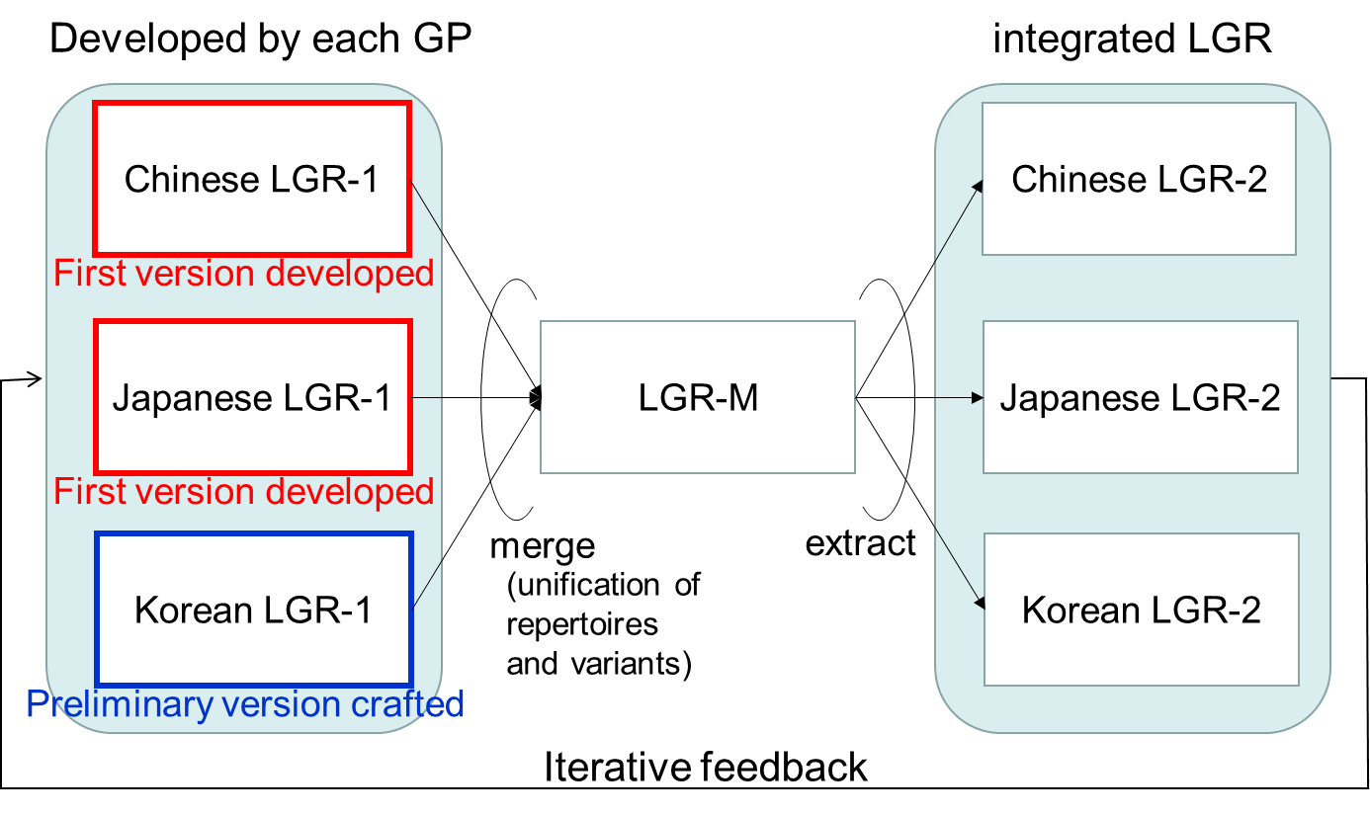
The Next Step
CJK agreed to generate merged LGR based on the algorithm proposed by Yoneya San.

Slide 9
Challenge
It still needs further in-depth exchange and compromise to reach the consensus on CJK variant set
“机”and“機” have different meaning in Japanese language environment
Similarly, K listed 258 unacceptable variant group in C LGR
C has invited J and K to visit Beijing at 20~21, March.

Slide 10
Thanks
Q&A

