Slide 1
Korean GP Status Update
ICANN #55 Marrakech (RAK), Morocco.| 2016.03.

Slide 2
Agenda
Introduction and a list of Hangul Syllables for K-LGR v0.3
A list of Hangul Syllables, Hanja characters for K-LGR v0.3
Review of C (Chinese) and K (Korean) Variant Groups
Timeline of KLGP activities

Slide 3
1. Introduction
Characters to be included in "kore" (Korean Label)
Both Hangeul (Hangul) and Hanja are included.
K-LGR v0.3 (2015.08.13.)

Slide 4
2. K-LGR v0.3
A list of Hangul Syllables for K-LGR v0.3 (2015.08.13.)
11,172 Hangul Syllbles (U+AC00 ~ U+D7A3)
A list of Hanja characters for K-LGR v0.3 (2015.08.13.)
Source of Hanja Character Set | # chars
1) KS X 1001 (268 comptb. chars excluded) | 4,620
2) KPS 9566 | 4,653
3) IICORE - K column marked | 4,743
4) IICORE - KP column marked (= KPS 9566) | 4,653
5) Qualifying Test of Korean Hanja Proficiency (한국 한자 능력 검정 시험) | 4,641
K-LGR v0.3 (2015.08.13.): Hanja List | 4,819

Slide 5
3. Review of C (Chinese) and K (Korean) Variant Groups
C-LGR (2015.04.30.): 3093 variant groups
(a variant group is composed of two or more variants)
K-LGR v0.3 (2015.08.13.): 37 variant groups
Analysis of 3093 C (Chinese) variant groups
extracted 303 variant groups where there are two or more K characters
K character is a character belonging to K-LGR v0.3 (2015.08.13.)
Korea classified 303 variant groups into three categories

Slide 6
3. Review of C (Chinese) and K (Korean) Variant Groups(2)
K position | # variant groups
acceptable | 44
unacceptable | 259
total | 303
1) K characters in some C variant groups have different meanings in Korea.
2) K characters in some C variant groups have similar meanings; however, those K chars are not regarded as “variants in the context of TLD” in Korea.

Slide 7
3. Review of C (Chinese) and K (Korean) Variant Groups(3)
K chars in 259 Unacceptable C var. group have | # C variant groups
Similar meaning | 97
Different meanings | 162
total | 259
Need to translate meanings of K chars with different meanings in 162 unacceptable C variant groups.

Slide 8
3. Review of C (Chinese) and K (Korean) Variant Groups(4)
A special class of variant groups in C-LGR
About 56 "Simplitional chars“: [= SIMPLIfied + tradiTIONAL]
Currently, the char is a simplified char in China.
However, the char has been used for a long time before PRC announced simp. chars in 1964 in Korea, China, etc.
An example of Simplitional char: 机
1) In China:
机: Currently, Simplified char, "machine".
机: simplified from Traditional char 機 (machine).
2) In Korea: the two chars are distinct
机: desk (reading "gwe")
機: machine (reading "gi")

Slide 9
3. Review of C (Chinese) and K (Korean) Variant Groups(5)
Analysis of 37 K (Korean) variant groups and Related 37 C variant groups
In all 37 K variants groups composed of two characters, there are two C characters
C character is a character belonging to C-LGR.
Korea classified 37 Related C variant groups into three categories as shown below.
K position RE: related C variant groups | # of Related C variant groups
acceptable | 33
Unacceptable * | 3
need to review | 1
total | 37

Slide 10
3. Review of C (Chinese) and K (Korean) Variant Groups(6)
E.g.1, Related C variant group
(O 4EC7 仇) (O 8B8E 讎) (O 8B90 讐) (X 96E0 雠)
--> K position: There is much difference in meaning in K between 4EC7 and (8B8E = 8B90).
E.g., 2: Related C variant group
(O 88CF 裏) (O 88E1 裡) (O 91CC 里)
--> C included 91CC since it is a simplified char of traditional characters 88CF and 88E1.
--> K position: There is much difference in meaning in K between 91CC and (88CF = 88E1).

Slide 11
3. Review of C (Chinese) and K (Korean) Variant Groups(7)
Possible errors in C-LGR-1 (2015.04.30.)
KLGP reviewed C-LGR-1 (2015.04.30.) and found possible errors.
sent to C members on July 16, 2015 and a few more times later. In two cases, there seem symmetry and/or transitivity issues (problems).
矿(77FF) 礦(7926) 砿(783F) 鉱(9271) 鑛(945B)
铁(94C1) 鐵(9435) 鉄(9244) 銕(9295) 鐡(9421)
Hope that these have been fixed by now.

Slide 12
3. Review of C (Chinese) and K (Korean) Variant Groups(8)
A mixture of trad. and simp. chars.
CGP will allow a HSBC domain mixed of simplified and traditional chars @ ICANN meeting in Buenos Aires.
left figure: only traditional chars.
right figure: only simplified chars.
a figure of HSBC domain mixed of simplified and traditional chars?

Slide 13
4. KGP’s Activities history (1)
2013
Dec : organization of Korean LGP
2014
Mar : Participate CJK joint meeting @ ICANN49 Singapore
Jun : Participate ICANN50 London and KGP status update
Jul : 1st KGP meeting
Aug : 2nd KGP meeting
Oct : Participate ICANN51 LA and KGP status update
2015
Jan : 3rd KGP meeting and re-composition KGP
Feb : Participate ICANN52 Singapore and KGP status update
Apr : 4^{th ,} 5th KGP meeting (reorganization of KGP)
May : 6th , 7th KGP meeting(K-LGR-1 v0.1) and CJK Joint meeting in Seoul
Jun : 8th KGP meeting(K-LGR-1 v0.2) and participate ICANN53 BA
Jul : 9th KGP meeting, workshop and Participate APrIGF Macau
Aug : 10th KGP meeting(K-LGR-1 v0.3)
Sep : 11th KGP meeting
Oct : Call for formal Generation Panel to ICANN and participate ICANN54 Dublin

Slide 14
4. KGP’s Activities history (2)
2015
Nov: 12th KGP meeting
2016
Jan : 13th KGP meeting
Feb : The Korean Community “formally” Forms Generation Panel for Developing the Root Zone Label Generation Rules (LGR), 2016-02-01.
Mar : Participate ICANN55 Marrakesh, Morocco and present KGP status update

Slide 15
5. Timeline of KLGP activities
10.
2015
11.
2015
01.
2016
02.01
2016
05 (?).
2016
Next
Steps
KGP Status Update @ ICANN #54
KGP #12 meeting
KGP #13 meeting
KGP formally formed
K-LGR v1.0
. Need to send translated meanings to CGP (in Mar/Apr (?), 2016)
.

Slide 16
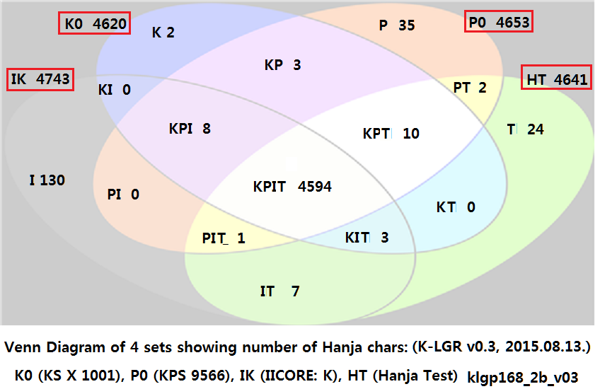
Appendix. Hanja in K0, P0, IICORE/K, HT (Hanja Test)

