Slide 1
CCWG-Accountability
Legal cost control mechanisms
July 13 2016
Notes:
Margie

Slide 2
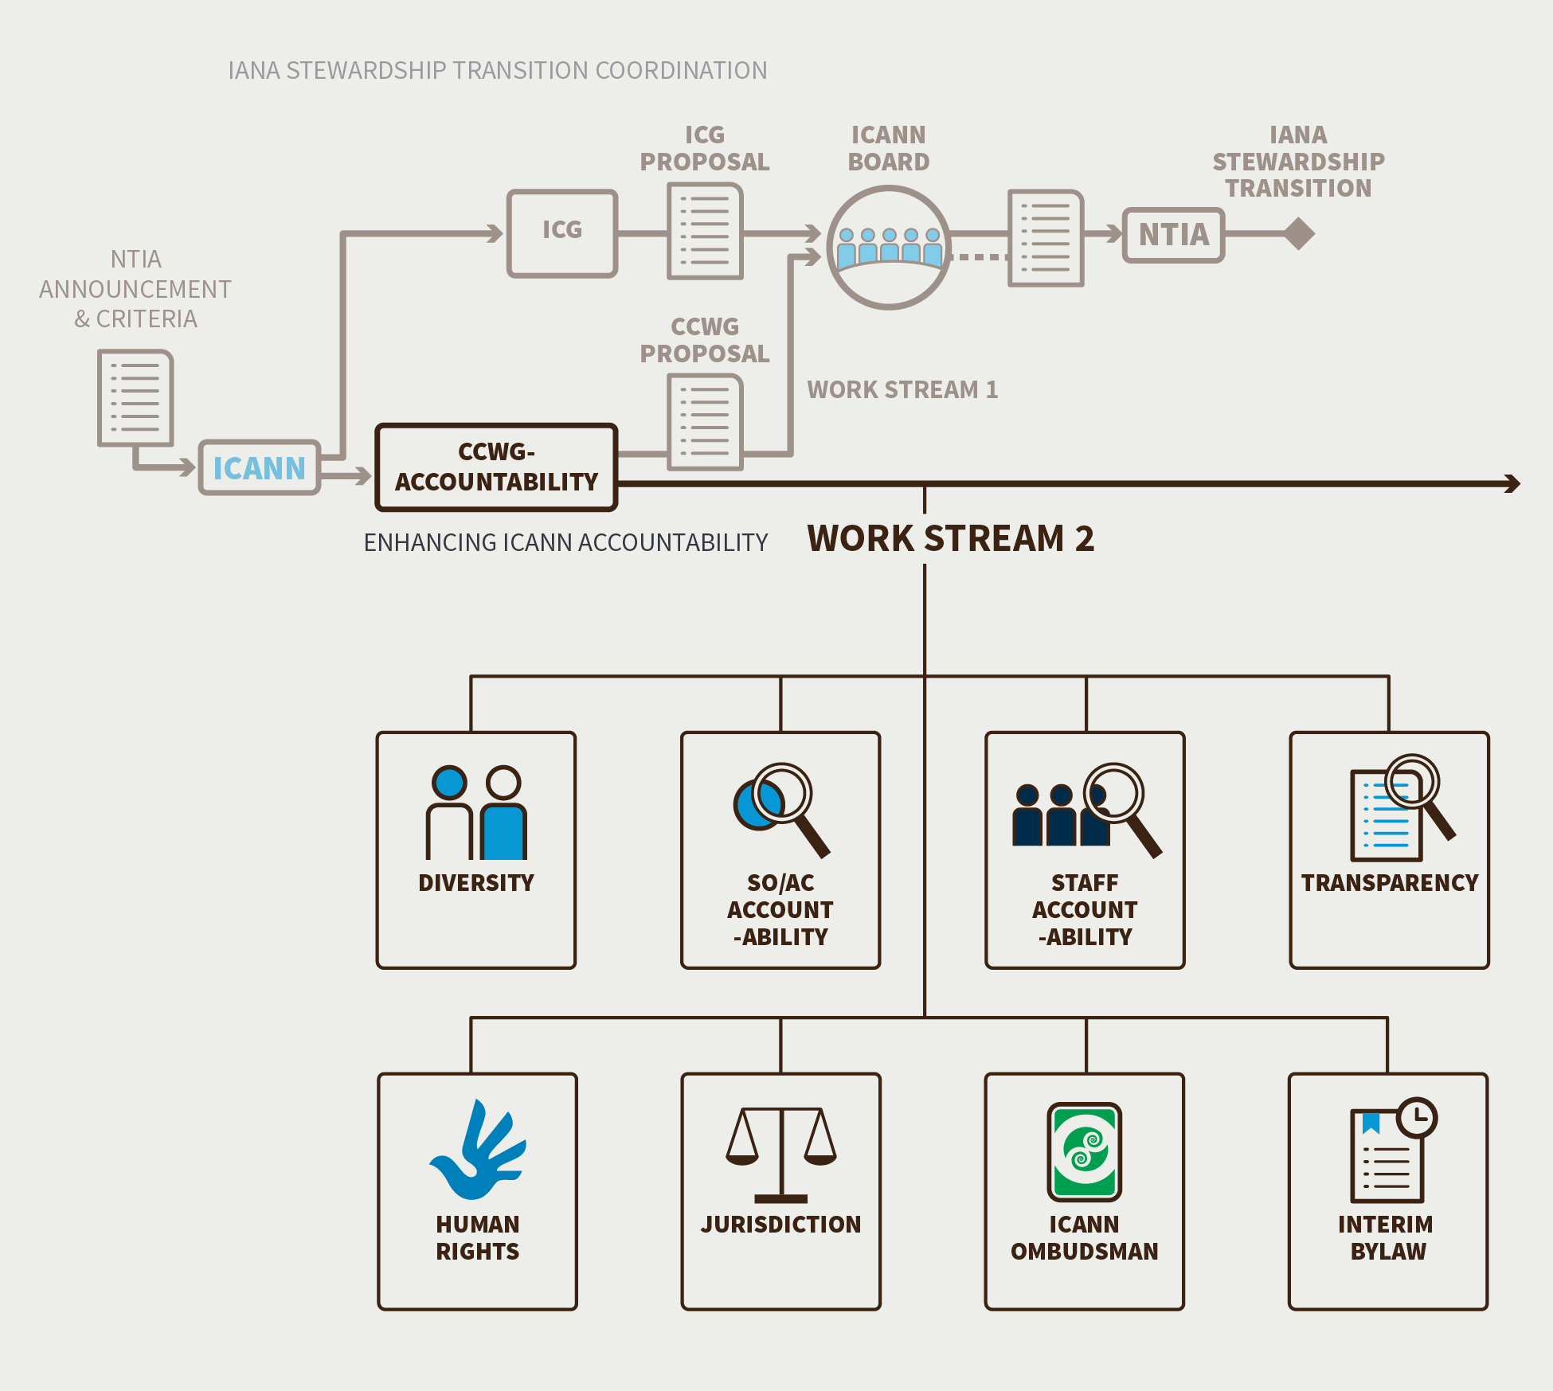
Work stream 2
Additional topics :
Review of CEP
Community guidelines for conduct during Board removal process

Slide 3
Cost estimate for FY17 – WS2 (reminder)
Includes WS2 accountability
Does not include IRP Phase 2 (0,8 million $), Transition Implementation (3,7 million $) or General Project activities (1,2 million $)
Continuation of ongoing effort to support WG, including staff, AC rooms, transcription
One day F2F meetings before Icann meetings (maximum of 20 travel support seats)
Continuation of independant legal advice, with lower intensity and refined cost control mechanisms
 | $ (thousand’s)
Staff | 808
Travel & meeting | 354
Telecom & Language services | 201
Legal services | 1,400
Other (education, engagement, communication) | 344
Total | 3,107

Slide 4
Legal Committee
Role :
Filter, analyze, refine (ensure clarity), and approve requests for legal advice
Determine which firm is best suited to respond
Process :
The Committee meets at least once a month
Based on subgroup requests documented and share before the meeting,
Rapporteurs may attend relevant part of the call to discuss their requests
LC ensures that request is a legal issue (not a policy one)
With support from PCST, LC tracks legal expenses with clear distinction between what is related to its scope vs any other Legal costs.
Counsel may be invited to attend parts of the LC meeting to ensure clarity of expectations and context (reminder : Counsel participation to CCWG and subgroup calls is exceptional only)
Composition based on WS1 Legal subteam executive team, ie :
León Sanchez (co-chair, lead)
Samantha Eisner (support)
Athina Fragkouli
Robin Gross
David McAuley
Sabine Meyer
Edward Morris
Greg Shatan

Slide 5
Budget ownership
Co-chairs would act as budget owners for WS2
Budget ownership scope excludes staff, as well as telecom & language services
Ownership implies :
Regular updates and progress assessment against the planned budget
Potential trade-off decisions
Requesting additional budget if necessary (subject to Chartering Orgs and BFC approval)
 | $ (thousand’s)
Staff | 808
Travel & meeting | 354
Telecom & Language services | 201
Legal services | 1,400
Other (education, engagement, communication) | 344
Total | 3,107 / 2,098

Slide 6
Legal Committee – allocation of requests
Proposed guidelines for the Legal Committee:
If Icann Legal already has an answer available to the question, it can be shared immediately to avoid extra costs.
The Committee may direct the request at ICANN Legal or external firms, based on a case by case assessment.
Decisions would have to take into account costs, delays, respective skills, as well as potential requirement for “independent” advice.
The Committee is encouraged to use ICANN Legal as much as possible in order to manage costs effectively.
Sidley & Adler will coordinate to decide which firm is best suited to address requests certified to CCWG Independent Counsel
If the CCWG requests advice from Jones Day, then Jones Day should either (a) disclose that ICANN (and not the CCWG) is their client for purposes of the memo or (b) enter into an engagement specifically with the CCWG as client (same as Sidley and Adler), and that ICANN has provided a waiver of conflict of interest.
Hiring of other firms for specific expertise would be subject to CCWG-ACCT and Icann Legal prior approval (similar process as during WS1)
Once the LC has determined it needs to hire external legal counsel it forwards the request with relevant details, including estimated costs and a report from the PCST on the financial impact, to the Co-Chairs for approval.
The Co-Chairs will consider the request and the financial impact as soon as possible and provide a formal response to the LC which will be documented on the CCWG WS2 Wiki if approved.

