Slide 2
Welcome to this zoom webinar
Please type your questions or comments in the Q&A pod
Text written in the chat will not be read aloud
Chat sessions are archived
To ask the floor, please use the raise hand icon
Moderator or Chair and remote participation manager will manage the queue
When it is your turn to speak, we will announce your name and unmute your microphone
This meeting is governed under ICANN’s Expected Standard of Behavior: http://www.icann.org/en/news/in-focus/accountability/expected-standards

Slide 3
Joint meeting ccNSO & GNSO Councils ICANN68 | Wed, 24 June 2020 | 03:30-04:30 UTC
Welcome
Approval full slate Customer Standing Committee (CSC)
Letter to the Board regarding adoption procedure FY21 Budget and 5-year operating plan
ccPDP4 on the (de)selection of IDN ccTLD strings
AOB
Closure

Slide 4
IDN TLD variant management in ccPDP4

Slide 5
Why ccPDP 4?
Current State of Play

Slide 6
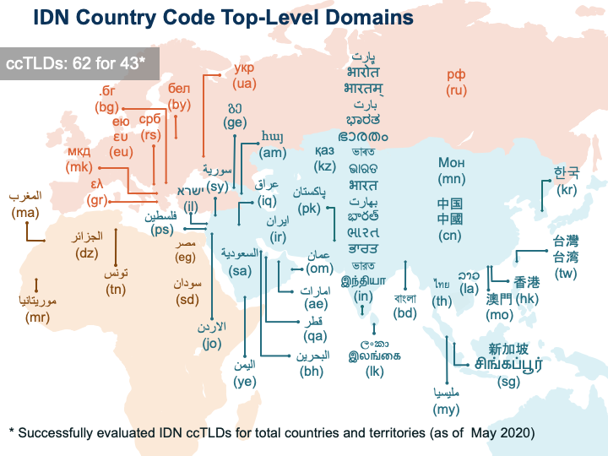
ccTLDs not eligible as member ccNSO
ccTLDs not eligible as member ccNSO

Slide 7
Known Open Issues (1/2)
Variant management
Root Zone – Label Generation Rules & need for policy around variant management of TLD
Placeholder in ccPDP 2
Evolution of process confusing similarity evaluation under Fast Track Process
From DNS Stability panel to extensive and extended process and evolution of assessment methodology and criteria

Slide 8
Known Open Issues (2/2)
Retirement of IDN ccTLD
What triggers the retirement of an IDN ccTLD?
Change in name of country or territory in official language of the country?
Change in status of the language of the country ( from language used from administrative purposes to non-specific language)?
Dissolution of the Country (although non-IDN: AN)
Once retirment is triggered the retirement process applies
Inclusion IDN ccTLDs in ccNSO

Slide 9
The Roadmap

Slide 10
To:
Policy for Selection of IDN ccTLD String
Amended ccNSO Article 10 ICANN Bylaws
Fast Track Process
&
Overall IDN ccTLD policy proposals
Selection of IDN ccTLD Strings
Inclusion Of IDN ccTLDs in ccNSO
So what is the roadmap?
To get from:

Slide 11
The Roadmap: Current Status
ccPDP2 Closed and Evolution of Fast Track Process stopped
Gap Analysis Overall IDN ccTLD policy (PDP 2): completed June 2019
Bylaw change process: include IDN ccTLDs in ccNSO: awaits Public comment process
Recommendation to replace ccPDP2
ccPDP 4 (policy to select IDN ccTLDs strings):
Issue Report adopted May 2020

Slide 12
ccPDP4: Includes IDN Variant Management

Slide 13
Operations under ccPDP4
One (1 ) Working Group to develop policy recommendations
At least two (2) sub-groups with specific invitation for participants from GNSO:
sub-group 1 on confusing similarity review process(es), procedures, criteria and method(s) and
sub-group 2 on variant management of IDN ccTLD strings.
Sub-groups submit their recommendations ( on IDN ccTLDs) & outcome , but coordinating efforts, to the ccPDP4 working group.

Slide 14
Why invite participants from GNSO to Sub-Groups?
Coordinate the policy efforts undertaken by both the ccNSO and GNSO in the areas of confusing similarity and variant management
In coordinating in the area of Variant Management to take into account requests from the Board
In the area of confusing similarity of TLD strings look for potential to increase efficiencies and effectiveness

Slide 15
Reference material IDN Variant Management
The Board resolution on IDN (cc)TLD Variants (14 March 2019) (https://www.icann.org/resources/board-material/resolutions-2019-03-14-en#2.a) requesting the ccNSO to work on Variant Management and related relevant material (see: https://www.icann.org/resources/pages/idn-variant-tld-implementation-2018-07-26-en)
Other material deemed relevant

