Slide 1
Data & Metrics for Policy Making
Jonathan Zuck | Council Update | 10 Oct 2015

Slide 2
Why is it Important?
Background
The Data & Metrics for Policy Making Working Group (DMPM) explored opportunities to review standard methodologies of reporting and metrics that could better inform fact-based policy development and decision making; including how the community can collaborate with Contracted Parties and other service providers in the sharing of metrics and data.
Tasks of the DMPM
In connection to the group’s charter questions, the DMPM has deliberated on the improved use of data in:
Issue identification, scoping and prioritization
Key performance metrics for recommended policy
Fact based assessment of policy outcomes
Public Comment
The WG launched a public comment forum based on its Initial Report and draft recommendations and has since reviewed those comments to prepare its Final Report: https://www.icann.org/public-comments/data-metrics-policy-making-2015-07-29-en. Nine comments were received.
Notes:
DG deliverables
Issues matrix, which compared issues identified by DG members against the principles, recommendations, impl. Guidelines from original GNSO Final Report from 2007. Helps to determine where policy adjustments, new policy needed.
Preliminary Issue Report (June 2015)
What is it for?
Sets the stage, or sets the preliminary scope for a possible PDP
NOT about solutions at this stage
Not fast process for PDP, other efforts in the community, so the report acknowledges that the scope could be expanded
An important principles is: The original policy recommendations as adopted by the GNSO Council and ICANN Board have “been designed to produce a systemized and ongoing mechanisms for applicants to propose new top-level domains,” those policy recommendations remain in place for subsequent rounds of the New gTLD Program unless the GNSO Council would decide to modify those policy recommendations via a Policy
Development process.

Slide 3
Opportunities for Data in Policy Development
Evolve ICANN culture to better informed, fact-based policy development
Help ensure that the most critical registrant, registry, and registrar issues are addressed
Facilitate deliberations and decisions based on tangible evidence as opposed to “gut feeling” or anecdotal evidence
Promote continuous improvement to the policy based on measured outcomes

Slide 4
Definitions
Data: Individual facts, a set of values, statistics, or items of information
Metrics: A set of measurements that help quantify results, which allows for better determination of the level of success against a set of goals

Slide 5
Proposed Recommendations
Recommendation 1
Recommendations 4&5
1
4&5
Update Charter and Final Report templates with standard recommendation to measure effectiveness of future consensus policies post implementation.
Initiate pilot effort for SGs/Cs to make tactical based data & metric requests within the GNSO to enhance issue development of policy issues.
Recommendation 2
Recommendation 6
2
Update Working Group Guidelines within GNSO OP Procedures regarding early outreach to include quantitative measures and expand audience beyond ICANN.
6
Create Metrics Request introduction into Working Group Guidelines.
3
Recommendation 3
7
Recommendation 7
Staff to create formal templates of Issue Report, Charter, and Final Reports and document accordingly in Working Group Guidelines.
Import metrics request decision tree and form into Working Group Guidelines.
**Final Report was sent to GNSO Council list on 9 Oct 2015.

Slide 6
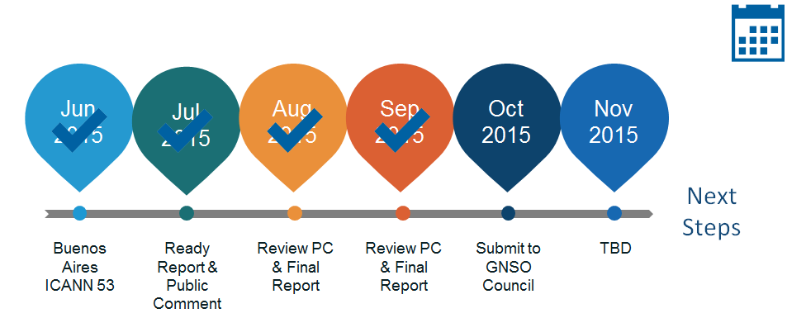
Current Status & Next Steps
Current status
Next Steps
Updated GNSO Council of preliminary recommendations
Completed review of public comments
Updating its Final Report
Submit Final Report to GNSO Council for its review in Dublin
Should WG recommendations be adopted, Policy staff will begin implementation

Slide 7
More Information
WG Workspace - https://community.icann.org/x/myt-Ag
Project info - http://gnso.icann.org/en/group-activities/active/dmpm
Public Comment Forum - https://www.icann.org/public-comments/data-metrics-policy-making-2015-07-29-en
Notes:
This is a simpler agenda slide, the outline for your presentation.

