Slide 1

inta new gtld cost impact survey
April 2017

Slide 2
Background & METHODOLOGY
The International Trademark Association (INTA) is a global organization of 6,600 trademark owners and professionals from over 190 countries. In 2013, hundreds of new generic top-level domains (“New gTLDs”) were introduced. INTA members and intellectual property owners have expressed concern about the New gTLDs on the basis that such expansion would likely create additional and increased costs in enforcing intellectual property rights.
Qualifying criteria
  INTA member able to speak for company, business unit or group
Sample
  INTA-supplied members (corporate); 1,046 records with valid email addresses
Survey
  Self-administered online survey.
  Total of 33 completed the survey
ONLINE SURVEY
January 17-February 28, 2017
SURVEY COMMISSIONED BY INTA AND CONDUCTED
BY NIELSEN
KEY OBJECTIVE: Obtain a solid understanding of reported estimated cost impact of the new gTLDs

Slide 3
SAMPLE DISPOSITION
Invitations sent
1,096
Bouncebacks
(bad or non-existent email addresses)
50 (5%)
Real email
addresses
1,046
Entered
survey
93 (9% of real addresses)
DNQ/
Suspends
57
Qualified
completes
33 (3%)

Slide 4
Survey protocol
Members were emailed a survey invitation and a worksheet to use to gather costs of trademark enforcement relative to domain registrations prior to taking the survey. They also were given the opportunity to suspend the survey in order to complete the worksheet.
Members were asked to capture all costs over the past 2 years (2015 and 2016) and that their cost estimates include:
  Both in-house and outside legal fees,
  Filing fees,
  Investigation costs,
  and the total costs, including benefits, of personnel responsible for these activities.
Members were asked to make their answers as accurate as possible, but were told that giving their best estimate was accepted practice.
Final results represent these reported estimated costs provided by members.
Method Used to Estimate 24-Month Period Costs
(n=33)
Nearly two-thirds reviewed 2016 and 2015 data
Reviewed data for both 2016 and 2015
Estimated based on 2016 data only
Estimated based on 2015 data only
Varied across questions
Notes:
BASE: ALL QUALIFIED RESPONDENTS
Q804 Please be sure that, to the best of your ability, your cost estimates include:
Both in-house and outside counsel legal fees,
Filing fees,
Investigation costs
and the total costs, including benefits, of personnel responsible for these activities.
You should capture all costs incurred over the past 2 years (2015 and 2016).
We are looking for the costs spent over the past 24 months (2015 and 2016) – If you only have costs available for a twelve-month period, use that to estimate costs for the total 24 months based on the level of activity in each 12-month period (i.e., if the level of activity was much greater in the year for which you have data, do your best to adjust the total for the two years combined).
Which method did you use to estimate your costs for the 24-month period?
Reviewed data for both 2015 and 2016
Estimated based on 2016 data only
Estimated based on 2015 data only
Varied across questions

Slide 5
A Note on Reading this report
Respondents who completed this survey reported that compiling the data necessary to properly respond to the survey was a significant task. The response rate for the survey is actually above the norm for a similar sample and when considering this level of required effort.
However, the sample size of completed interviews is still small from a statistical standpoint and requires some cautions, including:
  Analysis of sub-samples less than 30 are subject to high variability—caution is advised when interpreting them. This is noted on the relevant slides.
  Additionally, with a small sample size like this, percentages will not always add to exactly 100% due to rounding error. The decision was made to display whole numbers and accept this rounding error rather than displaying numbers with decimal points which are visually more cumbersome
  Lastly, some members occasionally reported that they were engaged in certain activities, but listed the costs as $1. This could indicate that the costs were zero (the survey did not allow $0 as a cost for activities they said they were engaged in) or that the costs could not be captured or were contained in some other costs they entered. We do not know the actual intent, but the $1 responses do not have a material effect on the averages shown. If anything, they would suggest that the costs may be understated.

Slide 6



Members who participated
No. of Employees | Total (n=33)
Less than 500 | 12%
500-4999 | 9%
5000-24,999 | 39%
25,000 or more | 39%
Total Annual Revenue
Less than $10M | 3%
$10M to less than $250M | 3%
$250M to less than $1B | 6%
$1B to less than $5B | 27%
$5B or more | 52%
Not sure | 9%
Region Conduct Business | Total (n=33)
Europe: European Union | 82%
Europe: Non-European Union | 73%
Europe: Russia & CIS | 70%
North American (US & Canada) | 100%
Latin America, Caribbean, or Mexico | 82%
East Asia & Pacific | 79%
South Asia | 76%
Middle East & North Africa | 76%
Sub-Saharan Africa | 61%
The members who participated in the research represent a broad range of company sizes but tend to be larger.
They conduct business in a range of geographies, but two-thirds are based in North America.
Region of Origin
Europe: European Union | 21%
Europe: non-European Union | 3%
North America (US & Can) | 67%
Latin America & Caribbean | 6%
East Asia & Pacific | 3%
Notes:
BASE: ALL qualified RESPONDENTS (q99/1)
Q1000 The next few questions are to allow us to better understand you and your organization.
What is the approximate number of employees in your company, at all locations worldwide? If you are unsure, please provide your best estimate.
Less than 25 employees
25 to 49 employees
50 to 99 employees
100 to 249 employees
250 to 499 employees
500 to 999 employees
1,000 to 4,999 employees
5,000 to 24,999 employees
25,000 or more employees
99 Not sure
BASE: ALL qualified RESPONDENTS (q99/1)
Q1005 What is your company’s approximate total annual revenue?
Less than $10 Million USD
$10 Million to less than $100 Million USD
$100 Million to less than $250 Million USD
$250 Million to less than $500 Million USD
$500 Million to less than $1 Billion USD
$1 Billion to less than $2 Billion USD
$2 Billion to less than $3 Billion USD
$3 Billion to less than $5 Billion USD
$5 Billion to less than $8 Billion USD
$8 Billion to less than $10 Billion USD
$10 Billion or more
Not sure
[BANK q1010 AND q1015]
BASE: ALL qualified RESPONDENTS (q99/1)
Q1010 Which one of the following best describes the type of business on which your company focuses?
1 Business to Business sales (B2B)
2 Business to Consumer sales (B2C)
3 Business to Government/Public Sector
5 Business to Non Profit
4 Some combination of the above
BASE: all respondents
Q635 In which of the following regions does your company conduct business? Please select all that apply.
[MULTIPLE MENTIONS ALLOWED]
East Asia & Pacific
Europe: European Union
Europe: Non-European Union
Europe: Russia & CIS
Latin America, Caribbean, or Mexico
Middle East & North Africa
North America (US & Canada)
South Asia
Sub-Saharan Africa

Slide 7


Members who participated
Business Focus | Total (n=33)
Business to Business sales (B2B) | 12%
Business to Consumer sales (B2C) | 39%
Some combination (B2B, B2C, Gov’t, Non-Profit) | 48%
Member Status
Regular | 94%
SME (1 participant) | 3%
Non Profit (1 participant) | 3%
Able to Speak For:
Entire company | 91%
Business unit/division | 6%
Group within | 3%
Business focus tends to be a mix or B2C focused.
Nearly all respondents were able to provide information for their entire company.
Notes:
BASE: ALL qualified RESPONDENTS (q99/1)
Q1010 Which one of the following best describes the type of business on which your company focuses?
1 Business to Business sales (B2B)
2 Business to Consumer sales (B2C)
3 Business to Government/Public Sector
5 Business to Non Profit
4 Some combination of the above
BASE: ALL RESPONDENTS
Q285 When answering questions in this survey about the registration of domain names, will you be able to speak. . .
For the entire company
For a business unit or division(s)
For a group within a business unit or division
None of the above – I’m not the right person to discuss domain name registration for my company → ASK Q286
BASE: NOT RIGHT PERSON TO DISCUSS DOMAIN NAME REGISTRATION FOR COMPANY (q285/4)
Q286 Would you be able to provide us with the contact information of a colleague who is the correct person to discuss domain name registration for your company?
Yes ASK Q287
No CONTINUE

Slide 8
Key Findings/Summary

Slide 9
Registration Activity is heavily defensive
INTA members are active in the registration of domain names, including new TLDs.
Vast majority (97%) of members registered domain names in past 24 months, with 9 in 10 registering new TLDs. But the volume of registrations varies widely across companies.
Registrations of new TLDs were overwhelmingly made for defensive purposes—to prevent someone else from registering it. As such, few (10%) felt there were alternative domains to consider—whether registering a New, Legacy or ccTLD.
Parking these domains is a very common practice. Redirection is also common, but less so for the new TLDs.

Slide 10
Defensive actions: Approx. $150K/year
Internet monitoring and diversion related actions are the largest line item.
Costs specific to new TLDs comprise about a seventh of the total amount spend on defensive internet monitoring/diversion related activities.
Since these costs were for the early years of the new TLD program, it is reasonable to expect the proportion specific to new TLDs to rise.
Estimated costs vary widely among the survey respondents and are not correlated to company size. The range of total costs reported ran form zero to $5.2 Million.
Average 2yr Costs
2015-2016 (n=33)

Slide 11
Active use of TMCH and sunrise periods
Over 90% of members have at least 1 trademark in the TMCH and more than half (61%) have registered between 1-10 trademarks.
Almost three-quarters (73%) have received Trademark Clearinghouse notices in the past 2 years, with more than one-third (36%) receiving 100+ notices.
  When these notices result in costs, investigations are the biggest cost contributor, followed by warning/cease and desist letters.
3 in 4 (73%) members have at least one Proof of Use filed, with an average of 13 filed. Reported costs related to Proof of Use filings vary greatly, but average around $1800.
Most members (90%) have registered new TLD domains in the past 2 years during a Sunrise Period.

Slide 12
Monitoring is commonplace
However, few have actively investigated damages from diversion.
Low levels of active investigation of these costs is likely related at least in part related to the fact that these costs are not readily defined or quantified
3 in 4 members (76%) have incurred costs for internet monitoring of trademarks in the past 2 years, with more than half (57%) of the members spending $10k or more.
Relatively few (33%) members have investigated damages incurred of web traffic diversion, and fewer still (only 2 members) have calculated actual costs.
Costs for counter-confusion efforts are substantial in the past 24 months, but only incurred by 15%.

Slide 13
New TLD enforcement—75% took action
Most typically take action via cease and desist letters and/or UDRP.
Three fourths (76%) of members have taken action against domain name owners using new TLDs by sending cease and desist letters and one in four (27%) have used UDRP proceedings.
Few have taken the next steps of Civil Actions, URS Proceedings, ACPA Lawsuits/Appeals and Trademark Infringement Lawsuits/Appeals (between one and 4 members for each).
  Three fourths (76%) have spent more than $1,000 on Cease and desist letters in the past 24 months.
  While less common, those who have taken UDRP actions spend 3x the average of cease and desist efforts.
Actions against Registrars are much more common than against Registries. Costs against Registrars average almost $8k.
Most receive responses from letters sent to privacy/proxy services.

Slide 14
PREMIUM PRICING affects MOST
Members (73%) evaluate premium pricing on case-by-case basis and most (67%) say they are affected by it to some degree.
The majority (73%) of members evaluate premium pricing on a case-by-case basis, while 15% flatly refuse to pay premium pricing and another 6% pay for top marks only.
In general, two-third (67%) of members feel their domain name registrations have been affected by premium pricing (notably .sucks).
  Half of the members (55%) have observed evidence or examples of discriminatory pricing or unfair business practices related to new TLDs.
  For legacy TLDs, only 2 in 10 (21%) are aware of premium pricing.

Slide 15
Some practices help mitigate effects
Two-thirds feel UDRPs (67%) and required Sunrise periods (64%) have helped mitigate risks to a major or moderate extent.
Many fewer feel that Trademark Claims (36%) or URS (27%) helps, and only 15% feel PDDRP, RRDRD, or PICDRP help – and then only to a moderate extent.
The general sense is that the new TLDs have complicated the landscape, and effectiveness of the tools for mitigating risks to trademarks has been limited—most have suggestions for improvement.
The new TLDs are not at all beneficial. The cost is totally unreasonable and most established businesses are not using them. Instead, speculators purchased TLDs in the hope of extorting money from established businesses. The only real beneficiary of this system is ICANN.
Have you heard of Wack a Mole? This is what domain enforcement is. As a brand owner, I fail to see the need for all of the new TLDs and feel like the RPMs are just another way to spend money on something that doesn't buy much protection.
They have helped mitigate risk in that they permit brand owners the ability to take action in cases of abusive registrations after the fact, but have failed to deter individuals from registering abusive domains in the first place.

Slide 16
domain name activity

Slide 17
Domain name registration
The vast majority of members surveyed have registered additional domain names in the past 24 months, with members registering/acquiring anywhere from 1 to around 3,500 domains (nearly two-thirds registered/acquired 50 or more).
Registered Additional Domain Names in Past 24 Months
%Yes
(n=33)
Number of Different Domain Names Registered/Acquired in Past 24 Months
(n=32)
1-29
30-49
50-99
100-250
251-500
501 or more
97%
63%
Average Number: 352
Median: 78
Range: 1 - 3,511
Notes:
BASE: ALL QUALIFIED RESPONDENTS
Q700 To start, let’s get an understanding of your company’s recent activity related to domain names.
In the past 24 months, has your company registered any additional domain names (as opposed to renewing registrations for existing domain names)? For clarity, by domain name we mean an internet domain name such as yourcompany.com or yourname.xyz.
Yes
No
BASE: registered a domain name in past 2 yrs (Q700=1)
Q705 How many different domain names did your company register or acquire in the past 24 months?
|__|__|__|__| [RANGE: 1-9999]

Slide 18
Type of Domain names registered
9 in 10 members have registered one or more new TLD domains (not legacy or ccTLDs). Members are registering a wide range of number of domains in all three categories, fewest among ccTLDs. The new TLDs are common but the top end of the range is lower than for other types.
Number of Different Domain Names
Registered in Each Category
Registered One or More New TLD Domains %Yes
(n=32)
Legacy TLDs
(n=32)
ccTLDs
(n=32)
New TLDs
(n=29)*
0
1-5
6-20
21-49
50-100
101 or more
91%
59%
75%
55%
41%
25%
45%
Average Number: 167
Median: 28
Range: 0 - 1,806
Average Number: 105
Median: 17
Range: 0 - 1,580
Average Number: 89
Median: 37
Range: 3 - 546
*Caution: low base size n=<30
Notes:
BASE: registered a domain name in past 2 yrs (Q700=1)
Q710 In a domain name, the “.com”, “.org”, or “.net” portion of the domain name is referred to as a “TLD". For many years, only a limited number of TLDs were available—we call these “Legacy” TLDs. There were also country code TLDs called “ccTLDs” such as “yourcompany.us” or “yourcompany.uk”.
Recently, new TLDs have been made available for registration of domain names. For example, .bank, .space, .photography, etc. domain names can be registered.
Did you register any domains names using a new TLD that WAS NOT one of the following TLDs?
LEGACY AND ccTLDs:
.aero
.arpa
.asia
.biz
.cat
.com
.coop
.edu
.gov
.int
.jobs
.mil
.mobi
.museum
.name
.net
.org
.post
.pro
.tel
.travel
.xxx
a country specific TLD like .us or .uk, called a ccTLD
Yes, registered one or more new TLD domains—a TLD NOT in the list above
(SHOW IF Q705>1) No, did not register a domain in a new TLD
(SHOW IF Q705=1) No, did not register a domain in a new TLD—but registered a legacy TLD
(SHOW IF Q705=1) No, did not register a domain in a new TLD—but registered a ccTLD
BASE: registered more than 1 domain past 24 mos (705>1)
Q715 Of the (RESPONSE FROM Q705) domain names you registered, how many did you register in each category:
Legacy TLDs |__|__|__|__| [RANGE: 0-9999]
ccTLDs |__|__|__|__| [RANGE: 0-9999]
New TLDs |__|__|__|__| [RANGE: 1-9999] [DISPLAY ONLY IF Q710/1]

Slide 19
Types of new Domain names
New TLD registrations primarily duplicate legacy TLD or ccTLD registrations. Among these large companies, replacing old with new TLDs was not observed behavior.
Number of Domains Registered Under New TLDs in Each Category
(n=29)*
Newly Registered Name
Replaced an Existing Domain
Duplicated a Domain in a Legacy TLD or ccTLD
0
1-5
6-20
21-49
50-100
101 or more
Average Number: 2
Median: 0
Range: 0 - 55
Average Number: 0
Median: 0
Average Number: 87
Median: 37
Range: 0 - 500
*Caution: low base size n=<30
Notes:
BASE: Registered more than 1 domain in past 24 mos and registered a new tld (Q705>1 and Q715_3>0)
Q720 For the (RESPONSE FROM Q715_3) domains you registered under new TLDs, how many fell into each of the following categories?
A newly registered name—no other
similar domains have been registered
using other TLDs |__|__|__|__| [RANGE: 0-9999]
A new TLD registration that replaced an existing
domain that used a legacy TLD or ccTLD |__|__|__|__| [RANGE: 0-9999]
A registration that duplicated a
domain in a legacy TLD or ccTLD—for example,
you registered yourcompany.bank
and also have yourcompany.com |__|__|__|__| [RANGE: 0-9999]
DISPLAY SUM
TOTAL OF REPONSES MUST = Q715
NEW TLD RESPONSE
SP: IF RESPONSE TO 1-3 LEFT BLANK, FORCE A 0 FOR EACH
[PN: ALLOW RESPONDENTS TO GO FORWARD WITHOUT ENTERING A RESPONSE IN EACH BOX AS LONG AS THE TOTAL MATCHES RESPONSE FROM q715_3]
BASE: registered 1 domain past 24 mos and registered a new gtld (705=1 and 710=1)
Q722 Which of the following categories did the new TLD domain name you registered fall into?
A newly registered name—no other similar domains have been registered using other TLDs
A registration that replaced an existing domain that used a legacy TLD or ccTLD
A registration that duplicated a domain in a legacy TLD or ccTLD—for example, you registered yourcompany.bank and also have yourcompany.com

Slide 20
New TLD alternatives Considered
For the new TLDs registered, the vast majority of members felt there was no practical TLD alternatives or they did not consider alternatives.
Number of TLD Alternatives Considered
(n=29)*
No Practical TLD Alternatives/Did Not Consider
Another New TLD
Legacy or ccTLD
0
1-5
6-20
21-49
50-100
101 or more
Average Number: 18
Median: 0
Range: 0 - 500
Average Number: 17
Median: 0
Range: 0 - 123
Average Number: 54
Median: 10
Range: 0 - 500
*Caution: low base size n=<30
Notes:
BASE: Registered 1 domain in past 24 mos and registered a new tld (Q705=1 and Q710=1)
Q725 What TLD alternatives did you consider, if any, for the domain registered in a new TLD?
There were no practical TLD alternatives or we did not consider alternatives for the new TLD domain we wanted
Closest alternative was another NEW TLD, e.g., .finance instead of .bank
Closest alternative was a LEGACY or ccTLD, e.g., .com versus .bank
sp: Registered 1 domain in past 24 mos and registered a new tld (Q705=1 and Q710=1) AND:
Q725/1, THEN FORCE Q727_1=1 ELSE FORCE A 0
Q725/2, THEN FORCE Q727_2=1 ELSE FORCE A 0
Q725/3, THEN FORCE Q727_3=1 ELSE FORCE A 0
BASE: registered more than 1 domain past 24 mos and registered a new gtld (705>1 and 715_3>0)
Q727 For the (RESPONSE FROM Q715_3) domain names that you registered in a new TLD, for how many did you consider alternative TLDs?
There were no practical TLD alternatives or we did not consider alternatives for the new TLD domain we wanted |__|__|__|__| [RANGE: 0-9999]
Another NEW TLD was the closest alternative, e.g., .finance instead of .bank |__|__|__|__| [RANGE: 0-9999]
A LEGACY TLD or ccTLD was the closest alternative, e.g., .com versus .bank |__|__|__|__| [RANGE: 0-9999]

Slide 21
Considered new tld as alternative for legacy tld or cctld
For those who registered domain names in a Legacy TLD or ccTLD, 9 in 10 did not consider a new TLD as an alternative.
Number of Domain Names Registered in a Legacy TLD or ccTLD Considered Registering in a New TLD as Alternative
(n=31)
Considered New TLD as Alternative
Did Not Consider New TLD as an Alternative
0
1-5
6-20
21-49
50-100
101 or more
The fact that few alternatives were considered between New and either Legacy or ccTLDs suggests that competition from the new gTLDs, at least among these larger scale, commercial registrants, is limited. It appears the primary behavior is to register specific new TLDs.
Average Number: 2
Median: 0
Range: 0 - 50
Average Number: 278
Median: 40
Range: 1 - 3,336
Notes:
BASE: REGISTERED 1 LEGACY or cctld DOMAIN NAME (715_1=1 or 715_2=1)
Q730 For the domain name that you registered in a legacy TLD or ccTLD, did you consider registering in a new TLD as an alternative?
Yes
No
sp: REGISTERED 1 LEGACY or cctld DOMAIN NAME (715_1=1 or 715_2=1) AND:
Q730/1, THEN FORCE Q732_1=1 ELSE FORCE A 0
Q730/2, THEN FORCE Q732_2=1 ELSE FORCE A 0
BASE: REGISTERED MORE THAN 1 LEGACY or cctld DOMAIN NAME (715_1>1 or 715_2>1)
Q732 For the (SUM OF RESPONSES FROM Q715_1 AND Q715_2) domain names that you registered in a legacy TLD or ccTLD, how many did you consider registering in a new TLD as an alternative?
Considered NEW TLD as an alternative |__ |__|__|__| [RANGE: 0-9999]
DID NOT consider NEW TLD as an alternative |__|__|__|__| [RANGE: 0-9999]
DISPLAY SUM
TOTAL OF REPONSES MUST = SUM OF Q715_1
LEGACY TLD RESPONSE AND Q715_2 CCTLD RESPONSE

Slide 22
Duplicated new domain name registrations
Members report that nearly all of the new domains registered as duplicates to a Legacy or ccTLD were intended primarily to prevent the name from being used by another registrant.
Number of Duplicated Domain Registrations Primarily Intended to Prevent Name from Being Used by Another and Not
(n=27)*
Primarily to Prevent Name from Being Used by Another Registrant
Not Primarily to Prevent Name from Being Used by Another Registrant
0
1-5
6-20
21-50
51-100
101 or more
Average Number: 92
Median: 40
Range: 4 - 500
Average Number: 1
Median: 0
Range: 0 - 15
*Caution: low base size n=<30
Notes:
BASE: NEW DOMAINS REGISTERED WAS DUPLICATE TO LEGACY (Q720_3>1)
Q735. For the (RESPONSE FROM Q720_3) domains that duplicated a registration in a legacy TLD or ccTLD, how many registrations were intended primarily to prevent the name from being used by another registrant and how many were not?
Primarily to prevent the name from being used by another registrant |__|__|__|__| [RANGE: 0-9999]
Not primarily to prevent the name from being used by another registrant |__|__|__|__| [RANGE: 0-9999]
DISPLAY SUM
TOTAL OF REPONSES MUST = Q720_3
DUPLICATED A LEGACY TLD RESPONSE
SP: IF RESPONSE TO 1-2 LEFT BLANK, FORCE A 0 FOR EACH
PN: ALLOW RESPONDENTS TO GO FORWARD WITHOUT ENTERING A RESPONSE IN EACH BOX AS LONG AS THE TOTAL MATCHES RESPONSE FROM Q720_3]
BASE: 1 NEW DOMAIN REGISTERED WAS DUPLICATE TO LEGACY (Q722/3)
Q737. For the domain name that duplicated a registration using a legacy TLD or ccTLD, was the registration intended primarily to prevent the name from being used by another registrant?
Yes
No

Slide 23
Parked domain names
Parking (not including redirected) domains is a common practice – particularly so for new TLDs, but is also widespread for Legacy and ccTLDs.
Number of Domain Names Registered in Past Two Years Parked
Parked New TLDs
(n=29)*
Parked Legacy TLDs
(n=28)*
Parked ccTLDs
(n=26)*
0
1-5
6-20
21-49
50-100
101 or more
79%
61%
62%
Average Number: 70
Median: 22
Range: 0 - 546
Average Number: 97
Median: 5
Range: 0 - 1,475
Average Number: 54
Median: 1
Range: 0 - 995
*Caution: low base size n=<30
Notes:
BASE: registered more than 1 domain name (705>1)
Q740. How many of each type of the (RESPONSE FROM Q705) domain names you have registered in the past two years are parked? By parked, we mean that they are registered and reserved for your use, but not in active service. The site displays a placeholder webpage like “under development” or similar term.
PLEASE DO NOT COUNT SITES THAT ARE REDIRECTED TO ACTIVE SITES.
For your reference, earlier you said you registered a total of (RESPONSE FROM Q705) domain names in the past two years:
[DISPLAY IF Q715_3>0] (REFERENCE q715_3) new TLDs
[DISPLAY IF Q715_1>0] (REFERENCE q715_1) legacy TLDs
[DISPLAY IF Q715_2>0] (REFERENCE q715_2) ccTLDs
Parked new TLDs |__|__|__| [RANGE: 0-Q715_3] [DISPLAY IF Q715_3>0]
Parked Legacy TLDs |__|__|__| [RANGE: 0- Q715_1] [DISPLAY IF Q715_1>0]
Parked ccTLDs |__|__|__| [RANGE: 0- Q715_2] [DISPLAY IF Q715_1>0]
DISPLAY SUM
TOTAL OF REPONSES MUST BE < OR = Q705
SP: IF RESPONSE TO 1-3 LEFT BLANK, FORCE A 0 FOR EACH
PN: ALLOW RESPONDENTS TO GO FORWARD WITHOUT ENTERING A RESPONSE IN EACH BOX AS LONG AS THE TOTAL IS LESS THAN OR EQUAL TO q705 RESPONSE]
BASE: registered 1 domain name (705=1)
Q742. Is the domain name you registered parked? By parked, we mean that they are registered and reserved for your use, but not in active service. The site displays a placeholder webpage like “under development” or similar term.
Yes
No

Slide 24
Redirected domain names
Redirecting domain names to active sites is much less prevalent with new TLDs, but quite prevalent for Legacy or ccTLDs. Since many domains were registered for defensive purposes, these high rates of parking and redirection fit.
Number of Domain Names Registered in Past Two Years Redirected to Active Sites
Redirected New TLDs
(n=29)*
Redirected Legacy TLDs
(n=28)*
Redirected ccTLDs
(n=26)*
0
1-5
6-20
21-49
50-100
101 or more
38%
71%
69%
Average Number: 33
Median: 0
Range: 0 - 546
Average Number: 107
Median: 25
Range: 0 - 1,700
Average Number: 71
Median: 9
Range: 0 - 1,470
*Caution: low base size n=<30
Notes:
BASE: registered more than 1 domain name (705>1)
Q745. How many of each type of the (RESPONSE FROM Q705) domain names you have registered in the past two years are redirected to active sites? By redirected, we mean that they transfer the web browser to another site that is active.
For your reference, earlier you said you registered a total of (RESPONSE FROM Q705) domain names in the past two years:
[DISPLAY IF Q715_3>0] (REFERENCE q715_3) new TLDs
[DISPLAY IF Q715_1>0] (REFERENCE q715_1) legacy TLDs
[DISPLAY IF Q715_1>0] (REFERENCE q715_2) ccTLDs
Redirected to new TLDs |__|__|__| [RANGE: 0- Q715_3] [DISPLAY IF Q715_3>0]
Redirected to Legacy TLDs |__|__|__| [RANGE: 0- Q715_1] [DISPLAY IF Q715_1>0]
Redirected to ccTLDs |__|__|__| [RANGE: 0- Q715_2] [DISPLAY IF Q715_2>0]
DISPLAY SUM
TOTAL OF REPONSES MUST BE < OR = Q705
SP: IF RESPONSE TO 1-3 LEFT BLANK, FORCE A 0 FOR EACH
PN: ALLOW RESPONDENTS TO GO FORWARD WITHOUT ENTERING A RESPONSE IN EACH BOX AS LONG AS THE TOTAL IS LESS THAN OR EQUAL TO q705 RESPONSE]
BASE: registered 1 domain name (705=1) and not parked (742=2)
Q747. Is the domain name you registered redirected? By redirected, we mean that they transfer the web browser to another site that is active.
Yes
No

Slide 25
Applied to operate new tld
More than 4 in 10 members have applied to operate a new TLD, and the majority (87%) had their application delegated to the root zone by ICANN.
Applied to Operate a New TLD
%Yes
(n=33)
Application Delegated to the Root Zone by ICANN
%Yes
(n=15)*
No
7%
Some were, some were not
7%
45%
87%
*Caution: low base size n=<30
Notes:
BASE: ALL QUALIFIED RESPONDENTS
Q750. Did your company apply to operate a new TLD? To be clear, we are not asking about registering a domain name, but having the rights to control the use of a TLD registry.
Yes
No
BASE: APPLIED TO OPERATE A NEW TLD (Q750=1)
Q755. Was your application(s) delegated to the root zone by ICANN?
Yes
No
Some were, some were not
Fyi – root zone: Basically it means that the TLD they filed to operate has been approved and that there are “name servers” that have responsibility for directing traffic to domains registered with that TLD

Slide 26
enforcement costs – Average Total Costs Per company

Slide 27
Average total defense costs per company
On average, INTA members spend $150,000 per year on defensive actions with internet monitoring and diversion actions the largest line item. Costs specific to new TLDs comprise about a seventh of the total.
Since these costs were for the early years of the new TLD program, it is reasonable to expect the proportion specific to new TLDs to rise in future. It is also worth noting that while the new TLDs account for a 7th of the costs, they do not yet represent 1/7th of domains.
Average 2yr Costs
2015-2016
(n=33)
Costs show a slight correlation with the number of domains registered in the period. There is no consistent relationship to company size.

Slide 28
enforcement costs – general costs

Slide 29
Trademark clearinghouse
The majority of members (~9 in 10) registered at least 1 trademark in the TMCH, with 6 in 10 registering 1-10. Costs run the gamut, ranging anywhere from $1 to $48,000.
Number of Trademarks Registered Within the Trademark Clearinghouse
(n=33)
Cost of Trademark Clearinghouse Registrations – 2015 and 2016
(n=30)
0
1-5
6-10
11-20
21 or more
Less than $1,000 USD
$1,000 to $4,999 USD
$5,000 to $9,999 USD
$10,000 or more USD
Keep in mind that not all trademarks will require actions—creating and average cost per trademark does not reflect the cost per action.
61%
30%
Average Number: 15
Median: 7
Range: 0 - 148
Average Cost: $7,773
Median: $4,038
Range: $1 - $48,000
Notes:
BASE: All QUALIFIED respondents
Q805 For the remaining questions, while you should make your answers as accurate as possible, we understand that you may only be able to give your best estimate and that is fine.
Worksheet 1: How many, if any, of your trademarks are registered within the Trademark Clearinghouse?
|__|__|__| Trademarks registered in the Trademark Clearinghouse [RANGE: 0-999]
BASE: had one or more DOMAINS IN THE tMch (q805>0)
Q807 Worksheet 2: What is your estimate of the total costs (internal and third party) of these Trademark Clearinghouse Registrations for 2015 and 2016, in USD?
|__|__| , |__|__|__| , |__|__|__| USD$ [RANGE: 1-99,999,999]

Slide 30
Trademark clearinghouse – proof of use filings
Nearly 3 in 4 members have at least Proof of Use filed and reported costs vary.
Number of Proof of Use Filed
(n=33)
Cost of Proof of Use Filings – 2015 and 2016
(n=24)*
0
1-5
6-10
11-20
21 or more
Less than $1,000 USD
$1,000 to $4,999 USD
$5,000 or more USD
73%
Average Number: 13
Median: 6
Range: 0 - 146
Average Cost: $1,790
Median: $837
Range: $1 - $17,500
*Caution: low base size n=<30
Notes:
BASE: All QUALIFIED respondents
Q816 Worksheet 3: For how many of the (REFERENCE Q805) trademarks registered within the Trademark Clearinghouse did you file a Proof of Use?
|__|__|__| Proofs of Use filed in the Trademark Clearinghouse [RANGE: 0-999]
BASE: FILED one or more PROOFS OF USE IN THE tMch (q816>0)
Q817 Worksheet 4: What is your estimate of the total costs of these Proofs of Use Filings for 2015 and 2016, in USD?
|__|__| , |__|__|__| , |__|__|__| USD$ [RANGE: 1-99,999,999]

Slide 31
Sunrise registrations
9 in 10 members have registered new TLD domains in the past two years in the Sunrise Period.
Number of New TLDs Registered in Past Two Years That Are Sunrise Registrations
(n=29)*
0
1-10
11-24
25-74
75 or more
Average Number: 64
Median: 13
Range: 0 - 495
*Caution: low base size n=<30
Notes:
BASE: registered 1 or more domains past 24 mos and registered a new gtld (705>=1 and 710=1)
Q818 Worksheet 5: Of the (REFERENCE Q715_3) new TLD domains that you registered in the past two years, how many were Sunrise Registrations?
|__|__|__| Trademarks filed in the Sunrise Period of New TLDs [RANGE: 0-999]

Slide 32
Trademark clearinghouse Claim notices
Almost three-quarters of members have received Trademark Clearinghouse claim notices in the past two years, with more than one-third receiving 100 or more notices.
Number of Claim Notices Received – 2015 and 2016
(n=33)
0
1-10
11-99
100-299
300 or more
Average Number: 107
Median: 16
Range: 0 - 999
Notes:
BASE: All QUALIFIED Respondents
Q810 Worksheet 6: How many, if any, Trademark Clearinghouse claim notices has your company received in 2015 and 2016 under new TLDs?
|__|__|__| Claims notices received in 2015 and 2016 [RANGE: 0-999]

Slide 33
Trademark clearinghouse Claim notices
Of those who have received Trademark Clearinghouse claim notices that have resulted in costs, the majority have been for investigations, followed by warning/cease and desist letters.
Number of Claim Notices Resulting in Costs Incurred
(n=24)*
Investigations
Warning/Cease and Desist Letters
UDRPs
Other Actions
0
1-10
11-99
100-299
300 or more
Average Number: 74
Median: 13
Range: 0 - 551
Average Number: 9
Median: 0
Range: 0 - 93
Average Number: 1
Median: 0
Range: 0 - 11
Average Number: 6
Median: 0
Range: 0 - 105
NOTE: According to the “Independent Review of TMCH Services, Revised Report” (Liu, Rafert and Seim) 93.7% of domain name applications that were subject of Trademark Notices were abandoned
*Caution: low base size n=<30
Notes:
BASE: RECEIVED 1 OR MORE CLAIM NOTICES FOR NEW GTLDS (q810>0)
Q815 Worksheet 7: How many of these (RESPONSE FROM Q810) Trademark Clearinghouse claim notices have resulted in costs incurred related to any of the following?
1 Investigations |__|__|__| [RANGE: 0-Q810]
3 Warning/Cease and desist letters |__|__|__| [RANGE: 0-Q810]
4 Uniform Domain Name Dispute Resolution Policy proceedings (UDRPs) |__|__|__| [RANGE: 0-Q810]
5 Other actions (e.g. Declaratory Judgment/civil action) that led
to above related costs |__|__|__| [RANGE: 0-Q810]

Slide 34

Trademark clearinghouse Claim notices
Although very low base size, there is an indication that Investigation costs vary greatly, and generally cost around $500 per Investigation. Actions needed for Warning / Cease and Desist Letters appear to be more costly but base sizes are even lower.
Costs Incurred – 2015 and 2016
Investigations
(n=17)*
Warning/Cease and Desist Letters
(n=11)*
UDRPs
(n=5)*
Other Actions
(n=3)*
Less than $1,000 USD
$1,000 to $4,999 USD
$5,000 to $9,999 USD
$10,000 or more USD
1: $1
2: $3,400
3: $17,500
4: $22,000
5: $45,000
1: $955
2: $3,000
3: $6,500
Average Cost: $12,837
Median: $2,625
Range: $1 - $60,500
Average Cost: $4,652
Median: $2,000
Range: $500 - $16,800
Average Cost: 17,580
Median: $17,500
Average Cost: $3,485
Median: $3,000
*Caution: low base size n=<30
Notes:
BASE: had one or more ACTIONS ON claim notices (sum of q815_1-5>0)
Q820 Worksheet 8: And what were the costs incurred for each type of action you took vis-à-vis the (REFERENCE Q810) claim notices you received during the 2-year period (2015 and 2016)?
[PN: ONLY SHOW THOSE THAT WERE GIVEN ONE OR MORE IN Q815 (Q815_1-5>0)]
1 Investigations |__|__| , |__|__|__| , |__|__|__| USD$ [RANGE: 1-99,999,999]
3 Warning/Cease and desist letters |__|__| , |__|__|__| , |__|__|__| USD$ [RANGE: 1-99,999,999]
4 Uniform Domain Name Dispute
Resolution Policy proceedings (UDRPs) |__|__| , |__|__|__| , |__|__|__| USD$ [RANGE: 1-99,999,999]
5 Other actions (e.g. Declaratory Judgment/
civil action) that led
to above related costs |__|__| , |__|__|__| , |__|__|__| USD$ [RANGE: 1-99,999,999]

Slide 35
Internet monitoring of Trademarks
Three-quarters of the members have incurred costs for internet monitoring of trademarks to identify potentially abusive or infringing domain names, with more than half spending $10,000 or more.
Total Amount Spent to Identify Potentially Abusive or Infringing Domain Names – 2015 and 2016
(n=33)
$0 USD
$1,000 to $9,999 USD
$10,000 to $49,999 USD
$50,000 or more USD
Average Cost: $50,726
Median: $13,300
Range: $0 - $405,000
Notes:
BASE: All QUALIFIED respondents
Q830 Worksheet 9: What is your estimate of the total amount spent in 2015 and 2016 on internet monitoring of trademarks to identify potentially abusive or infringing domain names, in USD?
|__|__| , |__|__|__| , |__|__|__| USD$ [RANGE: 0-99,999,999]

Slide 36
Steps taken regarding damages incurred from web traffic Diversion
Disclaimer added
Two-thirds of members have not investigated (either they are aware but haven’t done so or are not concerned). One in three have investigated but few (only 2 members) actually calculated costs.
Steps Taken Regarding Damages Incurred from Diversion of Web Traffic from Trademark Owner’s Legitimate Website
(n=33)
Total Damages of Web Traffic Diversion – 2015 and 2016
(n=2)*
33%
67%
1: $0
2: $5,000,000
Investigated, but do not have a clear estimate of costs
Investigated and have calculated costs
Issue we are aware of, but have not investigated
Not something we have been concerned about
NOTE: This data is not typically or readily collected by companies
*Caution: low base size n=<30
Notes:
BASE: All QUALIFIED respondents
Q870 Worksheet 17: What steps, if any, have you taken regarding the damages incurred from diversion of web traffic from the trademark owner’s legitimate web site (lost sales, lost revenue, and reputational damage)?
(1) Not something we have been concerned about
(2) It is an issue we are aware of, but have not investigated
(3) We have investigated, but do not have a clear estimate of costs
(4) We have investigated and have calculated costs
BASE: Investigated cost from diversion (Q870=4)
Q872 Worksheet 18: What is your estimate of the total damages of web traffic diversion over the past 24 months?
|__|__| , |__|__|__| , |__|__|__| USD$ [RANGE: 0-99,999,999]

Slide 37
Costs incurred with counter-confusion or education
Only 15% of members reported to have incurred costs in connection with counter-confusion marketing efforts. More than twice that reported to have incurred costs for the education of internal teams about enforcement efforts related to new TLDs, with dollar amounts varying greatly – but averaging around $4,000.
Counter-Confusion Marketing Efforts – 2015 and 2016
(n=33)
Education of Internal Teams About Enforcement Efforts Related to New TLDs – 2015 and 2016
(n=33)
$0 USD
$1 to $999 USD
$1,000 to $9,999 USD
$10,000 or more USD
Average Cost: $2,243
Median: $0
Range: $0 - $50,000
Average Cost: $3,967
Median: $1,000
Range: $0 - $25,000
Notes:
BASE: All QUALIFIED respondents
Q880 Worksheet 19: What is your estimate of the total costs you have incurred in the past 24 months in connection with the following activities?
1 Counter-confusion marketing efforts,
such as corrective advertising |__|__| , |__|__|__| , |__|__|__| USD$ [RANGE: 0-99,999,999]
2 Education of internal teams about
enforcement efforts related to
the new TLDs |__|__| , |__|__|__| , |__|__|__| USD$ [RANGE: 0-99,999,999]

Slide 38
enforcement costs – New TLDs

Slide 39
Actions taken against domain name owners using new TLDs
Three-quarters of the members have taken action against domain name owners using new TLDs by either sending cease and desist letters and/or UDRP proceedings.
Number of Actions Taken – 2015 and 2016
(n=33)
Cease and
Desist Letters
UDRP
Proceedings
Civil Actions Filed After Adverse UDRP Rulings
URS Proceedings
ACPA Lawsuits and Appeals
Trademark Infringement or Unfair Competition Lawsuits and Appeals
0
1
2-29
30-99
100 or more
< -------------------- Showing actual responses by members (other than zero)------------------- >
1: 1
1: 2
2: 6
3: 11
4: 16
1: 1
1: 2
Average Number: 336
Median: 2
Range: 0 - 9,500
Average Number: 2
Median: 0
Range: 0 - 30
Notes:
BASE: All QUALIFIED respondents
Q840 Worksheet 10: How many of each of the following actions has your company taken in the past 24 months against domain name owners using new TLDs?
Cease and desist letters |__|__|__|__| [RANGE: 0-9999]
UDRP proceedings |__|__|__|__| [RANGE: 0-9999]
Civil actions filed after adverse
UDRP rulings |__|__|__|__| [RANGE: 0-9999]
Uniform Rapid Suspension System (URS)
proceedings |__|__|__|__| [RANGE: 0-9999]
Anti-cybersquatting Consumer Protection
Act (ACPA) lawsuits and appeals |__|__|__|__| [RANGE: 0-9999]
Trademark infringement or unfair competition
lawsuits and appeals (other than ACPA lawsuits
and appeals and civil actions filed after
adverse UDRP rulings) |__|__|__|__| [RANGE: 0-9999]

Slide 40
Costs of Actions taken against domain name owners using new TLDs
Cost vary by the action taken, however 76% have spent more than $1,000 on cease and desist letters and 88% have spent the more $1,000 on UDRP proceedings.
Costs Incurred for Actions Taken
Cease and
Desist Letters
(n=25)*
UDRP
Proceedings
(n=9)*
Civil Actions Filed After Adverse UDRP Rulings
(n=1)*
URS
Proceedings
(n=4)*
ACPA Lawsuits and Appeals
(n=1)*
Trademark Infringement or Unfair Competition Lawsuits and Appeals
(n=1)*
$0 USD
$1-$999 USD
$1,000 to $9,999 USD
$10,000 or more USD
< ------------------------------------- Showing actual responses by members -------------------------------------- >
1: $3,000 (1)
1: $2,450 (2)
2: $6,300 (16)
3: $6,350 (6)
4: $16,500 (1)
1: $50,000 (1)
1: $3,720 (2)
Average Cost: $17,813
Median: $3,000
Range: $0-$250,000
Average Cost: $46,152
Median: $9,500
Range: $0-$300,000
*Caution: low base size n=<30
Notes:
BASE: TAKEN ACTION (SUM OF q840_1-6>0)
Q845 Worksheet 11: What are the costs your company has incurred for these actions in the past 24 months?
Cease and desist letters |__|__| , |__|__|__| , |__|__|__| USD$ [RANGE: 0-99,999,999]
UDRP proceedings |__|__| , |__|__|__| , |__|__|__| USD$ [RANGE: 0-99,999,999]
Civil actions filed after adverse
UDRP rulings, |__|__| , |__|__|__| , |__|__|__| USD$ [RANGE: 0-99,999,999]
Uniform Rapid Suspension System (URS)
proceedings) |__|__| , |__|__|__| , |__|__|__| USD$ [RANGE: 0-99,999,999]
Anti-cybersquatting Consumer Protection
Act (ACPA) lawsuits and appeals |__|__| , |__|__|__| , |__|__|__| USD$ [RANGE: 0-99,999,999]
Trademark infringement or unfair competition
lawsuits and appeals (other than ACPA lawsuits
and appeals and civil actions filed after
adverse UDRP rulings) |__|__| , |__|__|__| , |__|__|__| USD$ [RANGE: 0-99,999,999]

Slide 41
Actions taken against domain name owners
Among members who have taken action against domain names owners, more than 3 in 4 involve privacy and proxy services. Nearly 2/3rds encounter some level of inaccurate/incomplete WHOIS information.
Inaccurate/ Incomplete WHOIS Information
(n=26)*
Privacy and Proxy Services
(n=26)*
62%
77%
Average Percent: 22%
Average Percent: 41%
51%-75%
76%-100%
26%-50%
1%-25%
0%
*Caution: low base size n=<30
Notes:
BASE: TAKEN ACTION (SUM OF q840_1-6>0)
Q875 Worksheet 12: What percent of the actions that you have taken against domain name owners involve the following?
1. Inaccurate/incomplete WHOIS information
(i.e., email bounces back or cease and desist letters
returned as undeliverable) |__|__|__| [RANGE: 0-100%]
Privacy and proxy services |__|__|__| [RANGE: 0-100%]

Slide 42
Actions against registrars
Just over half of the members have sent cease and desist letters to registrars. Fewer than 20% have filed WHOIS inaccuracy complaints or ICANN contractual compliance complaints and only 1 had a lawsuit.
Number of Actions Against Registrars Taken
(n=33)
Cease and Desist Letters
WHOIS Inaccuracy Complaints
ICANN Contractual Compliance Complaints
Lawsuits
0
1-10
11 or more
Average Number: 9
Median: 1
Range: 0 - 50
Average Number: 13
Median: 0
Range: 0 - 289
Average Number: 0.8
Median: 0
Range: 0 - 17
Average Number: ~0
Median: 0
Range: 0 - 1
Notes:
BASE: All QUALIFIED respondents
Q850 Worksheet 13: What is your estimate of the number of each of the following types of actions against registrars (a registrar is an entity authorized to sell domain names e.g. GoDaddy)?
Cease and desist letters |__|__|__| [RANGE: 0-999]
WHOIS Inaccuracy complaints |__|__|__| [RANGE: 0-999]
ICANN Contractual Compliance
complaints |__|__|__| [RANGE: 0-999]
Lawsuits |__|__|__| [RANGE: 0-999]

Slide 43
Actions Against Registrars
70% of members have incurred cost of $1,000 or more for cease and desist letters, but costs average much higher.
Costs Incurred for Actions Taken Against Registrars
Cease and Desist Letters
(n=17)*
WHOIS Inaccuracy Complaints
(n=6)*
ICANN Contractual Compliance Complaints
(n=5)*
Lawsuits
(n=1)*
$0 USD
$1 to $999 USD
$1,000 to $9,999 USD
$10,000 or more USD
< -------------------------------- Showing actual responses by members -------------------------------- >
1: $0
2: $500
3: $500
4: $2,000
5: $9,892
6: $10,000
1: $250
2: $1,164
3: $5,000
4: $5,000
5: $75,000
1: $4,500
Average Cost: $7,869
Median: $4,000
Range: $0 - $30,000
*Caution: low base size n=<30
Notes:
BASE: had proceeding against registrars (sum of Q850_1-4>0)
Q855 Worksheet 14: What is your estimate of the costs incurred for each of the following from actions against registrars?
Cease and desist letters |__|__| , |__|__|__| , |__|__|__| USD$ [RANGE: 0-99,999,999]
WHOIS Inaccuracy complaints |__|__| , |__|__|__| , |__|__|__| USD$ [RANGE: 0-99,999,999]
ICANN Contractual Compliance
complaints |__|__| , |__|__|__| , |__|__|__| USD$ [RANGE: 0-99,999,999]
Lawsuits |__|__| , |__|__|__| , |__|__|__| USD$ [RANGE: 0-99,999,999]

Slide 44
Actions taken against Registries
18% of members have sent 1 or more cease and desist letters to registries.
Number of Actions Taken – 2015 and 2016
(n=33)
Cease and Desist
Letters
PDDRPs
RRDRPs
PICDRP
ICANN Contractual Compliance Complaints
Lawsuits
0
1-10
11 or more
< --------------------------------- Showing actual responses by members (other than zero)-------------------------------- >
1: 5
1: 5
1: 1
2: 1
1: 15
Average Number: 4
Median: 0
Range: 0 - 75
Notes:
BASE: All QUALIFIED respondents
Q860 Worksheet 15: What is your estimate of the total number of each of the following actions against registries in the past 24 months?
Cease and desist letters |__|__|__| [RANGE: 0-999]
Post Delegation Dispute Resolution Policy
proceedings (PDDRPs) via online complaint
system or formal proceeding |__|__|__| [RANGE: 0-999]
Registry Restriction Dispute Resolution
Policy proceedings (RRDRPs) via online
complaint system or formal proceeding |__|__|__| [RANGE: 0-999]
Public Interest Commitment Dispute
Resolution Policy proceeding (PICDRP)
via online complaint system or formal
proceeding |__|__|__| [RANGE: 0-999]
ICANN Contractual Compliance complaints |__|__|__| [RANGE: 0-999]
Lawsuits |__|__|__| [RANGE: 0-999]

Slide 45
Costs of Actions taken against Registries
As few members have taken actions against registries, a good feel as to the costs incurred is difficult to ascertain.
Costs Incurred for Actions Taken - 2015 and 2016
Cease and Desist Letters
(n=6)*
PDDRPs
(n=1)*
RRDRPs
(n=1)*
PICDRP
(n=2)*
ICANN Contractual Compliance Complaints
(n=1)*
Lawsuits
(n=0)*
< ----------------------------------------------- Showing actual responses by members ----------------------------------------------- >
1: $1
2: $120
3: $1,640
4: $10,000
5: $10,000
6: $10,000
1: $10,000
1: $10,000
1: $15,000
2: $30,000
1: $2,000
*Caution: low base size n=<30
Notes:
BASE: Took actions against registries (sum of Q860>0)
Q865 Worksheet 16: What is your estimate of the total cost incurred in the past 24 months from proceeding against registries through the following?
Cease and desist letters |__|__| , |__|__|__| , |__|__|__| USD$ [RANGE: 0-99,999,999]
Post Delegation Dispute Resolution Policy
proceedings (PDDRPs) via online complaint
system or formal proceeding |__|__| , |__|__|__| , |__|__|__| USD$ [RANGE: 0-99,999,999]
Registry Restriction Dispute Resolution
Policy proceedings (RRDRPs) via online
complaint system or formal proceeding |__|__| , |__|__|__| , |__|__|__| USD$ [RANGE: 0-99,999,999]
Public Interest Commitment Dispute
Resolution Policy proceeding (PICDRP)
via online complaint system or formal
proceeding |__|__| , |__|__|__| , |__|__|__| USD$ [RANGE: 0-99,999,999]
ICANN Contractual Compliance complaints |__|__| , |__|__|__| , |__|__|__| USD$ [RANGE: 0-99,999,999]
Lawsuits

Slide 46
behaviors, policies and perceptions

Slide 47
Cease and desist letters
Of the members who sent cease and desist letters, 64% were directed to privacy/proxy service. Among those directed to privacy/proxy service, the majority (86%) have received at least one response from the registrant.
Number of Cease and Desist Letters Directed to Privacy/Proxy Service – 2015 and 2016
(n=11)*
Number That Received Response From Registrant
(n=7)*
0
1-10
11-24
25 or more
0
1-10
11-24
25 or more
Average Number: 8
Median: 1
Range: 0 - 36
Average Number: 7
Median: 2
Range: 0 - 27
*Caution: low base size n=<30
Notes:
BASE: HAD CEASE AND DESIST LETTERS (Q815/3 >0)
Q900 Worksheet 20: Of the estimated (INSERT RESPONSE FROM 815/3) cease and desist [IF Q815/3=1 INSERT letter] [IF Q815/3 >1 INSERT letters] your company sent in 2015 and 2016, how many are directed to a privacy or proxy service?
Cease and desist letters sent to privacy/proxy service |__|__|__| [RANGE: 0-999]
[PN: DO NOT ALLOW RESPONDENT TO MORE FORWARD UNLESS RESPONSE IS < OR = TO RESPONSE FROM Q815_3.]
BASE: CEASE AND DESIST LETTERS SENT TO PRIVACY/PROXY SERVICE (Q900 >1)
Q905 Worksheet 21: And, of those (INSERT RESPONSE TO Q900) cease and desist letters sent to privacy or proxy services, for how many did you get a response from the registrant (i.e., the alleged infringer complies or responds to the letter)?
|__|__|__| [RANGE: 0-999]
[PN: DO NOT ALLOW RESPONDENT TO MORE FORWARD UNLESS RESPONSE IS < OR = TO RESPONSE FROM Q900.]
BASE: one CEASE AND DESIST LETTER SENT TO PRIVACY/PROXY SERVICE (Q900=1)
Q907 Did the cease and desist letter sent to privacy and proxy services get a response from the registrant (i.e., the alleged infringer complied or responded to the letter)?
Yes
No

Slide 48
Premium pricing for domain names
Three-quarters of the members evaluate premium pricing for domain names on a case-by-case basis. Two-thirds of their domain name registration decisions have been affected by premium pricing with .sucks being mentioned the most as a TLD that they did pay premium pricing for.
Company’s Policy on Premium Pricing for Domain Names
(n=33)
Domain Name Registration Decisions Affected by Premium Pricing %Yes
(n=33)
New TLDs Paid a Premium Price to Register
(n=22)*
.movie
.sucks, .security, .protection
.HBO
.fun
.asia
.watch
.shop
67%
.sucks, .tickets
.news, .earth, .london
Evaluate on a case-by-case basis
Refuse to pay all premium pricing
Pay for our top marks but not for all
Other
.sucks, .xxx
.playcity
.sucks, .shop
.design, .digital, .photography, .photos, .pictures, .video, .website, .software
.ceo, .technology, .sucks, .software, .engineer, .buzz, .wiki, .club
*Caution: low base size n=<30
Notes:
BASE: ALL qualified RESPONDENTS
Q910 Which of the following best describes your company’s policy/practices on premium pricing for domain names? By premium pricing, we are specifically referring to pricing that is higher when the domain name incorporates a trademark than when the domain is more generic or does not include a trademark.
We refuse to pay all premium pricing
We pay for our top marks but not for all
We evaluate on a case-by-case basis
Other (specify)
BASE: ALL qualified RESPONDENTS
Q915 Have any of your domain name registration decisions been affected by premium pricing of domain names?
Yes
No
BASE: decisions affected by premium pricing (q915=1)
Q920 For which new TLDs did you pay a premium price to register a domain name? [NON-MANDARTORY]

Slide 49
Premium Pricing – legacy TLDs
Only 2 in 10 are aware of premium pricing for Legacy TLDs. Of those aware, .mobi, .xxx and country specific TLDs are the Legacy TLDs mentioned most often as having premium pricing.
Aware of Premium Pricing for Legacy TLDs
%Yes
(n=33)
Registries Observed Premium Pricing for Legacy TLDs
(n=7)*
.mobi
.xxx
Country specific TLD
.asia
.tel
Other
Don’t know
21%
*Caution: low base size n=<30
Notes:
BASE: ALL qualified RESPONDENTS (Q99/1)
Q930 Are you aware of any premium pricing for any legacy TLDs?
LIST OF LEGACY TLDs:
.aero
.arpa
.asia
.biz
.cat
.com
.coop
.edu
.gov
.int
.jobs
.mil
.mobi
.museum
.name
.net
.org
.post
.pro
.tel
.travel
.xxx
a country specific TLD like .us or .uk, called a ccTLD
Yes
No
BASE: aware of premium pricing for legacy gtlds (q930=1)
Q935 In which registries did you observe premium pricing for legacy TLDs? Please select all that apply.
[ALLOW MULTIPLE MENTIONS, DISPLAY LIST IN 2 COLUMNS]
.aero
.arpa
.asia
.biz
.cat
.com
.coop
.edu
.gov
.int
.jobs
.mil
.mobi
.museum
.name
.net
.org
.post
.pro
.tel
.travel
.xxx
a country specific TLD like .us or .uk, called a ccTLD
96 Other
98 None of the above
99 Don’t know
|__|__|__|__| [RANGE: 1-9999]

Slide 50
Commentary: DISCRIMINATORY PRICING/UNFAIR PRACTICES
Roughly half of members did not provide an answer or said ‘no’ they did not observe evidence of discriminatory pricing.
“
Everyone knows about the .sucks issue; having higher prices during the Sunrise period effectively means trademark owners will pay higher prices to ensure they obtain an important domain registration in a certain new TLD.
Some TLDs consider our “[sports]" trademark to be a premium due to being three letter characters and as a result are charged a premium. Also, other TLDs - including .tickets - charged a premium for domain name registrations related to some of our member teams (but not others).
A number of registries charge premium prices for our core house brand on the basis that it was "valuable" despite the fact that it is not a descriptive term.
We were also concerned that registries like .SUCKS set their pricing to discriminate against the brand owner, whereas the price to the public was lower.
Increasing number of nTLDs that are setting premium pricing for both Sunrise and trademark registration of domain names including: .sucks, .top, .love, .yoga, .voting, .site, .rent
Certainly with regard to .SUCKs, as well as programs which charge a significant fee to block registration of marks across a variety of domains under the control of the same registry.
Yes, as "premium" domain names lists are not published or defined in advance but only on a case by case basis, after the trademark owner asked for the registration. Moreover, premium names are often excluded from protection program (such as former DMPL from DOnuts, and not known in advance !)
Yes, the .FEEDBACK registry is targeting brand owners with discriminatory premium pricing and also is engaging in a number of other activities that violate its PICs, among other things.
Yes - Rightside Registry and Donuts have charged premium pricing.
We are aware that there are significant differences in pricing among Registrars. In addition, we are aware that some Registries and Registrars for new TLDs engage in premium pricing or charge early access fees for domains containing our trademarks. We consider this discriminatory, unfair and trademark infringement.
Yes, with .sucks and .feedback. We also find the premium fees charged by registries to be over-the-top.
Yes, the .top registry raised the Sunrise fee by $30,000 for [company].top. We refused to register.
”
Notes:
BASE: ALL qualified RESPONDENTS (Q99/1)
Q940 Have you observed any evidence or examples of discriminatory pricing or other unfair business practices related to any of the new TLDs? If so, please describe. [NON-MANDARTORY]

Slide 51
RIGHTS PROTECTION MECHANSIMS
Two-thirds of the members feel that UDRPs and required sunrise periods have helped mitigate risks to a major/moderate extent.
How Well Rights Protection Mechanisms Have Helped Mitigate Risks
(n=33)
15%
27%
36%
64%
67%
Required Sunrise Periods
Trademark Claims
Uniform Rapid Suspension System (URS)
Post-Delegation Dispute Resolution Procedures (PDDRP, RRDRP, PICDRP)
UDRP
To a major extent
To a minor extent
Not at all
To a moderate extent
Unsure
Notes:
BASE: ALL qualified RESPONDENTS (Q99/1)
Q950 How well do you believe that the newly created Rights Protection Mechanisms for the new TLDs (required Sunrise Periods, Trademark Claims, Uniform Rapid Suspension System (URS), Post-Delegation Dispute Resolution Procedures (PDDRP, RRDRP, PICDRP) and UDRP) have helped to mitigate the risks involved with the expansion of the new TLD program?
Not at all
To a minor extent
To a moderate extent
To a major extent
Unsure
Required Sunrise Periods
Trademark Claims
Uniform Rapid Suspension System (URS)
Post-Delegation Dispute Resolution
Procedures (PDDRP, RRDRP, PICDRP)
UDRP

Slide 52
Commentary: RIGHTS PROTECTION MECHANIsMS
“
Going after cyber squatters remains a very expensive line item, because they are very good at hiding. The .vn registry allows cyber squatters to thrive and hold domain names for ransom. Defensive registrations are also expensive because there are so many new TLDs. You can't register in them all, and when you do register in a select few, some have much higher prices during the Sunrise period, which is the only time you can guarantee being able to register the name.
They have helped mitigate risk in that they permit brand owners the ability to take action in cases of abusive registrations after the fact, but have failed to deter individuals from registering abusive domains in the first place.
We support the idea of having RPMs, however given the volume of new gTLD real-estate created, we do not believe that the balance has been struck correctly between the high cost and limited effectiveness of the measures
UDRP still helps mitigate risks the best. While URS is helpful, the escalated proof required and limited remedy makes it of limited usefulness. Trademark Claims are merely another form of Monitoring and are useful in perhaps 20% of cases where an inadvertent application is filed. And Sunrise Periods have quickly become more a money-making product than a protective tool.
For Trademark Claims, Trademark registration is higher and more difficult than obtaining domain names. The owner of the registered trademark in any jurisdiction might be considered to be authorized by the Trademark Office to use the mark. Therefore, I feel that Trademark Claim has mitigated the risks.
The URS and DRPs are burdensome procedures - have to be selectively pursued, compared to the broad number of registrations which incorporate a protected mark. More effective (unfortunately) to defensively register, and only target particularly concerning domains using the RPMs.
The new TLDs are not at all beneficial. The cost is totally unreasonable and most established businesses are not using them. Instead, speculators purchased TLDs in the hope of extorting money from established businesses. The only real beneficiary of this system is ICANN.
Have you heard of Wack a Mole? This is what domain enforcement is. As a brand owner, I fail to see the need for all of the new TLDs and feel like the RPMs are just another way to spend money on something that doesn't buy much protection.
I don't think URS is very useful since it only suspends the domain temporarily.
Sunrise periods always helped protect trademark owners, the UDRP has traditionally been an incredibly effective tool for reclaiming assets, the claims process strong. Cannot speak to the URS or post procedures; have not used these mechanisms.
”
Notes:
BASE: ALL qualified RESPONDENTS (Q99/1)
Q951 Please tell us why you feel the Rights Protection Mechanisms listed above have or have not mitigated the risks involved with new TLDs? [NON-MANDARTORY]

Slide 53
Changes proposed to improve Efficiency or effectiveness of Enforcement Actions in new tld space
“
Extended/Unlimited period of time for TMCH warnings when domains are registered by third parties. More "Donuts"-like blocking mechanisms.
More pro-active respect for trademarks: e.g.., no discriminatory pricing to brand owners; a global blocking mechanism across all registries; a means to challenge premium name designation. Currently the entire process is skewed towards domain name registrants and brand owners are forced to take reactive action.
Include a "Loser Pays" provision in both UDRP and URS actions -- this would be a real threat to bad acting speculators (NOTE: we think speculation is fine, but not using Trademarks, etc.). Also reduce rates and consider penalties on Defaulting domain name registrants. Stronger WHOIS requirements -- even if there is an "actual controversy" requirement for obtaining the contact information -- should be applied universally. NOTE: .com remains the most frequent source of cyber squatters, but this could change if certain nTLDs become popular.
Increase the time for which TMCH claims notices will be sent to at least a year, and enlarge to include domains with only slight spelling variations.
Blocking lists for trademark owners
Award some kind of monetary penalty on registrants who fail to respond to demand letters or default in proceedings.
URS should also allow the transfer; WHOIS accuracy/verification or any similar checking process; Fair pricing: "premium domains" list to be approved in advance and should not include protected trademarks; Trademark claim: exact domain matching: should be object of a express consent of owner of the trademark registered in the TMCH (For instance with a one click action when logged in the TMCH account).
Strictly prohibit any registration of new gTLDs domain names incorporating a well-known trademark.
Recovery of domains at the conclusion of a proceeding- not suspension as in the URS.
Improvements to URS. Perhaps a loser-pays model. Perhaps improvements to the remedy.
The URS should be even more rapid. The evidentiary burdens should continue to be on the domain registrant - it would be unfair to shift them to the trademark owner. We need controls against premium and better WHOIS accuracy. We should encourage more mechanisms like the Donuts DPML block, across registries.
”
Notes:
BASE: ALL qualified RESPONDENTS (Q99/1)
Q960 What changes, if any, would you propose to improve the efficiency or effectiveness of enforcement actions in the New TLD space? [NON-MANDARTORY]

Slide 54
Additional thoughts on new tlds OR THEIR EFFECT ON TRADEMARK AND ASSOCIATED COSTS
“
So far, there is no indication of any return on investment or other value in the new gTLD's for our company. It is a cost source only.
The system has improved but not nearly enough to offset the vast amount of new TLDs within which trademark owners now to have police their marks.
We consider that the expansion of the TLD space without adequate checks and balances has imposed significant costs and risks on brand owners without any proven value to consumers. We would urge that ICANN exercises much greater caution in any further expansion.
Further and follow-up study of this information should be conducted. Also, there appears to be a general sentiment among registry and registrar operators and domain speculators that corporations can easily absorb the costs of monitoring and protecting their trademarks in the DNS. However, all of these costs have a negative impact on both the business and the consumers to whom businesses offer their goods and services, and have limited value to most businesses. ICANN is an industry organization that establishes marketplace rules, regulations, and costs, but it is largely controlled by companies and individuals that directly benefit from the DNS system and the decisions they make. Compliance and protection of both privacy and intellectual property rights should obtain greater emphasis.
We have plenty of TLDs. Adding more just adds more enforcement costs.
On the principle we agree with the new TLDs, but it is the way it has been managed (notably by ICANN and some major domain names actors such as registries) which is questionable and not in favour of IP rights' owners
If Google and other social media and aggregating sites are ever going to update their activities and SEO protocols, then please encourage them to do so NOW - not to wait any longer. TOO many brand owners are on hold waiting for their actions - meaning that the whole experiment fails other than for new language entrants
”
Notes:
BASE: ALL qualified RESPONDENTS (q99/1)
Q1020 Thank you very much for your efforts to complete this survey. If there is anything else you would like to say about the new TLDs, their effect on trademarks and the associated costs, please enter that here. If you have nothing else to add, again, we thank you.
[NON-MANDATORY TEXT BOX]

Slide 55
Summary Thoughts

Slide 56
Summary thoughts
The new TLD program does appear to have increased the overall costs of trademark defense.
These costs are not well correlated with company size—some of the smallest companies in the sample spent the largest amounts. With a larger sample, such a relationship may appear, but this data suggests that the size of the company is not a driving factor—brand activity more likely is.
However, there does appear to be a slight correlation between the number of domains registered during the two year period and defense costs incurred.
Most of the domain registrations were made for defensive purposes, and alternatives were few—the registrations were for specific domains related to the brand portfolio. So, while the goal of the new TLD program is to increase choice, for brand managers choice does not seem to be the prime consideration.

Slide 57
Appendix – Additional verbatim comments

Slide 58
DISCRIMINATORY PRICING/UNFAIR BUSINESS PRACTICES (Cont’d)
“
Not other than premium pricing.
Example: .LOVE
yes, for .sucks
.sucks - pricing was predatory and outrageous.
We have identified a couple of registrars who were withholding/reserving our company trademark from registration. In one case, we were able to work with the registrar to "unlock" the domain and register it.
”
Notes:
BASE: ALL qualified RESPONDENTS (Q99/1)
Q940 Have you observed any evidence or examples of discriminatory pricing or other unfair business practices related to any of the new TLDs? If so, please describe. [NON-MANDARTORY]

Slide 59
RIGHTS PROTECTION MECHANSIMS (cont’d)
“
Sunrise - often come with a major cost to the brand owner: Claims - the name is already registered before we are notified; URS - name does not get transferred; narrow criteria for action; PDDRP - criteria are so narrowly drawn that circumstances extremely unlikely to arise; UDRP - criteria are well-defined; there is now a body of helpful case law; transfer of the name is an option. However price is a deterrent for all but the most egregious cases.
Sunrise period and trademark claim periods are too short; companies need to implement additional measures to watch their portfolio in numerous gTLDs being published week per week.
Some we use and they work. Other not.
URS: it is costly only to suspend (and not transfer) the litigious domain; Post Delegation: very interesting, but difficult and heavy to put in place (joint actions from various TM holders almost required).
Sunrise periods have only a minor effect because many registries target brand owners with discriminatory pricing while at the same time many offer the same domain name to non-brands at a much cheaper price. Claims notices do not prevent squatters from registering domain names despite notice of existing rights, which means that the same problems as exist in the legacy TLDs persist in the new gTLDs after registration has occurred. The URS has a fairly high burden of proof compared to the less cost effective UDRP. The PDDRP, RRDRP, and PICDRP can be effective, but are not well understood as available options, leading them to have minor impacts on mitigating risks.
Most of what we have done is defensive registration.
These are good, but incomplete mechanisms. URS is faster than UDRP, but it is more than a matter of "days," - ineffective with really bad malware - and you don't get the domain. UDRP takes a few months. Both are costly. Businesses still need to register defensively at significant cost to protect our customers from misuse of our trusted brands.
We would prefer to have a blocking procedure for trademarks which would greatly mitigate the risks, but in the absence of blocking, the TMCH at least provides a mechanism for us to register domains with our marks before they are squatted. The TMCH claims procedure works only to a minor extent because it only captures filings for a very limited period of time. We find the URS of limited value because of the requirement for multiple domains. We use UDRP but only have done so with legacy TLDs because an overwhelming volume of infringing domains are in .com.
The Sunrise Period allows trademark owners to purchase a domain incorporating a key trademark before anyone else can. The other mechanisms, however, do not seem that effective and require a significant outlay of resources from trademark owners.
We've not had the opportunity to use.
Registrants are willing to risk a small registration fee to use a domain name with a famous trademark in it.
”
Notes:
BASE: ALL qualified RESPONDENTS (Q99/1)
Q951 Please tell us why you feel the Rights Protection Mechanisms listed above have or have not mitigated the risks involved with new TLDs? [NON-MANDARTORY]

Slide 60
Changes proposed to improve Efficiency or effectiveness of Enforcement Actions in new tld space (Cont’d)
“
They should be cheaper.
There should be designated employees at each registrar and proxy service who actually answer emails from brand owners and those registries should ban certain registrants who are repeat offenders.
More understanding by marketing and sr. management within organizations. Currently, most are still focused on .com and do not see any benefit of new TLDs - especially since they are not relevant for SEO activities
Acceptable Use policies at the registry level have been very helpful. If ICANN would take notice of what bad registries are currently doing in the new gTLD space it would help with keeping the new gTLD space safer and cleaner.
”
Notes:
BASE: ALL qualified RESPONDENTS (Q99/1)
Q960 What changes, if any, would you propose to improve the efficiency or effectiveness of enforcement actions in the New TLD space? [NON-MANDARTORY]

Slide 61
Appendix – survey and worksheet

Slide 62
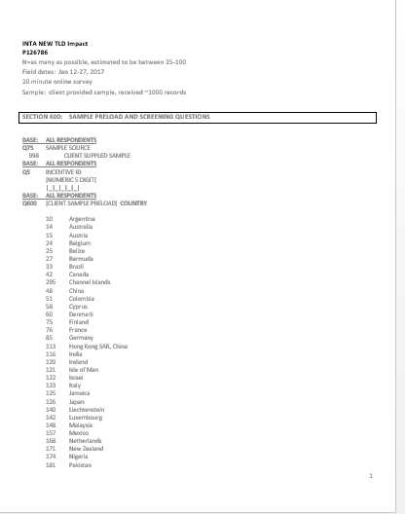
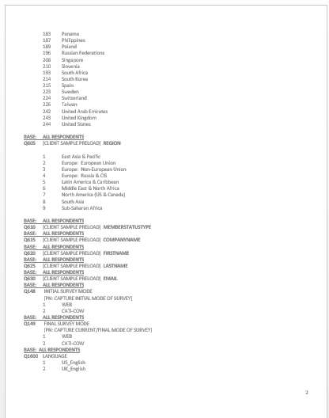
survey

Slide 63
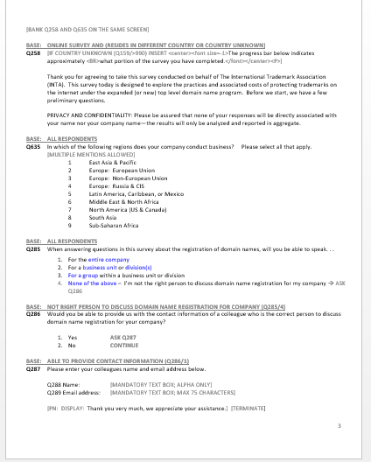
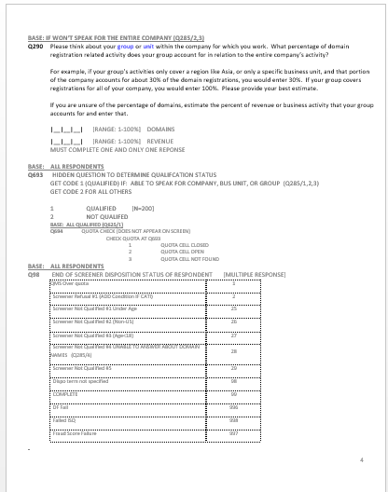
survey

Slide 64
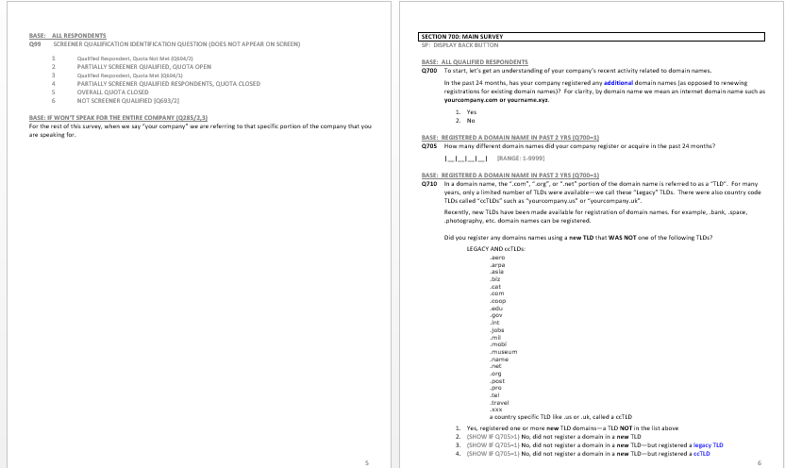
survey

Slide 65
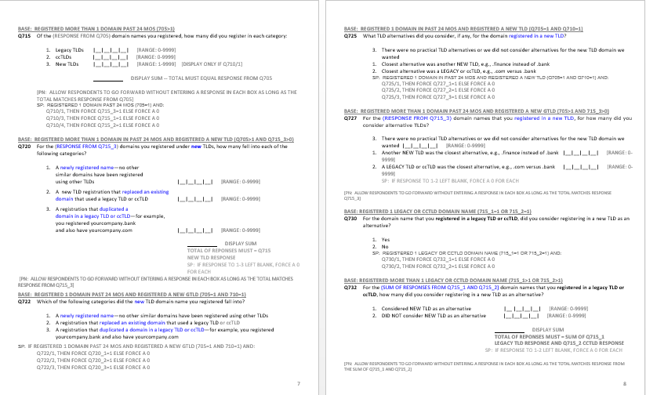
survey

Slide 66
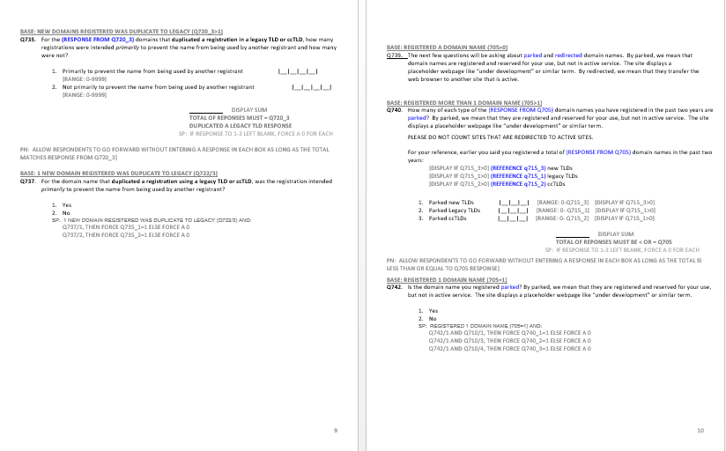
survey

Slide 67
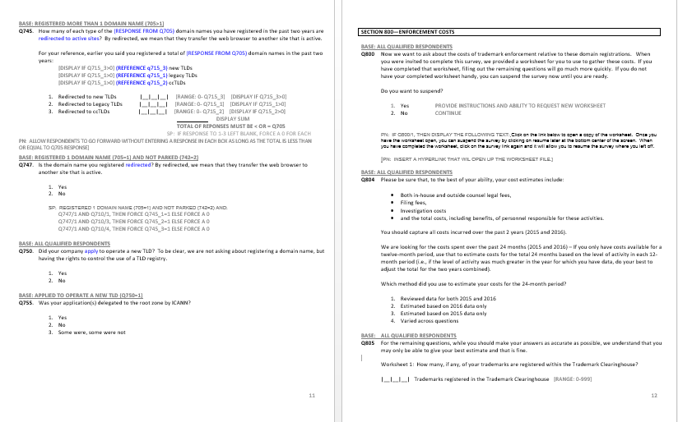
survey

Slide 68
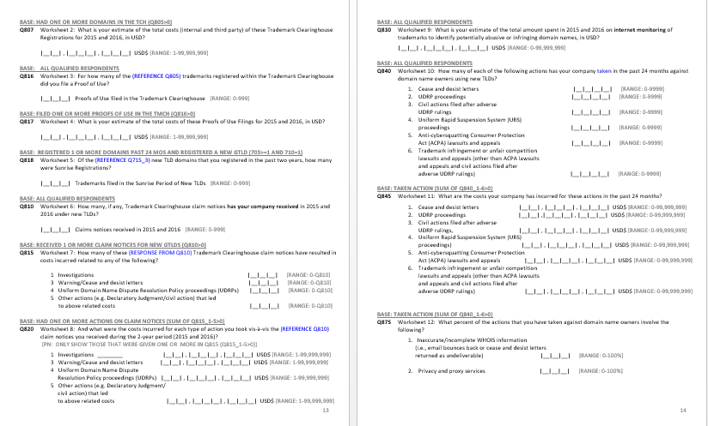
survey

Slide 69
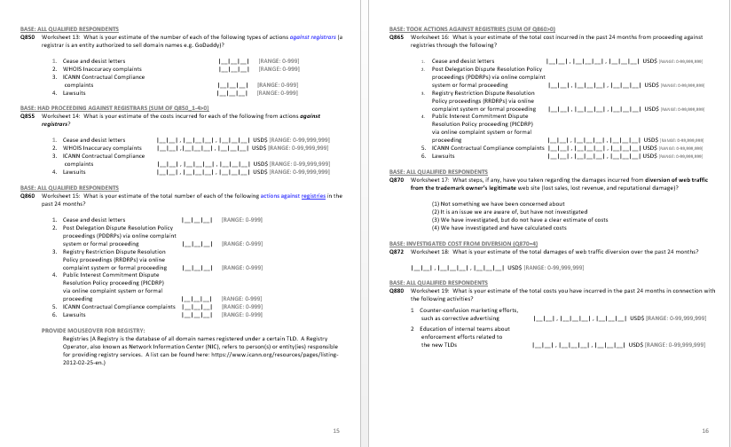
survey

Slide 70
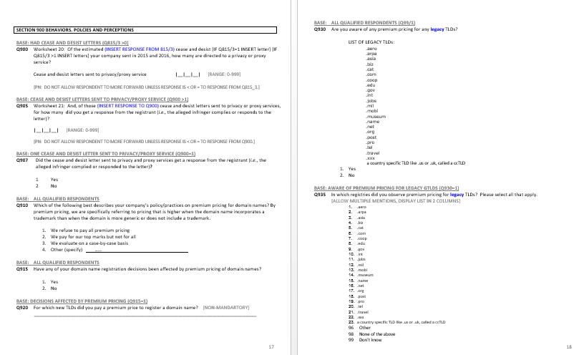
survey

Slide 71
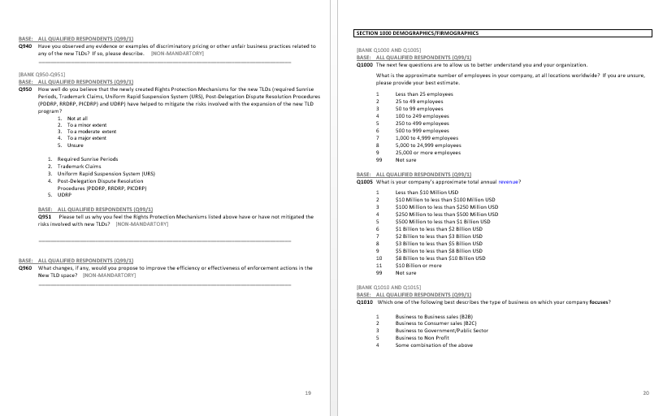
survey

Slide 72
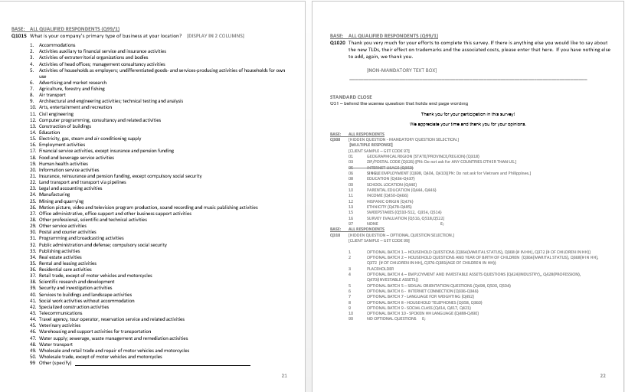
survey

Slide 73
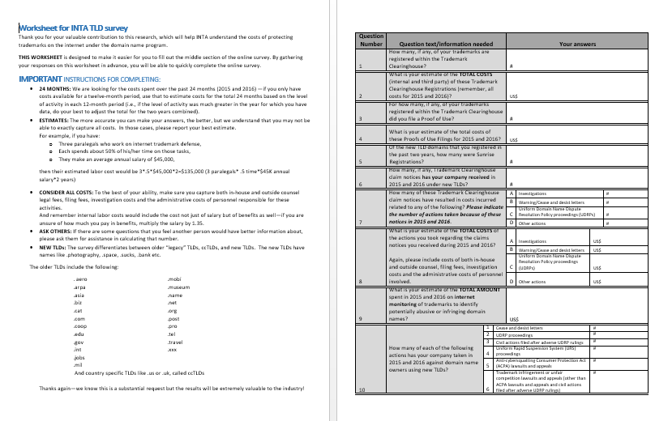
worksheet

Slide 74
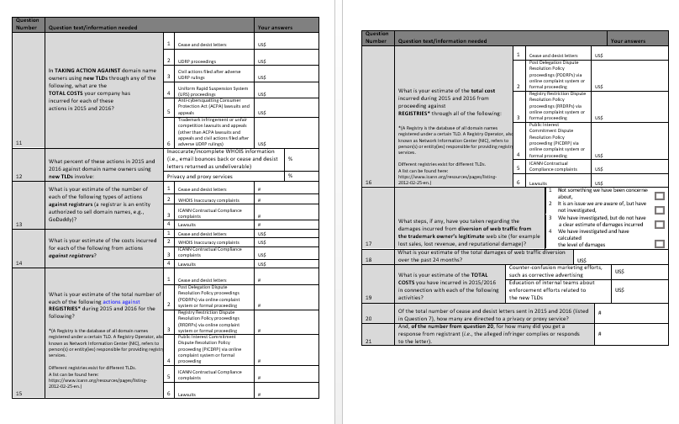
worksheet

