Slide 1
Latin Generation Panel
Chris Dillon | IDN Program session, Marrakech

Slide 2
Agenda
1
2
3
Potential scope of the Latin Generation Panel
Members of the Latin Generation Panel
Additional expertise required
4
5
6
Repertoire
What next?
Questions and contact details

Slide 3
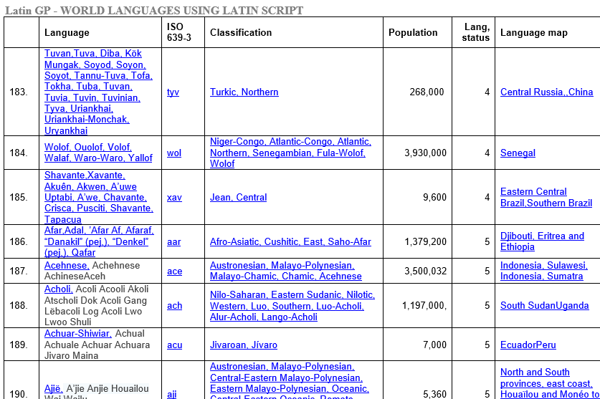
Scope of the Latin Script (extract)

Slide 4
Current membership of Latin Generation Panel
Name | Country | Expertise
Tunde Adegbola | Nigeria
Sarat Assirou | Ivory Coast | Dioula, Baoulé Bété, Ebrié
Dwayne Bailey | South Africa | Afrikaans, Northern Sotho, Venda, Tswana and Southern Sotho
Ahmed Bakht Masood | Pakistan | Urdu, English
Matthias Brenzliger | South Africa
Eric Brunner-Williams | US | English
Chris Dillon (Co-Chair) | UK | English, German, Spanish
Tarkan Doruk | UAE | Turkish
Yashar Hajiyev | Azerbaijan | Azerbaijani, English
Hazem Hezzah | Egypt | Arabic, German
Paul Hoffman | US | English
Tarik Merghani | Sudan
Meikal Mumin | Germany | German, English, use of Latin script for African languages
Danko Jevtovic | Serbia | Serbian, English
Ngo Thanh Nhan | US | Vietnamese
Daniel Omondi | Kenya
Oscar Gabriel Ledesma Piñeiro | Argentina | Spanish, English
Gideon Kiprono Rop | Kenya
Jean-Jacques Subrenat | France | French, English
Mirjana Tasić | Serbia | Serbian, English
Aysegul Tekce | Turkey | Turkish
Bonface Witaba | Kenya | Swahili

Slide 5
Additional expertise needed
? National and regional policy makers
X Technical community (general and DNS)
? Security and law enforcement
? Academia (technical and linguistic)
O Community-based organizations
O Local language computing using Unicode and specifically IDNs

Slide 6
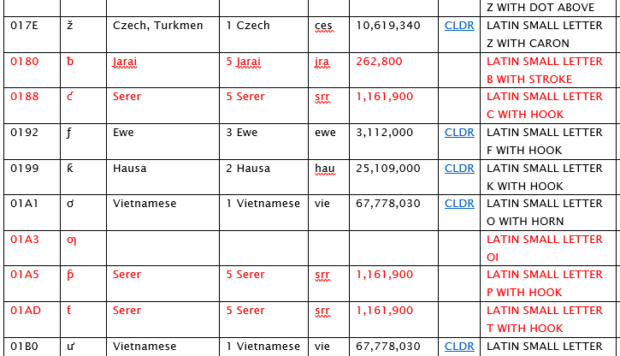
Draft Latin Script Repertoire (extract)

Slide 7
What next?
Analyze similar code points, also in related scripts
Apply to form panel
Add members
Create a repertoire and WLEs
Create XML repertoire and WLEs
Write report and submit for review

Slide 8
Engage with ICANN
Thank you and questions
Website: https://community.icann.org/display/ croscomlgrprocedure/Latin+GP
email: c.dillon@ucl.ac/uk
twitter.com/icann
gplus.to/icann
facebook.com/icannorg
weibo.com/ICANNorg
linkedin.com/company/icann
flickr.com/photos/icann
youtube.com/user/icannnews
slideshare.net/icannpresentations

