Slide 1
Neo-Brahmi Generation Panel (NBGP)
Face to Face meeting
Delhi – 23rd April 2018
Dr. Ajay Data
अजय@डाटा.भारत

Slide 2
Agenda
1
2
3
Introducing NBGP: Scope: Scripts, Languages, Geo Coverage
NBGP Members
Variant Analysis Mechanism
4
5
6
Efforts and Progress so far - Timeline
Future Plan of Action
UASG / IDN / EAI
Notes:
This is a stylized agenda slide for your presentation.
To delete a box, if there are too many boxes, click the edge of the box, ensure the entire box is highlighted, then DELETE.
To update the numbers and text, click inside the circle for the numbers or in the box for the text, revise the text.

Slide 3
NBGP, Scope, Scripts, Coverage, Impact etc.
Introduction
Coverage
1
4
20% of the worlds populations user the scripts, which are under the discussion under NBGP. Approx 60 languages are under scope as per EGIDS scale.
Generate proposals for script specific LGRs, based on community expertise and requirements. Ensure Global Acceptability of Neo-Brahmi Script based language IDN’S and variants.
Scope
Impact
2
Devanagari, Gujarati, Bengali, Gurmukhi/Punjabi, Odia/Oriya, Tamil, Kannada, Telugu and Malayalam.
5
People using these scripts will be able to enable themselves for internet in there language using IDNs and EAI.
3
Geo Coverage
India, Sri Lanka, Nepal, Bangladesh
EGIDS: Expanded Graded Intergenerational Disruption Scale
Notes:
Look for different ways to display your data or text by using alternatives to simple bullets.
To adjust the number in the arrow to text or another number, click on the text box around the number, revise.
To add an arrow, click on the arrow, ensure the arrow is highlighted, COPY and PASTE and move to the desired placement, or DELETE if there are too many arrows.

Slide 4
Members
Co-chairs: Dr. Ajay Data, Dr. Mahesh D. Kulkarni, Prof. Udaya Narayana Singh
Members: 60+ members from India, Nepal, Sri Lanka
Bengali
Atiur Rahman Khan
t\\
Kannada
U.B. Pavanaja
1
2
9
3
Malayalam
Veena / Prasad
Devanagari
Akshat S. Joshi
NBGP
Data Analysis
9 Script Leads
4
Oriya
Kuldeep Patnaik
8
63%
Gujarati
Raiomond Doctor
22%
7
5
Tamil
Shanmugam R
6
Gurmukhi
Gurpreet Singh Lehal
Telugu
Uma Maheshwar G Rao

Slide 5
Timeline
.भारत
May
2010
Aug
2014
May
2015
Aug
2017
Dec
2017
Feb
2018
April
2018
IDN ccTLD
ccTLD .bharat
NBGP Seated
IP feedback and Draft Devanagari LGR is getting prepared
F2F meeting in Colombo
Draft of Gurmukhi, Gujarati, Kannada, Telugu LGR are gettering prepared
Draft LGRs are sent to IP for first comments and revised version sent to IP again.
Summary
Draft LGR for Devanagari is at final stages to be released for public comments. LGR for all other scripts are in the revision stage with the Integration Panel.
Notes:
To adjust the length and width of the arrow, click on the arrow, grab a corner, and lengthen or shorten, depending on your preference.
To add a bubble, click on the bubble, ensure it is fully highlighted, COPY and PASTE. Then drag the bubble to your preferred placement.
To delete a bubble, click on the bubble, ensuring it is highlighted and click DELETE. If you make a mistake, go to your top bar on PP and click EDIT, UNDO

Slide 6
Future Timeline
April
2018
April
2018
May
2018
June
2018
June
2018
July
2018
Release of Devanagari LGR for Public Comments
Send all scripts for next round of comments to IP
Receive feedback and update the documents
Final Versions of LGR for Other Scripts
IP Feedback on LGRs Received
Release of all Neo-Brahmi LGRs for Public Comments
Face to Face meeting in Bangladesh – Small group from Bangla Script
Notes:
To adjust the length and width of the arrow, click on the arrow, grab a corner, and lengthen or shorten, depending on your preference.
To add a bubble, click on the bubble, ensure it is fully highlighted, COPY and PASTE. Then drag the bubble to your preferred placement.
To delete a bubble, click on the bubble, ensuring it is highlighted and click DELETE. If you make a mistake, go to your top bar on PP and click EDIT, UNDO

Slide 7
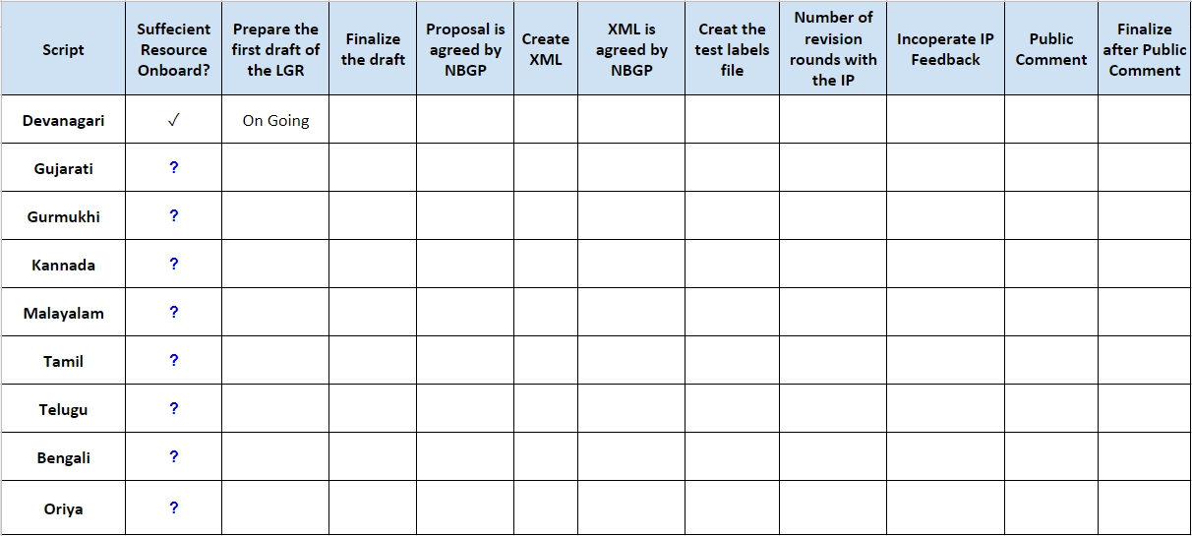
Status as of 1 January 2017

Slide 8
Status as of 22nd April 2018
Script | Sufficient Resource Onboard? | Prepare the first draft of the LGR | Finalize the draft | Proposal is agreed by NBGP | Create XML | XML is agreed by NBGP | Create the test labels file | Number of revision rounds with the IP | Incorporate IP Feedback | Public Comment
Devanagari | ✓ | ✓ | ✓ | ✓ | ✓ | ✓ | ✓ | 7 | Ongoing, due 27 Apr
Gujarati | ✓ | ✓ | ✓ | ✓ | ✓ | ✓ | ✓ | 2 | Ongoing, due 27 Apr
Gurmukhi | ✓ | ✓ | ✓ | ✓ | ✓ | ✓ | ✓ | 2 | Ongoing, due 27 Apr
Kannada | ✓ | ✓ | ✓ | ✓ | ✓ | ✓ | ✓ | 2 | Ongoing, due 27 Apr
Malayalam | ✓ | ✓ | ✓ | ✓ | ✓ | ✓ | ✓ | Going to submit after F2F
Tamil | ✓ | ✓ | ✓ | ✓ | ✓ | ✓ | ✓ | 1
Telugu | ✓ | ✓ | ✓ | ✓ | ✓ | ✓ | Ongoing, due 27 Apr | 2 | Ongoing, due 27 Apr
Bengali | ✓ | ✓ | ✓ | ✓ | ✓ | ✓ | Ongoing, due 27 Apr
Oriya | ✓ | ✓ | ✓ | ✓ | ✓ | ✓ | ✓ | 1 | Ongoing, due 30 Apr
Notes:
To adjust the length and width of the arrow, click on the arrow, grab a corner, and lengthen or shorten, depending on your preference.
To add a bubble, click on the bubble, ensure it is fully highlighted, COPY and PASTE. Then drag the bubble to your preferred placement.
To delete a bubble, click on the bubble, ensuring it is highlighted and click DELETE. If you make a mistake, go to your top bar on PP and click EDIT, UNDO

Slide 9
Cross-Script Variant Analysis Mechanism
The GP identified multiple script pairs including Devanagari-Gurmukhi , Kannada-Telugu (ಅಕ್ಷರಮಾಲೆ - తెలుగు లిపి) and Tamil-Malayalam (தமிழ் - മലയാളലിപിfor the cross-script variant analysis
The panel had a detailed discussion on cross-script variant characters to determine an agreeable mechanism to identify them
The panel converged on a solution to tag each pair of candidate cross-script variant code points with one of the three colors
Red – Identical / Indistinguishable | document as variant code points
Yellow – Similar but distinguishable | document as reference in the appendix
Green – Not similar

Slide 10
Cross-Script Variants for Devanagari and Gurmukhi

Slide 11
TLD - Variant example for Devanagari and Gurmukhi
.ਠਗ
.ठग

Slide 12
Methodology followed to achieve goal.
Attracting members – No rejection policy
Fixed date and time for update conference all (fixed agenda)
F2F meetings
Follow-up on fixed date and time
Finalising champion for each script and internal scope
Organising cross scripts calls
Motivating members / Appreciations
Lead by example to join each call and contribute to resolve
Involve Government stakeholders
F2F meetings at every opportunity
Collaborative document update and view
Taking support from ICANN for XML and expert view from other LGR experience
Submitting document to IP for review
Phased feedback approach from IP
15. WhatsApp group for quick update / follow up and reminders
16. Personal calls to group leaders with expert connect
Division of Responsibility

Slide 13
UASG - IDN - EAI
All Internet applications and systems must treat all TLDs in a consistent manner, including new gTLDs and internationalized TLDs.
Specifically, they must accept, validate, store, process and display all domain names.

Slide 14
Building Blocks: Domain Names
A domain name is dotted text string used as a human-friendly technical identifier for computers and networks on the internet
example.domain.tld
Subdomain or third-
level domain
Second-level
domain
Top-Level Domain
(TLD) or suffix
Each dot represents a level in
the Domain Name System (DNS)
Notes:
This may be too basic for some courses, but review of terminology is generally worth the time.

Slide 15
Building Blocks: gTLDs
Starting in 2013, ICANN (the organization responsible for the creation and maintenance of TLD assignments) approved the creation of a large number of new TLDs. These new TLDs can represent brands, communities of interest, geographic communities (cities, regions) and more generic concepts. Collectively, all of these new TLDs are known as Generic Top Level Domains (gTLDs).
Original Seven gTLDs
.com
.org
.gov
.edu
.mil
.net
.int
Common cc TLDs
.de
.cn
.uk
.nl
.eu
.ru
.tk
New gTLDs
.top
.xyz
.loan
.club
.网址
.信息
.コム
Notes:
Optional Slide:
Good review of concepts of generic top-level domains and country-code top-level domains.
Students tend to enjoy hearing how .com originated in 1985 and grew to be the dominant TLD. It can be contrasted with some of the generic TLDs that were introduced later (e.g., .aero) which have not yet gained wide-spread usage. The widespread usage of some country-code TLDs can also be discussed. If a discussion ensues, make sure to keep a limit on the discussion time so as to ensure time remains for the remainder of the lecture.

Slide 16
Internationalized Domain Name: IDN
почта.рус
ડાટામેલ.ભારત
ਡਾਟਾਮੇਲ.ਭਾਰਤ
ডাটামেল্.ভারত
ڈاٹامیل.بھارت
డేటామెయిల్.భారత్
डाटामेल.भारत
داده.امارات
இந.இந்தியா
电邮.在线
датамэйл.рф
датамэйл.рус
දත්තතැපැල.ලංකා
ดาต้าเมล.ไทย
डाटाइंफोसिस.भारत
एक्सजेनप्लस.भारत
राजस्थान.भारत
मेल.डाटा.भारत
मेल.राहुलदेव.भारत
पत्रिका.भारत
मेल.माइक्रोसॉफ्ट.भारत

Slide 17
Email Address Internationalization: EAI
Can you send email to this address ?
अजय.डाटा@uasg.tech
CC to
ajay@uasg.tech
Or
अजय@डाटा.भारत

Slide 18
Join & Contribute
Please join our social media platform
@nbgp_community
Or
Visit out Wiki page for membership and current status
https://community.icann.org/display/croscomlgrprocedure/Neo-Brahmi+GP
Sarmad Husain
Dr. Ajay Data
@ajaydata
sarmad.hussain@icann.org

