Slide 1
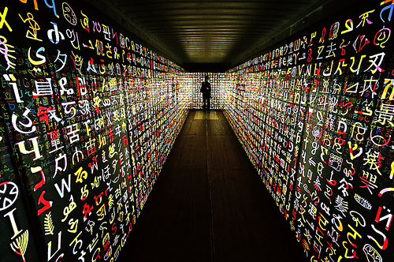
The World of languages
Mahesh D. Kulkarni
Senior Director (Corporate R&D) & HoD, CDAC, GIST
Country Manager W3C India
mdk@cdac.in
23rd April 2018
Co-Chair NBGP

Slide 2
C-DAC’s Involvement in IDNs
C-DAC is involved in IDN related activities since 2008. The research done has resulted in robust and reliable framework behind delegation of “.bharat” domain names
Major Indian language specific changes in ICANN Root Zone LGR framework
Appreciation from John Klensin (Member of founding team of Internet)
Currently the “.bharat” domain names are available for registration

Slide 3
Background research during the IDN Project Phases

Slide 4
Multilingual diversity of India:
Number of individual languages listed for India - 452.
Living Languages - 438
Number of constitutionally recognized Languages – 22
Number of language families – 4
Indo-Aryan
Dravidian
Tibeto-Burman
Munda
Number of major families of scripts - 2
Brahmi – Left to Right writing system
Perso-Arabic - Right to left writing system
19 languages use 11 derivations of the Brahmi script.
While 3 languages Urdu, Sindhi and Kashmiri uses the Perso-Arabic derivations.

Slide 5
Multilingual diversity of India:
Alternate Spellings
One language – Many scripts
One Script – Many Languages
Alternate forms

Slide 6
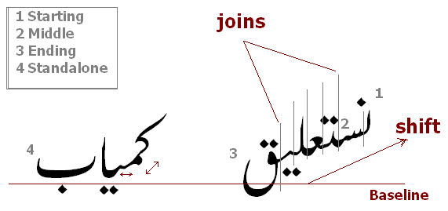
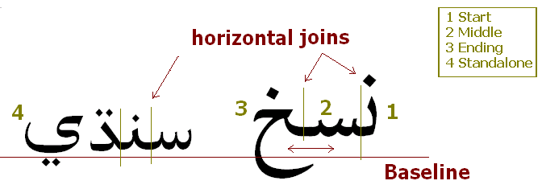
Complex Nature:
Irrespective of the South-North division, each of these writing systems has numerous difficulties for the font developers because of the way their syllabic structures are captured by the graphics – protruding below, above, and on the aisles as well as hanging letters.
Script Grammar for all Indic systems to capture their aesthetics.
Only Sindhi uses system – Naskh (linear-seamless) but Kashmiri & Urdu use Nastaliq (Right-to-left plus Top-to-bottom):
Naskh
Nastaaliq

Slide 7
Domain Names:
Broad Components :
Storage
Unicode with its inherent issues – universally accepted.
Rendering Engine
Varies from Operating system to Operating system
Font
Thousands of variations available.
In case of English, most are mere stylistic
In case of Indian Languages, can be interpretational
Operating System
Major ones, Microsoft, Linux, Macintosh, iOS, Android…
Browser / Email Client / Web enabled Application
Can be many…

Slide 8
Internationalized Domain Names
IDN is a domain name that contains characters from the Unicode character repertoire that other than letter/digit/hyphen (LDH) characters, which are Latin letters (a-z case ignored so includes A-Z), digits (0-9) and the hyphen (-).
www.सीडैक.भारत
www. ਸੀਡੈਕ. ਭਾਰਤ

Slide 9
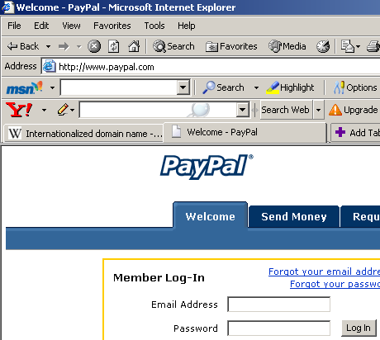
Domain Names : Possible Troubles
Phished paypa1 site
Original paypal site
Phishing is typically carried out by e-mail spoofing or instant messaging, and it often directs users to enter details at a fake website whose look and feel are almost identical to the legitimate one

Slide 10
Variants in Indian Languages
Homographic variants : Similar Looking
1 / l in Latin
द्र / द्न in Devanagari
Homophonic variants : Similar Sounding / alternate spelling
color / colour in Latin
हिंदी / हिन्दी in Devanagari
Case variants :
C / c in Latin (No such case in Indian Languages)

Slide 11
Similar looking variants : Illustrated
द + ् + र = द्र
www.मुद्रा.भारत
www.मुद्ना.भारत
www.मुद्गा.भारत
द + ् + न = द्न
द + ् + ग = द्ग

Slide 12
Meeting the challenges

Slide 13
Solution:
A formalism based on ABNF has been put in place to validate desired domain name for each language based on syllabic structure.
Variant Identification, Generation and Action

Slide 14
Solution:
Design of a single Font
Same height
Monothick
Supporting all the scheduled Indian languages

Slide 15
Study of IDNs vis-à-vis Indian languages
Under the aegis of MeitY, C-DAC has undertaken the activity of IDN.
A detailed study of various IDN related RFCs was undertaken
Nature and level of Indian language(s) support on Digital Platforms
Nature of Internet transactions and implications of Indian language introduction to it
Study of Internet usage tools
At the inception of project, an extensive study of various Internet access tools (Web Browsers) was carried out.
All the major browsers at the time, i.e. Mozilla Firefox, Google Chrome, Internet Explorer and Safari were tested and detailed report was prepared
The findings of this report aided in policy formation

Slide 16
Policy Framework Design
A robust policy framework has been put in place for registration of IDNs in Indian languages.
Includes all the 22 scheduled languages of India.
This policy was publically discussed at almost 10 National and International workshops held across the country.
Venues: Pune, Hyderabad (2), Mohali, Guwahati, Bangalore, Bhuwaneshwar, Delhi (3)
Implementation of the policy
The widely discussed IDN Policy framework was then implemented in the form of software APIs.
APIs for all the 22 scheduled languages of India were designed as a policy manifestation
The same have been integrated in the current “.bharat” domain names registration framework.

Slide 17
Implementing the policy
Translation of the Reserved names lists for all the languages released under “.bharat”.
Suggesting the names for various second level zones under the “.bharat” (e.g. .edu, .co, .gov etc.)
Translations of domain names to be launched
Trans-creation of “.in” domains promotional video in Hindi
Creation of launch related multimedia content
Implementation requirements
In parallel to policy implementation, the process of applying for the said “.bharat” domain names for various Indian languages, to ICANN was also being studied.
C-DAC gathered all the necessary linguistic documentation support required by the “IDN ccTLD Fast-track process” of ICANN
The necessary support for the same was extended to NIXI.

Slide 18
Phases | Policy Development | API Creation
IDN Phase I | Study – stakeholder consultation
IDN Phase II | Assamese, Bangla, Gujarati, Hindi, Kannada, Konkani, Malayalam, Marathi, Nepali, Oriya, Punjabi, Sanskrit, Tamil & Telugu
IDN Phase III | Bodo, Dogri, Maithili, Manipuri, Santali(Devanagari), Sindhi(Devanagari) & Sindhi(Ol-Chiki) | Assamese, Bangla, Gujarati, Hindi, Kannada, Konkani, Malayalam, Marathi, Nepali, Oriya, Punjabi, Sanskrit, Tamil & Telugu (In a proto C language API)
IDN Phase IV | Santali (Ol-Chiki), Kashmiri (Devanagari), Manipuri (Meetei Mayek) and Sindhi (Perso-Arabic) | Bangla. Bodo, Dogri, Gujarati, Hindi, Konkani, Marathi, Maithili, Manipuri, Nepali, Punjabi, Tamil, Telugu and Sindhi-Dev (In Java JAR files as per changes demanded by Registry)
IDN Phase V |  | Assamese, Kannada, Kashmiri, Malayalam, Odia (Oriya), Sanskrit, Santali and Sindhi

Slide 19
C-DAC - ICANN & Neo-Brahmi GP Activity

Slide 20
Getting involved with ICANN
C-DAC Team participated in the ICANN’s “Variant Issues Project” as an Indian voice, since 2010.
C-DAC successfully represented the nature of Indian languages vis-à-vis Variants to ICANN.
The need of “Whole Label Evaluation” rules in the current “Root LGR Project” is the culmination those efforts.
CDAC GIST lead the “Devanagari Case Study” team. Devanagari was taken as the representative complex script for issues identification
An exhaustive report on various issues was brought out by the team which was well received by the ICANN community.
The same was specially appreciated by “Dr. John Klensin” – A member of “Internet Hall of Fame”
Participated in the “Integrated Issues Report” phase
Issues as identified by various case-study teams were considered to bring out a unique requirement for the next phases of the project

Slide 21
Getting involved with ICANN
Participation in the “Procedure Drafting team” for the now “Root LGR Project”
The outcome of this phase is the “Root LGR Procedure” (Currently underway)
Apart from the introduction of “Whole Label Evaluation” rules, which is a significant contribution from the team, there are many clauses added to the procedure which deal with the nitty-gritties of Indian languages.
Neo-brahmi GP:
Some Facts:
Status: Seated
Is the largest group in terms of number of scripts to be handled (9 Scripts)
Is to take a call of inclusion/exclusion of a total of 1150 code points.
Is the largest group in terms of number of languages to be handled (21 languages)

Slide 22
Getting involved with ICANN
Neo-brahmi GP:
First Face to face meeting of the group took place on 16th July 2015 with support from ICANN
The team took initiative in arranging for the meeting
All the volunteer members were appraised of
The work done so far
Next steps to be taken
Schedule for next steps prepared

Slide 23
Getting involved with ICANN
Neo-brahmi GP:
Second Face to face meeting of the group took place on 24th to 26th May 2017 in Kathmandu, Nepal with support from ICANN
The community from Nepal was made aware of all the aspects of the procedure and the Devanagari LGR draft
Active participation from community in Nepal which provided great insights to the GP on Nepali, Newar and Tamang
Members from Bangla, Gurumukhi and Kannada were also present
The GP charted out the plan of action for DV LGR rollout and other script LGR initiation
Third Face to face meeting of the group took place in December 2017 at Colombo, Sri Lanka with support from ICANN
Major discussions on Tamil script LGR
Initial presentations of Bengali, Kannada, Malayalam, Telugu, Tamil, Gurmukhi and Gujarati

Slide 24
Getting involved with ICANN
Neo-brahmi GP:
At this point C-DAC team is editing Four LGR
Devanagari
Gujarati
Tamil
Bengali
Along with the editing, C-DAC team is also involved in enabling other script LGRs by way of discussions and presentations at various F2F meeting.

Slide 25
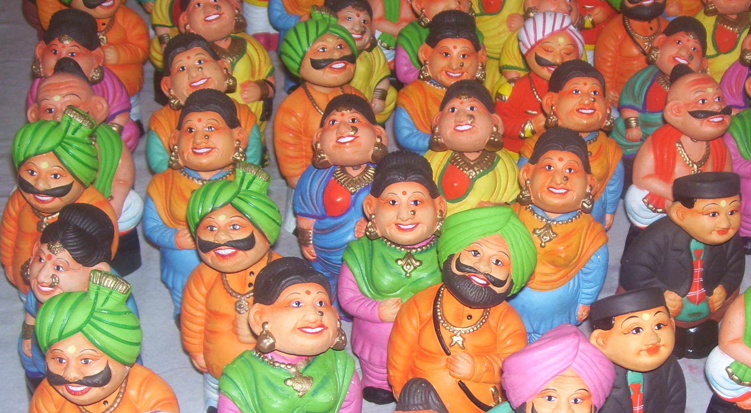
Thank you all
“कोस कोस पर पानी बदले तीन कोस पर वाणी”

