Slide 1
Developing Label Generation Rules (LGR) for the Root Zone
Pitinan Kooarmornpatana
Manager, IDN Programs
Neo-Brahmi Meeting, Delhi
23 – 25 April 2018

Slide 2
Agenda
1
2
3
Background of IDN TLD Program
Root Zone Label Generation Rule Project
RZ-LGR Procedure
4
5
6
LGR
Analysis
LGR Proposal (XML)
LGR Test Labels
(TXT)
Notes:
This is a stylized agenda slide for your presentation.
To delete a box, if there are too many boxes, click the edge of the box, ensure the entire box is highlighted, then DELETE.
To update the numbers and text, click inside the circle for the numbers or in the box for the text, revise the text.

Slide 3
Background of IDN TLD Program

Slide 4
ASCII Domain Name Label
www.cafe123.com
Third Level
Domain
Second Level
Domain
Top Level
Domain (TLD)
Forming ASCII Labels
Use LDH
Letters [a-z]
Digits [0-9]
Hyphen (LDH)
Label length = 63
Other constraints (e.g. on hyphen)
Forming ASCII Labels
Use only Letters
Letters [a-z]
Label length = 63

Slide 5
Internationalized Domain Name (IDN) Labels
हिन्दी.भारत
IDN Second
Level
Domain
IDN Top
Level
Domain
Syntax of IDN Labels
Valid U-Label: Unicode code points as constrained by IDNA 2008
Valid A-Label - “xn--” followed by punycode of U-Label of length 59
Syntax of IDN Labels
Valid U-Label, further constrained by the “letter” principle for TLDs
Valid A-Label

Slide 6
“Same” or Different Domain Labels?
Example of within-script variant labels (Arabic script)
شبکۃ (06C3 06A9 0628 0634)
شبکة (0629 06A9 0628 0634)
شبكة (0629 0643 0628 0634)
Example of within-script variant labels (Simplified Chinese and Traditional Chinese)
名称 (540D 79F0)
名稱 (540D 7A31)
Example of cross-script variant label (Latin script and Cyrillic script)
epic (0065 0070 0069 0063)
еріс (0435 0440 0456 0441)

Slide 7
Complex Scripts Require Label Level Rules
Allow only specific sequences in the script, otherwise could create unpredictable rendering issues for labels
  Rendering issues can cause confusion in reading labels and potentially security issues for end users
Prevent labels which should not be allowed or usable
For NBGP it means encoding Akshara rules
  But should not try to encode language specific spelling rules to allow for innovative labels

Slide 8
IDN Program Objectives
Enable deployment of domain names
in the local languages and scripts
used by the communities globally
in a secure and stable manner

Slide 9
Root Zone Label Generation Rule Project

Slide 10
RZ-LGR for IDN Variant Implementation
SECURE AND STABLE RESULTS:
INVALID TLD LABEL
LGR Tool
Ethiopic
VALID TLD LABEL
ALL VARIANTS:
Applied-for TLD: t1
ግዕዝ
{
Thai
t1v1
t1v2
t1v3
t1v4
Arabic
ไทย
العربیة
{
Existing TLD: t1
…28
scripts
RZ-LGR
ALLOCATABLE
BLOCKED

Slide 11
Status of Generation Panels

Slide 12
RZ-LGR Procedure

Slide 13
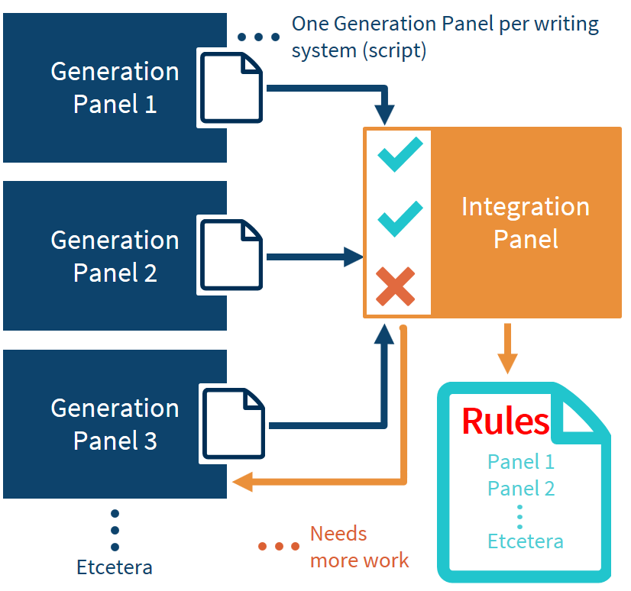
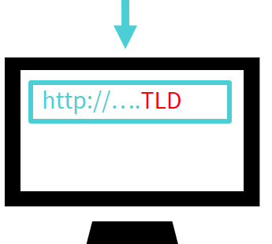
Root Zone LGR Procedure
Generation Panels
  Generate proposals for script
  specific LGRs, based on community expertise and requirements
Integration Panel
  Integrates them into common Root Zone LGR while minimizing the risk
  to Root Zone as shared resource
Label Generation Rules (LGR)
  Which labels are permissible
  Which variant labels exist
  Which variant labels may be allocated

Slide 14
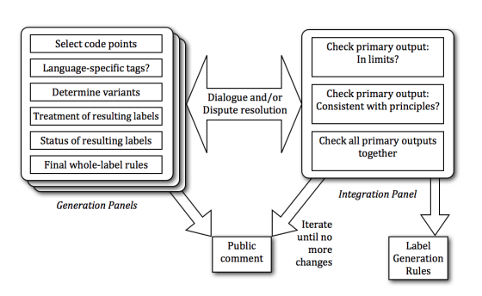
High Level Process
Procedure to Develop and Maintain the Label Generation Rules for the Root Zone in Respect of IDNA Labels https://www.icann.org/en/system/files/files/draft-lgr-procedure-20mar13-en.pdf

Slide 15
Label Generation Rules for the Root Zone
For the Root Zone, single “table” containing data for all scripts
  As it is a shared resource, must be conservative
  Must be stable and secure
  Must be based on inclusion based analysis
For each script or writing system:
  Which code points are valid for use?
  Are any of these code points variants of each other?
  Are the any additional constraints on the labels?
Final work of the Generation Panel:
  LGR Proposal (XML)
  LGR Supporting Document (PDF)
  Test Labels File (TXT)

Slide 16
Generation Panel Analysis
Code Point
Variant Code Point
Whole Label Evaluation Rules

Slide 17
LGR for the Root Zone
LGR Proposal – by Generation Panel of Script Community
Unicode
IDNA2008 – by IETF
Maximal Starting Repertoire
– by Integration Panel of ICANN
X |  | X |  | X
X
X |  | X
X
X |  |  | X | X | X
X |  |  |  |  | X
X |  |  |  |  | X
…
…

Slide 18
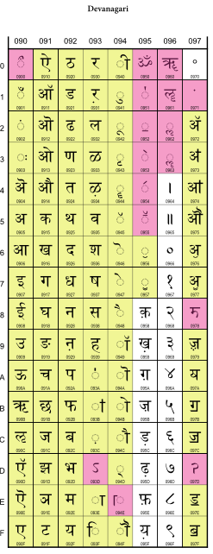
MSR and LGR
  1. Which code points must be included in the Root Zone
    Are exclusions from MSR (pink) correct?
    What must be included in LGR?
      “everyday, general purpose [use ...] in a stable and widespread manner”
  2. Are there any variant code points
    Two code points when replaced produce labels considered confusingly similar by an end-user
  3. Are there any label-level constraints
    Well-formedness of a cluster?
    Constraints on initial or final position in a label?
    Other?

Slide 19
What is the Overall Goal?
Goal is to create a mnemonic system for use in the Domain Name System (DNS)
  A mechanism to remember IP address
  Must remain secure and stable in use – if DNS is confusing to users, then the motivation is not met
  Not required to completely cover a language or a script
  May not form labels which are words in a language
    Not restricted to “correct” spellings
    May not carry a meaning in the “lexical” sense

Slide 20
What is the Repertoire?
Define a set of code points which are generally understand and used by the community
Avoid using code points which are not well understood:
  Special purpose use
  Historic use
Avoid using code points which are not stable in their use
  New orthographic formulations
  Discontinued orthographic conventions
Remain conservative – when in doubt, better to exclude a code point

Slide 21
What is the Goal of Variant Code Points?
      Successfully defining variant rules for an LGR is not trivial
      Code point or code point sequences causing two (or more) labels functionally “the same” in a script
      Make the mnemonic system to minimize user confusion
      Conservatism requires
        maximizing “blocked” variants
        minimize “allocatable” variants

Slide 22
What is the Goal of Cross-Script Variants?
Are there any related scripts?
Are there any specific characters which are indistinguishable between these scripts?
Are there sufficient such characters to form confusable labels across scripts?

Slide 23
What is the Goal of Label Level Rules?
Goal is to reduce label space
  Preventing labels which should not be possible for various reasons
    Not licensed by the script (but not spelling rules)
    Cause security issues
    Cause usability constraints
    Other?
  Reducing allocatable label by making them blocked in certain cases
  Put in contextual contexts for code points or their sequences

Slide 24
LGR Proposal (XML)

Slide 25
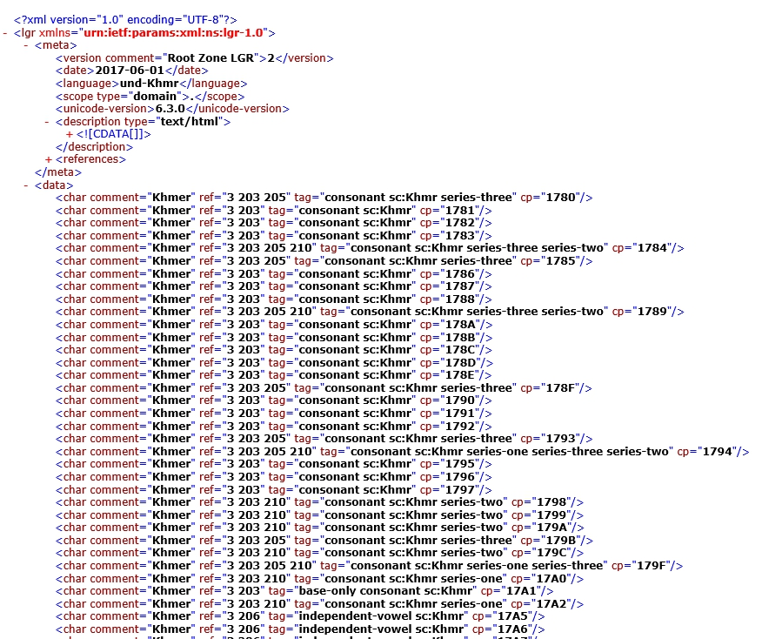
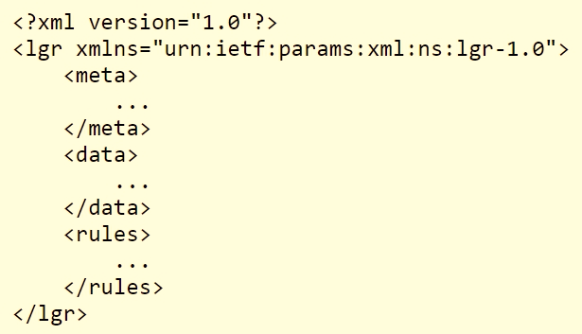
LGR Specification
Label Generation Rulesets (LGRs) used to generate domain name labels, as specified in RFC 7940

Slide 26
Test Labels File (TXT)

Slide 27
What Should a Test Labels File Have?
Have a list of labels
a. At least 50 valid labels, possibly more, also addressing the following:
i. Labels should cover all languages shortlisted for inclusion in the proposal for that script (EGIDS 1-4)
ii. Labels should cover all the code points in the repertoire
  b. A reasonable list of invalid labels containing some of the out-of-repertoire code points
  Have a list of labels which have variant labels (if the script proposal has variants listed), following by a list of all within-script and cross-script variant labels for that label. A reasonable coverage of variant code points is suggested
  Have a few labels for each rule
  a. Have positive examples, creating valid labels
  b. Have negative examples, with invalid labels as they should fail that specific rule – in some cases you may have to make us some nonsense labels just for that purpose
  c. In case there are multiple ways a rule can fail, please suggest a few examples for each of those cases

Slide 28
Questions to Ask about Test Labels File
1. Does it cover all inclusion code points?
2. Does it cover exclusion code points?
3. Does it cover all in-script variant sets?
4. Does it cover all cross-script variant sets?
5. Does it cover all rules for valid cases?
6. Does it cover all rules for invalid cases?

Slide 29
Example of the Test Labels File
Code point coverage test
# Labels-CyrillicScript-20180403
# valid label in repertoire
пойти
дом
тоже
хороший
:
# invalid label out of repertoire
ทดสอบ
Variant set test
# valid labels with corresponding list of variants
# сидеть - 0 allocatable variants, 3 blocked variants
сидеть
сидeть
cидеть
cидeть
# мӗн - 0 allocatable variants, 1 blocked variants
мӗн
мĕн

Slide 30
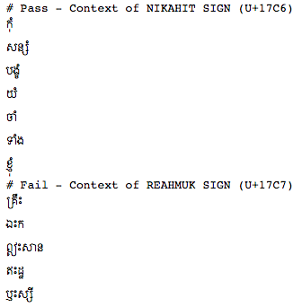
Example of the Test Labels File
WLE test
More examples: https://www.icann.org/resources/pages/lgr-proposals-2015-12-01-en

Slide 31
Thank you
Thank you NBGP for the hard work
  We have a lot of progress in ALL nine scripts
Next step: send updated and completes proposal for each script across for IP review
  For each script, need the complete set:
    Proposal Document (DOCX)
    XML File (XML)
    Test Labels File (TXT)

Slide 32






Engage with the IDN Program
Thank You and Questions
Visit us at icann.org/idn
Email: IDNProgram@icann.org
@icann
facebook.com/icannorg
youtube.com/icannnews
flickr.com/icann
linkedin/company/icann
slideshare/icannpresentations
soundcloud/icann

