Slide 1



Slide 2
IDN Root Zone LGR Workshop
Sarmad Hussain
Director, IDN Programs, ICANN
ICANN64
13 March 2019

Slide 3
Overview of Session Presentations
Variant Considerations - Michel Suignard
Update by RZ-LGR Study Group - Dennis Tanaka
Community Updates
  Chinese GP Update - Wei WANG,
  Kenny HUANG
  Japanese GP Update - Yoshiro Yoneya
  Korean GP Update - Dongman LEE
Q/A

Slide 4
Variant Considerations
Michel Suignard
Member of Integration Panel

Slide 5
Variant relation
Variants are EXCHANGEABLE: Users will accept one for the other
Variants are symmetric:
  A ~ B means B ~ A
Variants are transitive:
  A ~ B and B ~ C means A ~ C

Slide 6
Variant Types
Variants can be semantically equivalent, phonemically exchangeable, functionally exchangeable, visually identical
Semantic variants:
  Chinese: Traditional versus Simplified ideographs 萬 万
  Arabic: Orthography variants ك ڪ
Phonemic variants:
  Ethiopic (Amharic writing system only) ሆ ሖ ኆ
Functionally exchangeable variants:
  Latin (ligature œ versus the sequence ‘oe’)
Visually identical variants
  Latin (schwa ‘ə’ versus turned e ‘ǝ’)
  Arabic (shared positional forms, stylistic variants)

Slide 7
Code Point Variants versus Variant Labels
LGRs define variants among code points (or sequences)
  These result in variant labels after dispositions are applied
Users interact with variant labels
  Code points variants that cannot be used to create a variant label do not need to be defined.
    Example: Combining marks unless the base characters have also variants
  Code points have no context other than the label.
    Example: Most Devanagari users don’t expect a Nukta behind a Vowel (therefore creation of a variant pair with the naked vowels)

Slide 8
In-Repertoire and Out-of-Repertoire Variants
Variants are not restricted to being in-repertoire (or even in-script), they can be out-of-repertoire and cross-script
GPs must investigate all in-repertoire and declare all of them in their LGRs
Out-of-Repertoire or cross-scripts can be added through integration of other LGRs
GPs cannot add cross-script variants that would induce in-script variants in another script without agreement of the other GP (as a consequence, it is not possible to force an in-script variant in a script already included into the latest RZ-LGR)
  Exception for shared script scenario
No cross-script variants can create variants between ASCII letters or sequences

Slide 9
Special Cases of Generic Shapes
Generic, simple shapes lack identifying features
  High risk example: .ooo is a delegated non-IDN gTLD
Script | .ooo | .coco | .olol
Latin | .ooo | .coco | . olol
Cyrillic | .ооо | .сосо | . оӏоӏ
Greek | .οοο
Armenian | .օօօ
Oriya | .ଠଠଠ |  | .ଠାଠା
Malayalam | .ഠഠഠ
Myanmar | .ဝဝဝ | .ငဝငဝ

Slide 10
Determining visually exchangeable variants
It is not mere visual similarity, such cases are resolved outside of LGRs
But “Even for variants based on visual similarity, there exists a subset of evaluation rules that could be applied in an automated manner, obviating the need for further case-by case or even contextual review”
[Procedure A3.3]
IDN labels are much more restrictive than normal text
Identifiers are not restricted to being actual words
Procedure and IAB have directed the process to be biased to the conservative side
  A TLD cannot be visual identical to another one because users will be misled

Slide 11
In-script Exchangeability
Example of TABERU
食べる | Japanese "to eat", Kanji + Hiragana
食ベる | Substituting Katakana ベ
Exchangeable or not?

Slide 12
Allocatable and Blocked Variants
“The output of this procedure should aim to maximize the number of blocked variants, and to minimize the number of allocatable variants.”
[procedure A3.3]
Therefore, all LGRs must contain mechanism to reduce the number of allocatable variants when such a mapping/action set is defined.
Examples of mitigations:
  Arabic, using WLE rules to limit permutations
  Chinese (Draft), using a mix of mapping types and actions to reduce the number of allocatable labels (typically: original, 1 traditional, 1 simplified)
  Tamil SRI/SHRI ஸ்ரீ / ஶ்ரீ alternation, using WLE rules to restrict permutation in a single label

Slide 13
Variants are defined as Mapping + Context
Variant 1 | Glyph | Variant 2 | Glyph |  | Type | Required Context | Comment
0906 | आ | 0906 093C | आ़ | ↔ | blocked | not: followed-by-Nukta | Devanagari variant
Example is a NULL Variant because 093C maps to nothing when mapping from 0906 093C (Variant 2) to 0906 (Variant 1)
Variant 1 to Variant 2 relationship does not exist if the Variant 1 character is followed by a Nukta (U+093C) to avoid possible recursion:
  The 0906 in the new variant mapping including it could be mapped again to keep making the variant mapping longer
  This context rule is required to keep the variant set transitive.
Variant 2 to Variant 1 relationship seemingly does not require the same context because the string 0906 093C 093C is invalid per Nukta context rule.
  However it is required to keep the variant mappings symmetric

Slide 14
References
Procedure to Develop and Maintain the Label Generation Rules for the Root Zone in Respect of IDNA Labels
https://www.icann.org/en/system/files/files/draft-lgr-procedure-20mar13-en.pdf
Guidance on Designing Label Generation Rulesets (LGRs) Supporting Variant Labels
https://tools.ietf.org/html/rfc8228
Root Zone Label Generation Rules 2.0
https://www.icann.org/sites/default/files/lgr/lgr-2-overview-26jul17-en.pdf
Out of Repertoire Variants in Root-Zone LGR and Proposals
https://community.icann.org/download/attachments/43989034/Out-of-Repertoire-Variants_2017-09-25a.pdf

Slide 15
Update by RZ-LGR Study Group
Dennis Tanaka

Slide 16
Agenda
Background
Scope of Work
Current status
Next Steps

Slide 17
Background
RZ-LGR available through the LGR Procedure
  Several scripts already integrated; many others in-progress
Need of a harmonized way to use the RZ-LGR for ccTLDs and gTLDs
  Single source to validate top-level labels and calculate variant labels
Need for a technical assessment of the implementation of the RZ-LGR
  Technical considerations for subsequent policy
Notes:
Call for volunteers: https://www.icann.org/news/announcement-2018-02-08-en

Slide 18
Background – Study Group Members
 | Name | Organization | Sponsoring Organization
1 | Mirjana Tasic | .rs and .срб | ccNSO
2 | Edmon Chung | .asia | GNSO
3 | Gaurav Vedi | Dominion Registries | GNSO
4 | Dusan Stojicevic | Gransy | GNSO
5 | Dennis Tan Tanaka | Verisign | GNSO
6 | Wei Wang | KNET | GNSO
7 | Ajay Data | XGENPLUS | GNSO
8 | Alireza Saleh | IRNIC | IAB
9 | Dessalegn Yehuala | Addis Ababa Univ. and Ethiopic Generation Panel
10 | Harsha Wijayawardhana | Sinhala Generation Panel

Slide 19
Scope of Work
1
WHO will use it?
4
WHEN do you apply it?
TLD applicant (ccTLD, gTLD)
Generation and Integration Panels
Other stakeholders
Existing TLDs and new TLD applications
gTLDs: application window
ccTLDs: Fast Track process (rolling)
Reserved TLD labels
2
WHAT does it do?
WHERE do you find it?
Syntax validation
Calculation of variant labels and disposition values
What if RZ-LGR calculation is not accepted?
5
Implementation (i.e, specs, test cases)
Maintenance (e.g., update to repertoire, variant rules, etc.)
Repository of normative XML
3
WHY is it important?
Single source and/or repository, for consistency and predictable results
But, what about scripts not yet integrated in the LGR? What are the technical issues subsequent policy would need to address
Other Considerations
6
Variant states and transition among states
Limits on allocatable variant labels
Other security and stability considerations (e.g., single character IDN TLDs)

Slide 20
Not in Scope
Semantic validation
  IDN ccTLD, Geo-Names, Brand, Community, etc.
Limiting number of allocatable variant TLDs
How to process TLD applications whose script is not yet supported by the Root Zone LGR.
Notes:
This slide can be used for text, graphics or any other elements.

Slide 21
Proposed recommendations (1/2)
RZ-LGR is meant for all forms of top-level domain names (u-labels, a-labels and all other ldh labels)
    ASCII set (a-z) is a subset of Latin script; cross-script variants in Cyrillic, Greek or Armenian scripts are possible.
For scripts or writing systems integrated into the RZ-LGR, the RZ-LGR is the sole authoritative source
  to validate top-level domain labels, and
  to calculate variant labels and disposition values.
Policy should not overturn calculations of the RZ-LGR; doing so would invalidate the entire RZ-LGR.
For scripts not yet incorporated into the RZ-LGR, the SG defers to a policy development process to determine whether it is advisable to delegate an applied-for label which can’t be validated by the RZ-LGR.

Slide 22
Proposed recommendations (2/2)
Changes to the repertoire, variant code points or whole label evaluation rules should not affect existing top-level domains.
  Subsequent changes to components of the RZ-LGR must conform to the LGR Procedure.
There should be one and only one authoritative source for the RZ-LGR xml file (e.g. IANA).
ICANN should make available a non-authoritative implementation of the RZ-LGR as a community service.
Number of allocatable variant labels should be as small as possible.
ICANN and the relevant SOs needs to develop a process to resolve cases when a TLD applicant does not agree with the calculations of the RZ-LGR
  Any resolution that requires changes to the RZ-LGR must conform to the LGR Procedure

Slide 23
Chinese Generation Panel Update
Wei WANG
Kenny HUANG
C-GP Co-Chairs

Slide 24
Agenda
1
2
3
CGP Work Overview
CJK Coordination
CGP Proposal Draft
201902
4
5
Visual Similarity
Next Step
Notes:
This is a stylized agenda slide for your presentation.
To delete a box, if there are too many boxes, click the edge of the box, ensure the entire box is highlighted, then DELETE.
To update the numbers and text, click inside the circle for the numbers or in the box for the text, revise the text.

Slide 25
CGP CGP Team and Work Process
1
Members, 23 experts from 10 countries/regions
  China mainland, Taiwan, Hong Kong, Macau, Singapore, Malaysia, as well as members from Europe and North America.
Advisor, Edmon CHUNG
  CEO of dotAsia and Co-Chair of the Universal Acceptance Steering Group
CJK coordination working group
IP
Consultation
CGP
Repertoire
Variant Set
WLE
XML LGR
CJK Coordination

Slide 26
CGP Work Review
1
CJK Meeting@Beijing
CDNC@Beijing
CDNC@Beijing
CJ Meeting@Dallas
CDNC Meeting@Tapei
CJK Meeting@Seoul
CK Meeting@Taipei
CK Meeting@Seoul
Repertoire Size
Limited Labels number
Mar 2015
May 2015
Jul 2015
Oct 2015
Sep 2016
Nov 2016
Sep 2016
Nov 2016
Frequent Updates
… …
Jan 2017
Jul 2017
Sep
2014
Mar 2016
Jun 2016
Aug 2016
Dec 2017
Feb 2018
Apr 2018
Aug 2018
Oct 2018
Dec 2018
Feb 2019
CGP Formed Up
CGP Base Repertoire &
Variant Extension Review
CGP Proposal Draft v1
IP Feedback
CGP Proposal Draft v2
IP Feedback
Proposal v8
Proposal v9
Proposal v10
IP Feedback 201802
Proposal v11
IP Feedback 201812
Proposal v12
Notes:
To adjust the length and width of the arrow, click on the arrow, grab a corner, and lengthen or shorten, depending on your preference.
To add a bubble, click on the bubble, ensure it is fully highlighted, COPY and PASTE. Then drag the bubble to your preferred placement.
To delete a bubble, click on the bubble, ensuring it is highlighted and click DELETE. If you make a mistake, go to your top bar on PP and click EDIT, UNDO

Slide 27
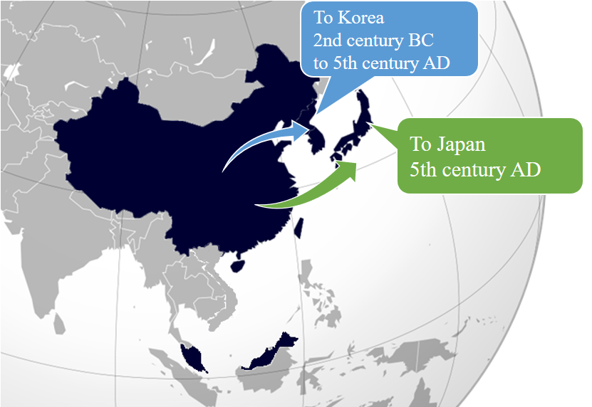
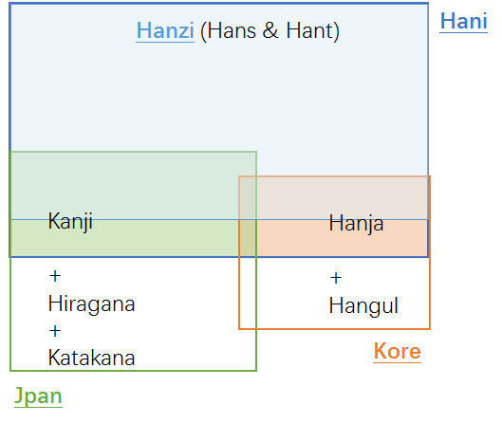
CGP CJK Coordination
2
Script and Languages Covered
Language | ISO 15924 Code | Countries | Local Names of the Script
Chinese | cdo, cjy, cmn, cpx, czh, czo, gan, hak, hsn, lzh, mnp, nan, wuu, yue, zho | China | 汉字 Hanzi
Japanese | jpn | Japan | 漢字 Kanji
Korean | kor | Korea | 한자 Hanja

Slide 28
CJK Coordination
2
Coordination within CGP
  Repertoire = CDNC + dotAsia
  Variant Mappings = CDNC + dotAsia + CGP Internal Review
MSR3
MSR2
dotAsia 122
CDNC & dotAsia 19561
dotAsia
19683
CDNC
19561
2 CDNC only
in MSR3

Slide 29
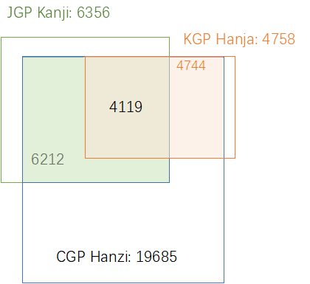
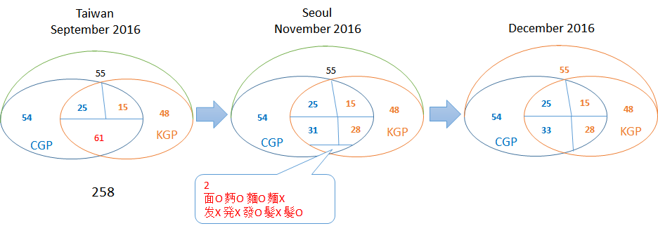
CJK Coordination
2
Coordination between C, (J) and K
  445 variant mapping entries
  146 unacceptable variant groups
CGP
CGP
CGP
KGP
KGP
KGP
Phase0 Phase1 Phase2 Phase3 Phase4
Self-Review

Slide 30
3
CGP Character source
MSR3
MSR3
IICORE∩JGP
IICORE∩KGP
IICORE∩JGP
IICORE∩KGP
42
42
TGSCC 18
TGSCC 18
dotAsia Unqiue 124
dotAsia Unqiue 122
2
2
19559
19561
CDNC
2015
CDNC
2018

Slide 31
3
CGP C-K Coordination Rollback
Statistics of disputed groups in .CN/TW/HK/网址 registration database
C Keep | Type1 | Number of labels containing each disputed variant char > 0; Semantic meaning of variant char in the labels are the same; CGP would insist to KEEP them as variants | 97 | 141
 | Type2 | Number of labels containing one disputed variant char ≈ 0; Semantic meaning of variant char in the labels are the same; CGP would insist to KEEP them as variants | 44
C Drop | Type3 | Number of labels containing each disputed variant char ≈ 0; CGP would DROP the variant mappings and split them into independent characters | 12 | 117
 | Type4 | Number of labels containing one disputed variant char ≈ 0; CGP would DROP the variant mappings and split them into independent characters | 67
 | Type5 | Number of labels containing any disputed variant char != 0; But semantic meaning of the chars in the labels NOT the same; CGP would DROP the variant mappings and split them into independent characters | 38
CK Coordination
... ...
146 Groups
445 entries
∩ 117 Groups
CK Coordination
... ...
327 entries

Slide 32
CGP C-K Coordination Rollback
3
Reduce the number of multiple allocatable labels
--Add 29 entries with multiple allocatalbe variant charcters
number | Original | Allocatable Simp | Allocatable Trad
2 | A | AB | A
1 | A | AB | C
103 | A | A | AB
23 | A | A | BC
5 | A | A | ABC
1 | A | A | ABCD
number | Original | Allocatable Simp | Allocatable Trad
4 | A | AB | A
1 | A | AB | C
1 | A | BC | A
127 | A | A | AB
23 | A | A | BC
7 | A | A | ABC
1 | A | A | ABCD
135
number | Original | Allocatable Simp | Allocatable Trad
2 | A | AB | A
1 | A | BC | A
24 | A | A | AB
2 | A | A | ABC
164
29

Slide 33
Visual Similarity
4
Unicode consortium‘s confusables list https://www.unicode.org/Public/security/11.0.0/confusables.txt
Source | Glyph | Target | Glyph
53E3 | 口 | 56D7 | 囗
571F | 土 | 58EB | 士
58AB | 墫 | 58FF | 壿
676E | 杮 | 67FF | 柿
8D7F | 赿 | 8D86 | 趆
9E42 | 鹂 | 9E43 | 鹃
Disposition Pinciple:
Non-moden used ones will be treated as visual identical variants
-- 58AB墫 & 58FF壿、676E杮 & 67FF柿、8D7F赿 & 8D86趆
Some will be kept with explaination
-- 571F土 & 58EB士、9E42鹂 & 9E43鹃
Some will be blocked as radical
-- 56D7 囗
Source | Glyph | Target | Glyph
C2A5 | 슥 | 4ECA | 今
C2B4 | 슴 | 5408 | 合
C4F0 | 쓰 | 4E1B | 丛
B9C8 | 마 | 535F | 卟
B258 | 뉘 | 723F | 爿
Source | Glyph | Target | Glyph
U+3078 | へ | U+30D8 | ヘ
U+30AA | オ | U+624D | 才
U+30AB | カ | U+529B | 力
U+30ED | ロ | U+53E3 | 口
U+30CF | ハ | U+516B | 八
U+30C8 | ト | U+535C | 卜
U+30CB | ニ | U+4E8C | 二
U+30A8 | エ | U+5DE5 | 工

Slide 34
Visual Similarity
4
https://www.icann.org/en/system/files/correspondence/wei-et-al-to-marby-25jan19-en.pdf
IP
Consultation
CGP
Repertoire
Variant Set
WLE
XML LGR
CJK Coordination
LGR
(Allocatable Labels)
Evaluation
(including Visual Similarity)
Appllicaiton
Delegation

Slide 35
Next Step
5
C-K Coordination Rollback
  Option1: back to 117 groups (Phase 1）
  Option2: back to 0 groups （Phase 0）
Visual Similarty
  Option1: leave the issue to evaluation process
  Option2: Solve 6 Hanzi-Hanzi pairs
  Option3: Import Kanji-Hanzi and Hangual-Hanja pairs

Slide 36
Japanese Generation Panel Update
Yoshiro Yoneya
J-GP Member

Slide 37
Agenda
1
2
3
Steps of Japanese Generation Panel (JGP)
Generation Panel Membership
Overview of the Japanese Root LGR
4
5
6
Coordination among Chinese/Japanese/Koean GPs
Reduction of allocatable variant labels
Handling characters with visual similarity
Notes:
This is a stylized agenda slide for your presentation.
To delete a box, if there are too many boxes, click the edge of the box, ensure the entire box is highlighted, then DELETE.
To update the numbers and text, click inside the circle for the numbers or in the box for the text, revise the text.

Slide 38
Steps of Japanese Generation Panel (JGP)
1
Mandate
  Proposing LGR for TLDs of Japanese language/scripts
  that co-exists in harmony with LGRs for other languages/scripts
Steps
  Step1 : Populate JGP with diverse experts (Aug/2014~)
  Step2 : Define the requirements and basic framework of Japanese
  LGR based on the expertise and experience of Japanese
  IDNs (~April/2015)
  Step3 : Coordinate with other language Generation Panels
  whose languages interrelated with Japanese (~February/2017)
  Step4 : Finalize LGR following necessary consultation with IP and
  Japanese community (March/2017~)
We are still here!
Rather, we are requested by ICANN/IP to go back to Step2

Slide 39
Generation Panel Membership
2
Hiro Hotta (chair)
  Policy/business aspects of registry/registrar
Akinori Maemura (vice chair)
  Internet governance and domain name in general
Shigeki Goto
  Internet in general
Kazunori Konishi
  Internet in general
Tsugizo Kubo
  Trademarks and domain names
Yoshitaka Murakami
  Trademarks and gTLD markets from registry/registrar perspective
Shuichi Tashiro
  Character codes
Yoshiro Yoneya
  Technical aspects of IDN, LGR

Slide 40
Overview of the Japanese Root LGR
3
Scopes of the character codes
  Kanji, Hiragana, Katakana (can be mingled in a label)
    JIS (Japanese Industrial Standard) level-1 and level-2
    >6,000 characters
Variants
  For Kanji
    Japanese LGR will define no variants for itself
    Final Japanese LGR will import (= passively adopt) variants defined by Chinese LGR and Korean LGR
  For Hiragana, Katakana
    No variants
  No variants for visual similarity : still unresolved
WLE (whole label evaluation)
  Rules for reduction of allocatable variants

Slide 41
Coordination among Chinese/Japanese/Korean GPs
4
Chinese LGR
e.g., 漢
Japanese LGR
Han*
Korean LGR
e.g., ひ
e.g., ア
e.g.,한
script
Hira
gana
Katakana
Hangul
・・・
・・・
coordination
Japanese GP
Chinese GP
Korean GP
* “Han” is called “Kanji” in Japan, “Hanja” in Korea
Coordinated definition of variants has been completed (~February/2017)

Slide 42
Reduction of allocatable variant labels
5
Any combination of characters is allowed in Japanese labels as in the case of Japanese words in daily life
The above may make the number of variant strings very huge, considering that many variant groups are imported from Chinese and Korean Root LGRs
  E.g., 慶応大学 has 3 variant strings –
  慶應大学 / 慶応大學 / 慶應大學
Reduction of the number of allocatable variant labels was requested by ICANN/IP to prevent the explosion of root zone size
With IP’s suggestion, JGP solved it by limiting allocatable strings by employing the notion that “allocatable labels consist of daily-use (Joyo) Kanji
  It reduces the maximum number of allocatable labels of an actually registered Japanese label under .JP from 486 to 8

Slide 43
Handling characters with visual similarity
6
Initial design of Chinese/Japanese/Korean Root LGRs is to define variants as characters with the same meaning and pronunciation having different forms (i.e., different versions of the same character)
  Despite the above, initial design of Japanese Root LGR has no variants, except those variant definitions imported from Chinese and Korean LGRs
However, ICANN/IP started to request Chinese/Japanese/Korean GPs to handle characters with visual similarity in their Root LGRs (March/2017)
Chinese/Japanese/Korean GPs decided to formally request ICANN to withdraw such request
  Correspondence to Göran Marby on 25 January 2019
  Response from Cyrus K. Namazi on 15 February 2019
    Not yet resolved

Slide 44
The correspondence : abstract
CJK GPs believe that incorporating variants into LGR in order to handle visual similarity is improperly over-loading LGR
visual similarity issue, if any, should be resolved outside LGR
Background reasons
  “Procedure to Develop and Maintain the Label Generation Rules for the Root Zone in Respect of IDNA Labels" describes that "While resolving string-confusability issues is beyond the scope of this project, the integration panel will need to ….”. This indicates that string-confusability including visual similarity of characters does not necessarily have to be solved in LGR
  gTLD Applicant Guidebook describes “similarity review will be conducted by an independent String Similarity Panel”, which is further augmented by the String Confusion Objection process … as included in the GNSO New gTLD policies. Likewise, string similarity and confusability has been taken into consideration for the IDN ccTLD Fast Track process
  for any script, visual similarity can only be judged by human intuition which varies with the individuals. And we think solid definition of “visual similarity” must be made only when the definition is universally understandable and precisely definable if it’s ever defined in LGR.

Slide 45
Korean Generation Panel Update
Dongman LEE

Slide 46
Agenda
1
2
3
Script(s) Covered and where they are used
Members of the GP
Work achieved
to-date 1
(K-LGR v1.0)
4
5
6
Work achieved
to-date 2
(Coordination between KGP and CGP)
Work achieved
to-date 3
(Brief History of KGP History)
Future Plan and Schedule
Notes:
This is a stylized agenda slide for your presentation.
To delete a box, if there are too many boxes, click the edge of the box, ensure the entire box is highlighted, then DELETE.
To update the numbers and text, click inside the circle for the numbers or in the box for the text, revise the text.

Slide 47
Script(s) Covered by K-LGR and Where They Are Used
K-LGR covers Korean script (= Hangul + Hanja)
“Korean script” usually means “Hangeul” or “Hangul”. However, in the context of the Korean LGR (K-LGR), Korean script is a union of
Hangul (한글) and Hanja (한자).
Korean language has a long history, more than 2000 years.
Hangul: invented in 1443.
Hanja was used before Hangul was invented. Hanja is still used in Rep. of Korea.
Korean language is mainly used in Rep. of Korea (S. Korea) and Democratic People’s Republic of Korea (North Korea).
- Also used by Korean people living in China, USA, Japan, Europe, Brazil, Russia, Vietnam, and so on.

Slide 48
Members of the GP
Technical Experts: Kyongsok KIM (Chair), Dongman LEE
Linguists: Jeongdo CHOI (Hangul), Sanghyun SHIN (Hanja), Sungduk CHO (Hanja)
Policy Makers: Youngeum LEE, Youn Jung PARK
Community: Eunjun JEON, Boknam YUN, Byeongil OH
Registry: Jinhyun CHO, Minjung PARK, Yunmi CHOI, Ryoung CHAE, Minjee KIM
Registration Agency: Seong-jin PARK, ChangKi JANG, Myungsoo LEE

Slide 49
Work Achieved To-Date by KGP – 1:
K-LGR v1.0 (2017.12.10.)
K-LGR v1.0 (2017.12.10.): repertoire and variant groups
  Hangul: repertoire – 11172 syllables, no variant groups
  Hanja: repertoire – 4758 characters, 152 variant groups
  Variant groups composed of Hangul syllables and Hanja chars: 5
  (3 Hanja chars: out-of-repertoire variant)
4758 Hanja chars in K-LGR v1.0

Slide 50
Work Achieved by KGP – 2:
Public Comments Reviewed
A summary of public comments
  Including Hanja in K-LGR repertoire: positive
  Allowing Hangul-Hanja mixed label: several negative comments, some positive comments
  Hangul-Hanja variant group: CJK agreement needed
  Specific details need be corrected/modified
Examples of issues raised by Mr. Byeon
  References; quotes; etc.
  Many Hanja chars allowed for personal names not included in K-LGR
  Hangul Jamo not included in K-LGR (actually not in MSR-3)
  More Hangul-Hanja variant groups need be included

Slide 51
Work Achieved by KGP – 2:
Public Comments Reviewed
Requests by Mr. Byeon for specific details
  Reviewed and discussed.
  Mostly accepted in principle and will be reflected in the next version of K-LGR
  Hangul-only labels, Hanja-only labels, Hangul-Hanja mixed labels
  KGP reconfirmed that there was a general consensus to allow Hangul-only labels and Hanja-only labels;
  However, KGP has not reached a conclusion as to whether to allow Hangul-Hanja mixed labels.

Slide 52
Plan and next steps
Waiting for the conclusion as to whether to include cross-script (visually identical) variant groups
  variant groups of Hangul syllables and Hanja characters;
  variant groups of Kana and Kanji characters
Hangul-Hanja mixed labels
  Decide on a final conclusion
  Revision of K-LGR 1.0
  After the above issues are resolved, K-LGR will be revised and published.

Slide 53
Work Achieved by KGP – 3:
Brief History of KGP Activities
Dec. 2013: Korean GP (KGP) Organized
May. 2015: K-LGR v0.1
Feb. 2016: The Korean community “formally” forms Generation Panel for Developing the Root Zone Label Generation Rules (LGR)
Dec. 2017: K-LGR v1.0
Jan. ~ Mar. 2018: public comments for K-LGR v1.0
Mar. ~ Dec. 2018: public comments for K-LGR v1.0 reviewed for possible reflection in the next version of K-LGR
34 KGP meetings
Several CJK coordination meetings during ICANN meetings 49 ~ 63
Several CJK coordination meetings in Rep. of Korea, China, and Taiwan.

Slide 54
Future Plan
Jan. 26
2018
Mar. 17
2018
Mar 24
2018
??
2019
Next
Steps
Public Comment: Open Date
Public Comment:
Close Date
Summary Report
Due Date
Rev. K-LGR Proposal with any public comments reflected
IP evaluates the final
K-LGR Proposal
K-LGR will be integrated into a subseq. Ver. of the RZ-LGR
Notes:
To adjust the length and width of the arrow, click on the arrow, grab a corner, and lengthen or shorten, depending on your preference.
To add a bubble, click on the bubble, ensure it is fully highlighted, COPY and PASTE. Then drag the bubble to your preferred placement.
To delete a bubble, click on the bubble, ensuring it is highlighted and click DELETE. If you make a mistake, go to your top bar on PP and click EDIT, UNDO

Slide 55






Engage with ICANN and IDN Program
Thank You and Questions
Visit us at icann.org/idn
Email: IDNProgram@icann.org
@icann
facebook.com/icannorg
youtube.com/icannnews
flickr.com/icann
linkedin/company/icann
slideshare/icannpresentations
soundcloud/icann

