Slide 1
NPOC Webinar Series (Introduction)
Webinar 1, 3 February 2021
Adam Peake, ICANN GSE Europe
adam.peake@icann.org

Slide 2
NPOC Webinar Series – Spring 2021
Webinars 1 & 2. Feb 3 and Feb 10. 14:00 UTC
Introduction to the webinar series, who we are and what we're going to discuss
Introduction to ICANN, what we do and how we do it
How the DNS works
Introduction to the registrant program
ICANN multistakeholder model, NPOC's place and role
Introduction to PDP, "consensus policies" and contracts

Slide 3
NPOC Webinar Series – Spring 2021
Webinars 3, 4 & 5 (5.5). Feb 17, Feb 24 and
March 3. 14:00 UTC
Registrant Rights and Responsibilities
Registering a domain name
Maintaining/managing and renewing domain names
Rights protection mechanisms, UDRP/URS
Review of relevant consensus and other policies that impact registrants (WDRP, Transfer Policy, ERRP, etc.)
Protecting and securing a domain names (passwords, authentication, lock)

Slide 4
NPOC Webinar Series – Spring 2021
Webinars (6 & 7). March 31 and April 7. 14:00 UTC
Good domain name security management, projects, and campaigns, HTTPS
Introduction to DNSSEC, what it protects against and how
DNSSEC implementation, NPOC promotion of DNSSEC implementation to NGOs
DoH (DNS-over-HTTPS) and DoT (DNS-over-TLS)
Review and wrap-up

Slide 5
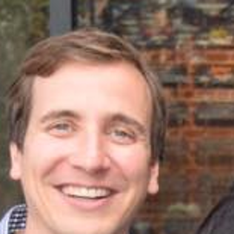
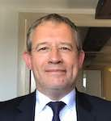
Staff Team – NPOC Webinar Series
Brian Gutterman - Program Manager, Strategic Initiatives GDS (Registrant program)
Patrick Jones, Sr. Director, Global Stakeholder Engagement (DNS fundamentals)
Adam Peake, Global Stakeholder Engagement (ICANN organization and multistakeholder approach)

Slide 6
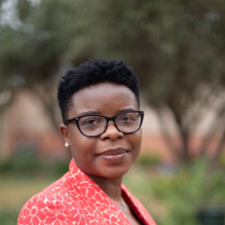
Staff Team – NPOC Webinar Series
Maryam Bakoshi, SO/AC Collaboration Services Sr. Coordinator, CSG/NCSG
Brenda Brewer, Community Operations Coordinator

