Slide 1
WHOIS1 Rec #3: Outreach
Agenda item #11
Time: 15:45-16:15
Presenter: Alan Greenberg
Subgroup Members: Alan, Carlton, Erika
Subgroup Wiki: https://community.icann.org/x/5JlEB

Slide 2
WHOIS1 Rec #3 – Outreach
WHOIS1 Recommendation
Rec 3 – ICANN should ensure that WHOIS policy issues are accompanied by cross-community outreach, including outreach to the communities outside of ICANN with a specific interest in the issues, and an ongoing program for consumer awareness.
Questions the subgroup attempted to answer when assessing this objective:
Review the multiple "outreach" resources with a specific focus on identifying:
Areas where there we inconsistencies, errors and out of date info
Gaps in the documentation
Review the various outreach events and activities
Research and background materials used to answer questions:
WHOIS1 Final Report, Action Plan, & Implementation Reports
Implementation Briefing Presentation, Answers to Questions, & Written Briefing
Documents cited in briefing on Recommendation 3, including
WHOIS Information Portal and Consolidated WHOIS Lookup Tool
Registrant's Benefits and Responsibilities
2013 RAA - see Section 9
Information for Registrars and Registrants
Registrant Educational Series
SME Answer to subgroup’s question on outreach activities

Slide 3
WHOIS1 Rec #3 – Outreach
Describe your methodology to answer questions and analyze the materials
To conduct its research, all members of this subgroup reviewed background materials followed by discussion within the sub-group
Based on the analysis, what are the main findings?
In summary, the Recommendation was carried out, but it was not well integrated with other WHOIS-related information.
Significant outreach to communities within ICANN has been carried out.
[Add analysis of outreach to communities outside of ICANN here.]

Slide 4
WHOIS1 Rec #3 – Outreach
Based on findings, the subgroup identified the following problems/issues
There is a wide variety of information related to WHOIS, some is well integrated and some very disjoint. Of necessity this information is somewhat interwoven with other information related to 2nd level gTLD domain names.
The information and documents cover several "generations" and do not integrate well.
Moreover a typical user or registrant will not readily be able to identify where they need to look for information, and identifying one of the multiple locations will not lead them to the others.
The problem is exacerbated by the introduction of the terms RDS (and at times RDDS) to replace WHOIS
It is clear that although WHOIS is an issue of interest to those within ICANN, from a Registrant perspective, it needs to be well integrated with other information with relation to gTLD registration. At the same time, due to interest in privacy issues, it is a subject that stands on its own as well.

Slide 5
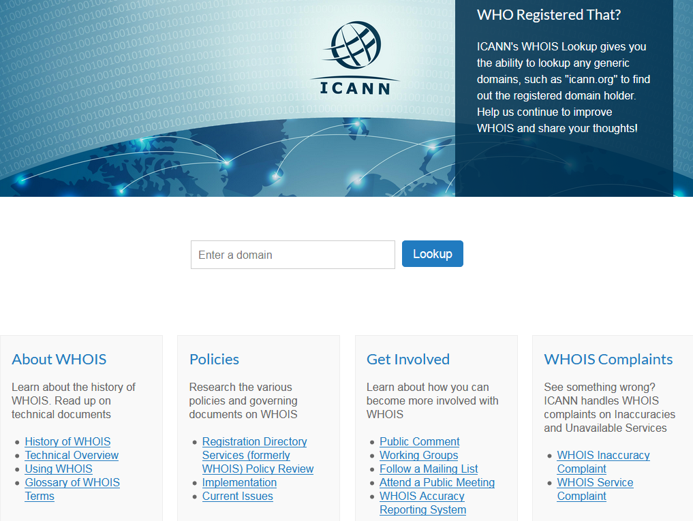
WHOIS1 Rec #3 – Outreach
Examples:

Slide 6
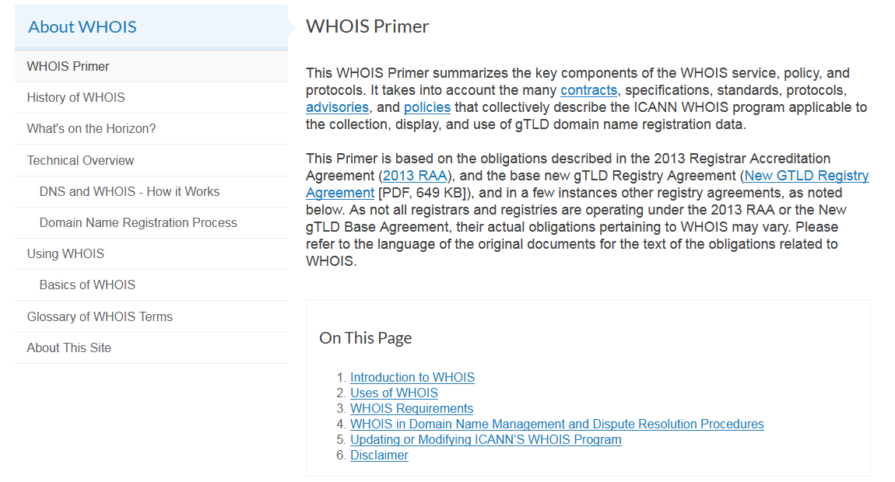
WHOIS1 Rec #3 – Outreach

Slide 7
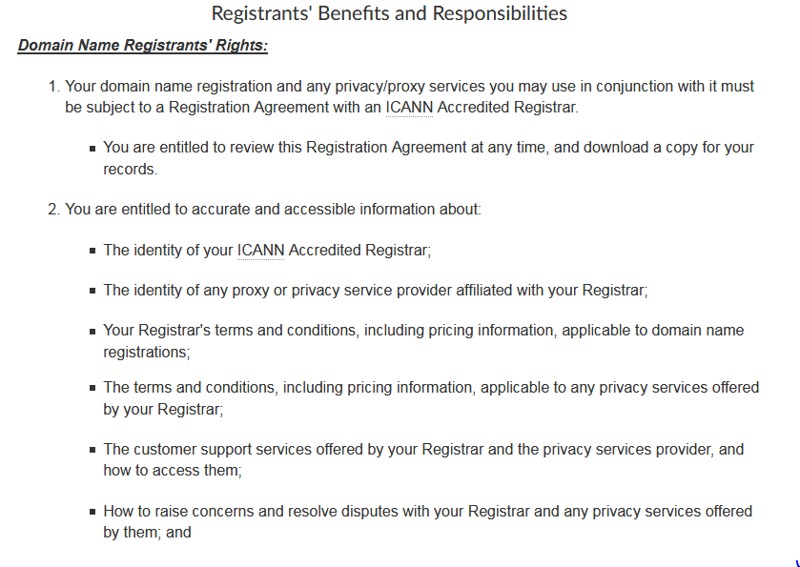
WHOIS1 Rec #3 – Outreach

Slide 8
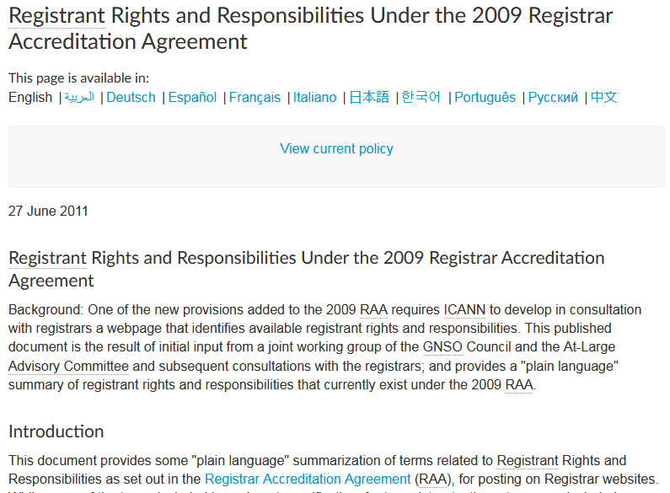
WHOIS1 Rec #3 – Outreach

Slide 9
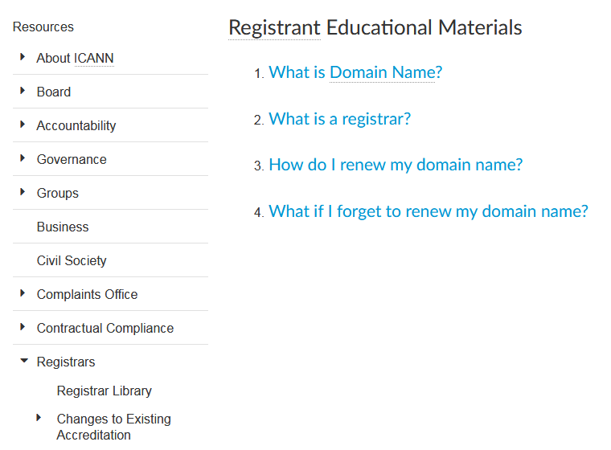
WHOIS1 Rec #3 – Outreach

Slide 10
WHOIS1 Rec #3 – Outreach

Slide 11
WHOIS1 Rec #3 – Outreach
To address the above problems/issues, the subgroup proposes the following recommendations (if any)
To be better formulated:
All public-facing information related to gTLD registrations needs to be reviewed and reformulated. This includes the RAA-related documents on registrant rights, benefits and responsibilities, the WHOIS portal, and the education tools (ICANN Learn, Video tutorials), ensuring up-to-date and consistent messaging.
Timing for this needs to factor in the timing of both interim and long-term GDPR and privacy considerations.

