Slide 1
WHOIS1 Recs #15-16: Plan & Annual Reports
Agenda Item #6
Time: 09:45-10:15
Presenter: Lili Sun
Subgroup Members: Lili, Alan, Chris
Subgroup Wiki: https://community.icann.org/x/9plEB

Slide 2
WHOIS1 Recs #15-16: Plan & Annual Reports
WHOIS1 Recommendations
Rec 15 – ICANN should provide a detailed and comprehensive plan within 3 months after the submission of the Final WHOIS Review Team report that outlines how ICANN will move forward in implementing these recommendations.
Rec 16 – ICANN should provide at least annual written status reports on its progress towards implementing the recommendations of this WHOIS Review Team. The first of these reports should be published one year, at the latest, after ICANN publishes the implementation plan mentioned in recommendation 15, above. Each of these reports should contain all relevant information, including all underlying facts, figures and analyses.
Questions the subgroup attempted to answer when assessing this objective:
Check whether Action Plan properly addressed the other 16 recommendations
Assess the effectiveness of the already-published WHOIS Annual Reports
Research and background materials used to answer questions:
WHOIS1 Final Report, Action Plan, & Implementation Reports
Implementation Briefing Presentation, Answers to Questions, & Written Briefing
ICANN 5-Year Strategic Plan and ICANN FY2017 Operating Plan and Budget
2013-2016 WHOIS Annual Reports

Slide 3
WHOIS1 Recs #15-16: Plan & Annual Reports
Describe your methodology to answer questions and analyze the materials
Review all the background materials to assess whether the WHOIS1 Recs #15-16 have been implemented, have the objectives been met.
Plan to base analysis in part upon key findings for all other WHOIS1 Recs
Based on the analysis, what are the main findings?
This subgroup couldn’t find any separate work plan with milestones, deliverables and/or specific deadlines beyond the Action Plan.
Except ICANN FY 2013 Operating Plan and Budget, this subgroup has difficulties in tracking the budget and resources allocated to the implementation of WHOIS1 recommendations in the following years.
The WHOIS Improvements Annual Report contains elemental information about WHOIS policy development, fact-based progress about the Action Plan, but there are hardly figures and analysis on specific improvement, e.g. data accuracy, outreach.
There has been a delay for ICANN to publish WHOIS Improvements Annual Report since 2016. And the annual report for 2016 was published till 1 September 2017, the annual report has not been ready for 2017 yet.

Slide 4
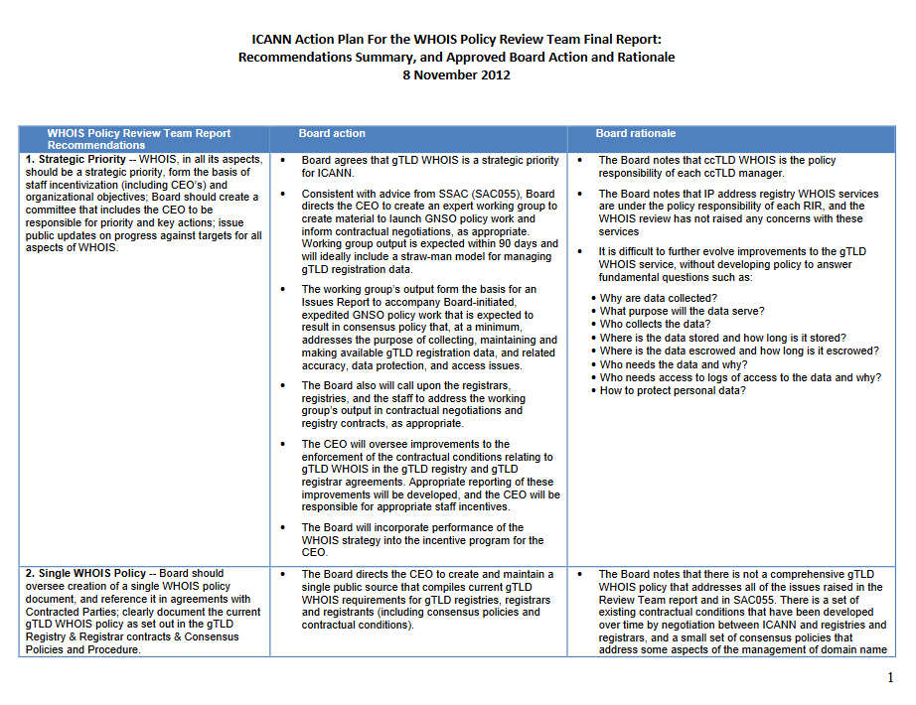
WHOIS1 Recs #15-16: Plan & Annual Reports

Slide 5
WHOIS1 Recs #15-16: Plan & Annual Reports
Describe your methodology to answer questions and analyze the materials
Review all the background materials to assess whether the WHOIS1 Recs #15-16 have been implemented, have the objectives been met.
Plan to base analysis in part upon key findings for all other WHOIS1 Recs
Based on the analysis, what are the main findings?
This subgroup couldn’t find any separate work plan with milestones, deliverables and/or specific deadlines beyond the Action Plan.
Except ICANN FY 2013 Operating Plan and Budget, this subgroup has difficulties in tracking the budget and resources allocated to the implementation of WHOIS1 recommendations in the following years.
The WHOIS Improvements Annual Report contains elemental information about WHOIS policy development, fact-based progress about the Action Plan, but there are hardly figures and analysis on specific improvement, e.g. data accuracy, outreach.
There has been a delay for ICANN to publish WHOIS Improvements Annual Report since 2016. And the annual report for 2016 was published till 1 September 2017, the annual report has not been ready for 2017 yet.

Slide 6
WHOIS1 Recs #15-16: Plan & Annual Reports
Based on findings, the subgroup identified the following problems/issues
The Plan and Annual Reports partly met the objectives of WHOIS1 Recs #15-16.
To address the above problems/issues, the subgroup proposes the following recommendations (if any)
Plan & Annual Reports are essential to guarantee the effective implementation of any recommendations, more specific methodologies on Plan & Annual Reports should be taken in future.

