Slide 1
Overview of ICANN Process for Engaging Qualified Contractor to Support Review Teams
20 October 2017

Slide 2
Engaging Qualified Contractors for Specific Review Teams
Objective: follow an accountable process, in line with transparency obligations, to select qualified and independent contractors to perform work requested by a Review Team (RT).
Guiding principles: good practices followed by similar organizations to ensure fair, objective, well-documented and predictable process of selecting qualified independent contractors based on RT specifications; RT point person(s) to speak for RT with a singular voice and aid with efficient engagement and management.
ICANN Bylaws Section 4.6 (a) (iv): “Review teams may also solicit and select independent experts to render advice as requested by the review team. ICANN shall pay the reasonable fees and expenses of such experts for each review contemplated by this Section 4.6 to the extent such fees and costs are consistent with the budget assigned for such review. Guidelines on how review teams are to work with and consider independent expert advice are specified in the Operating Standards.”
Notes:
This slide can be used for text, graphics or any other elements.

Slide 3
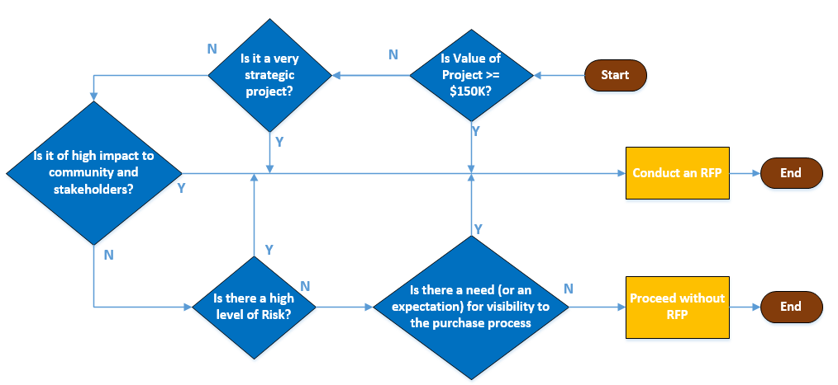
ICANN’s RFP Policy and Guidelines
RFP Policy: A Request for Proposal (RFP) is required to optimally identify provider(s) for projects that are valued at >= US$ 150K
An RFP may also be conducted for other reasons
Decision Tree to determine if an RFP should be conducted:
For accountability & transparency reasons RFPs may also need to be conducted below the $150K threshold, if the elements of the project warrant it (see decision tree)

Slide 4
Steps for Engaging Contractors as Independent Experts
Standard steps for engaging contractors as Independent Experts to support the work of the Review Team:
Requirements
Define & document
Funding
Ensure expenditure is consistent with budget assigned to Review
Candidates
Communicate with prospective candidates
Secure RT approval
Solicit qualified candidates
Gather information from interested candidates
Evaluate skills, potential conflicts, adherence to ICANN standards
Engagement
Identify finalist
Negotiate terms
Execute professional Services Agreement
Scope of work
Skills and experience
Timeline & milestones
Deliverables
Designate RT point person(s) to speak with a singular voice (can be chair(s) or any other RT member); RT member signs NDA
ICANN organization proposes to develop more detailed steps, if necessary, in collaboration with the Review Team

Slide 5
Roles and Responsibilities
Review Team (RT)
Determine scope of work, skills/expertise, deliverables, timeline
Liaise with RT and ICANN Procurement
Procurement
Identify contractors based on criteria
Share responsibility with designated point person(s) from RT for selection of suitable candidate
Determine appropriate procedural steps based on scope of work
Evaluate candidates
Negotiate contract
Approve expenditure
Share request for submissions with network
Announce request for submissions or proposals
Designate point person(s) from RT to select and interact with contractor; signs NDA
Manage operational elements, financials and deliverables based on contractual terms
Manage invoicing and remittances
Ensure compliance with contractual terms
Ensure compliance with procurement process and best practices
Inform applicants that some information will be shared with designated point person(s) (no cost or contractual terms will be shared)
Manages substantive aspects of work (as defined in statement of work and within budgetary constraints)
MSSI
Designated point person(s)* share(s) responsibility with ICANN organization for selection of suitable candidate **
* can be chair(s) or any other RT member at RT/leadership’s discretion
** ICANN organization is building out a sub-process for this step.

Slide 6
Options for Designated Review Team Member
Signed NDA
Receives redacted materials (financial info removed) from candidates
Participates in interviews
No NDA
Receives limited materials from candidates: materials are redacted and anonymized
No participation in interviews
Participates in discussion with ICANN org regarding selection of candidate
No participation in discussion with ICANN org regarding selection of candidate

Slide 7
Fast-Track Process
Preparation
Requirement Gathering
Input from Working Group/Review Team
Creation/Updating of Documents
Selected Working Group/Review Team Member Signs NDA
Vendor Communication
Posting
Announcement released
Q&A
Respondents submit proposals
Planning
Evaluation
Consolidation & Analysis of responses
Evaluation of responses against criteria
Candidate (finalists) presentations and interviews
Any other follow up / due diligence
Contracting
Negotiations
Contracting
Award to finalist
Implementation

Slide 8
Selection Process
Materials used during the selection process are confidential and will not be shared on public mailing lists or on the wiki.
ICANN org receives materials; redacts financial information
Materials sent to designated RT Members off-list¹
Designated RT Members/ICANN org complete scorecards
ICANN org to coordinate interviews² with designated RT Member(s)
Designated RT Members/ICANN org re-score based on interviews
Designated RT Members/ICANN org select candidate
¹ Designated Review Team members must sign Non-Disclosure Agreement in order to participate in the selection process.
² Number of interviews to be determined.

Slide 9
Selection Guidelines
Designated Review Team members sign Non-Disclosure Agreement
ICANN org and designated Review Team members agree on scorecard weights
All financial information submitted by candidate(s) will be redacted prior to distribution to designated Review Team members
Applicant materials are confidential and cannot be distributed to Review Team, ICANN community, or mailing lists
Wiki page to be created and will include:
Announcement and project overview document
Anticipated timeline of project and expected deliverables
Number of applications received
Announcement of selected candidate after contract signed
Presentations/interviews with applicants will not be recorded

Slide 10
Notes
ICANN’s current process for engaging contractors reflects enhancements and streamlining to ensure the most effective outcome in line with best practices. There is no longer a distinction in the process based on expenditure thresholds, as may have been the case several years ago. The process and the standards outlined here and discussed with the Review Team leadership are being incorporated in the Draft Operating Standards for Specific Reviews.
The term “Request for Proposal (RFP)” refers to the act of documenting requirements and soliciting interested contractors to provide written responses to ICANN organization to illustrate their qualifications and skills relative to the task at hand.
Notes:
This slide can be used for text, graphics or any other elements.

