Slide 1
Planning for Review Team Face-to-Face Meetings

Slide 2
Considerations for F2F Meetings
When recommending a location for your next F2F meeting there is more to consider than just cost. Taking into account who is attending, from how far and how many are traveling, consider the following:
Evaluate need for meeting
  What are the meeting objectives?
Suitability
  Does the location provide the proper environment including health and safety?
Location
  Easily accessible for international travelers?
  Are there visa requirements?
Availability & Size
  Is a venue available for the dates required?
  Does a venue provide the proper size room or rooms?
Facilities
  Availability of quality services for internet, audio/visual, catering and group meals?
Cost
  Does the venue fall within budget and agree to ICANN’s contract terms?

Slide 3
Six Steps for Pre-Planning Success
Select Meeting Dates
Select Destination
Determine Agenda and Requirements
MSSI: Submit Global Event Request Form
MSSI: Submit Travel Request
MSSI/ Meetings Team Coordination

Slide 4
Options Menu for All Day Face-to-Face Meeting
Service | ICANN Meeting or Offsite Venue | ICANN Office
Room rental | $5,000/day | No charge
Catering (breakfast, lunch, beverages, snacks) | $75/day per person | $75/day per person
Dinner – one scheduled RT dinner | $150/pp | $150/pp
Push-to-talk microphones & Audio Visual | $2,500/day | $1,000/day¹
Remote Participation Services (presentation laptop, Adobe Connect, stream audio, record audio) & Internet | $1,700/day | $500/day
Interpretation² | $2,600/day | Not available
Scribes | $2,500/day | $2,500/day
Flip chart/easel | $30 | No charge
Costs are estimated.
¹Los Angeles – no charge
²Available during ICANN Meeting engagement sessions and webinars only

Slide 5
Estimated Travel Expenses: ICANN62
Expense Type Based on Four (4) Supported Review Team Members | ICANN62
Airfare: Review Team Members | $6,350
Airfare: ICANN org | No charge
Hotel: based on six (6) nights | $200/night
Per Diem: based on seven (7) days | $65/day
Estimated Total | ICANN62
Total | $12,970
Costs are estimated and are subject to change.

Slide 6
Appendix

Slide 7
Step 1: Select Meeting Date(s)
Selecting the event dates for the meeting is one of the most important decisions to be made at the beginning of the F2F meeting planning process.
We recommend that you select the ”Primary Meeting Date(s)” and have at least one option for “Alternative Meeting Date(s)”. Keep in mind global holidays and other community related events.
Everything related to this meeting will be based on these selected dates, so ensure all stakeholders are in agreement on the date selection(s). Date(s) and destination(s) should often be presented together to allow for attendees to determine their travel time.
Meetings Team deadlines to request meetings:
  120 days to submit request for a face-to-face meeting
  90 days to submit travel request
REQUIRED ACTIONS:
  Select primary meeting date(s)
  Select alternative meeting date(s)
  Confirm stakeholder agreement on chosen dates

Slide 8
Step 2: Select Destination
Now that you have completed selecting dates for your meeting, you should determine the destination of your meeting. Often dates will determine the destination based on availability of venue space, which is why having primary and alternative selections is so important to the meeting planning process. However, having too many selections can also be detrimental to the planning process, so keep your planning to a primary selection and one alternative.
Considerations for selecting the location should include:
  Geographically central for most attendees
  Easily accessible and cost effective for International travelers
  Suitable and environmentally conducive for a productive meeting
  Economical and cost effective for your budget and attendees
  Availability of hotels and meeting venues
REQUIRED ACTIONS:
  Select primary destination
  Select one alternative destination

Slide 9
Step 2: Select Destination–Venue Selection Process
Selecting the appropriate venue is a integral part of the destination selection process. Based on the considerations below, these will determine the selection of the venue and the destination city.
Considerations for selecting the venue include:
  Geographically central for most attendees
  Availability of hotel room accommodations and meeting space(s)
  Suitable and environmentally conducive for a productive meeting
  Economical and cost effective for your budget and attendees
  Agreeable to ICANN contracting terms
  Easily accessible and cost effective for International travelers
MEETING TEAM ACTIONS:
  Establish availability of venue space and accommodations
  Propose options to requesting team/department
  Start the contracting process with the selected venue

Slide 10
Step 2: Select Destination – ICANN Offices
Maximum conference room seating available at ICANN offices:
Brussels
20
Geneva
10
Istanbul
16
Los Angeles
24
Singapore
12
Washington, D.C.
20

Slide 11
Step 2: Select Destination – City Cost Examples
Los Angeles
Barcelona
38 International Attendees
3 Day Meeting, 4 Hotel Nights
$58,000 Average Overall Expense
$1,530 Average Cost per Attendee
(Pricing w/venues near ICANN Office)
38 International Attendees
3 Day Meeting, 4 Hotel Nights
$76,000 Average Overall Expense
$2,000 Average Cost per Attendee
Singapore or Hong Kong
Amsterdam
38 International Attendees
3 Day Meeting, 4 Hotel Nights
$62,000 Average Overall Expense
$1,630 Average Cost per Attendee
38 International Attendees
3 Day Meeting, 4 Hotel Nights
$77,000 Average Overall Expense
$2,030 Average Cost per Attendee
Washington D.C.
New York City
38 International Attendees
3 Day Meeting, 4 Hotel Nights
$71,000 Average Overall Expense
$1,860 Average Cost per Attendee
38 International Attendees
3 Day Meeting, 4 Hotel Nights
$99,000 Average Overall Expense
$2,610 Average Cost per Attendee
*Air transportation for these destinations is not factored into the overall expenses
**Seasonal selection & other factors can change prices significantly – these prices are only a snapshot of costs at a given time.

Slide 12
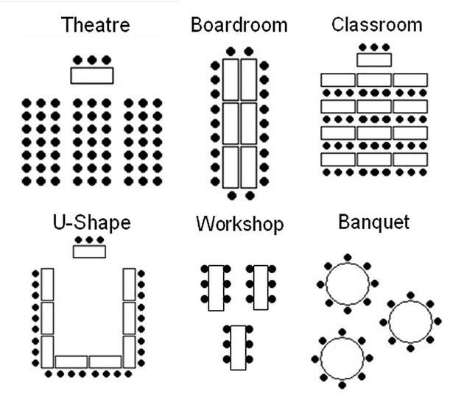
Step 3: General Agenda & Requirements
The third most important step of pre-planning for a meeting is having a basic idea of how the meeting will flow and be conducted. You do not need the specifics of a detailed agenda, but you do need to determine the following items:
  How many people are anticipated to attend?
    Is this a set list of attendees with potential community observers?
    Is this a closed private meeting or open to the public?
    Will you want to have remote participation of attendees?
  What type of room setup(s) will be most effective for this meeting?

Slide 13
Step 3: General Agenda & Requirements (con’t)
General Agenda & Requirements Continued:
  Agenda Overview
    What is the general idea of the meeting agenda?
    How many meeting rooms in total will you need?
    Will you utilize a plenary room for the entire meeting?
    Will you need to have breakout sessions in different rooms?
  Budget
    What is your overall budget allocation for this meeting?
REQUIRED ACTIONS:
  How many attendees anticipated? (Example: 20-25; 150-175)
    This number is very important to be accurate, as it determines your meeting room size, hotel accommodation needs. The goal is to be within 10% accuracy.
    Determine if observers will attend. If so, how many do you anticipate?
  How many meeting rooms and the setup allocations for each?
  What is the allocated budget for this meeting?

Slide 14
Step 4: Submit Global Event Request
After determining and completing Steps 1 thru 3, the MSSI Team will submit a request to the Meetings Team. The request will trigger several notifications and begin the formal process of planning your meeting, including:
  Meetings Team event planner assigned
  Notification to the Travel Team
  Notification to the Security Team
  Notification to the Meetings Technical Services Team
REQUIRED ACTIONS:
  MSSI-Secretariat to submit the request 120 days prior to meeting date

Slide 15
Step 5: Submit Travel Request
The MSSI Team will submit a request to Constituency Travel. The request will trigger several notifications and begin the process of arranging for Review Team travel, including:
  Constituency Travel to send welcome email to new travelers requesting required travel forms
  Constituency Travel to send welcome email to Review Team members notifying them of approved travel dates
REQUIRED ACTIONS:
  MSSI-Secretariat to submit the request 90 days prior to meeting date
  Review Team Members to respond to Constituency Travel emails in a timely manner to ensure lowest possible fares

Slide 16

Step 6: MSSI and Meetings Team Coordination
The MSSI and Meetings Teams will coordinate all logistics on behalf of the Review Team to ensure a productive face-to-face meeting.

