Slide 1
RDS-WHOIS2 RT Leadership Call #16
31 January 2018

Slide 2
Agenda
Terms of Reference and work plan
Subgroups Progress
WHOIS1 Recommendation Briefings
Face-to-Face Meeting
Review of Milestones/Review Team Progress
Outreach Plan
Scheduling
A.O.B.

Slide 3
Terms of Reference and Work Plan
Request sent to Board Caucus Group
Informal input received from Chris on 19 January (plenary call)
How do you envision engaging the Review Team on deciding what edits need to be made?
Need for RT to identify objectives (if any) to be addressed after progress on GDPR compliance models.
Leadership to confirm new due date for ToR submission to Board.

Slide 4
Subgroups – First Pass Planning Document Status
# | Subgroup | Rapporteur | Status | Update Given
1 | WHOIS1 Rec #1 - Strategic Priority | Cathrin | DOCX | ✓
 | WHOIS1 Rec #2: Single WHOIS Policy | Carlton | DOCX | ✓
 | WHOIS1 Rec #3: Outreach | Alan | DOCX | ✓
 | WHOIS1 Rec #4: Compliance ⦿ | Susan | DOCX | ✓
 | WHOIS Rec #5-9: Data Accuracy | Lili | DOCX | ✓
 | WHOIS Rec #10: Privacy/Proxy Services | Volker | DOCX | ✓
 | WHOIS Rec #11: Common Interface | Volker
 | WHOIS Rec #12-14: Internationalized Domain Names | Dmitry | DOCX | ✓
 | WHOIS Rec #15-16: Plan & Annual Reports | Lili | DOCX | ✓
2 | Anything New | Stephanie
3 | Law Enforcement Needs | Thomas | DOCX | ✓
4 | Consumer Trust | Erika | DOCX | ✓
5 | Safeguard Registrant Data | Alan | DOCX | ✓

Slide 5
Subgroups – Required Actions
No papers for two topics and no Team greenlight on a number of plans
Suggestion: Leaders to individually each reach out to the rapporteur of the subgroups of which each is a member.
Suggestion: have rapporteurs for each subgroup confirm their respective subgroup(s) ‘s work statements on the next plenary call.
Suggestion: rapporteurs to set “internal deadline” – depending on their workload – for reading assignments to be complete.
Leaders to review subgroup membership to determine if assignments should be adjusted before moving into next phase.
Note: proposed subgroup report structure that we circulated a few months ago -https://community.icann.org/download/attachments/71604702/Proposed%20Subgroup%20Report%20Structure%20.docx?version=2&modificationDate=1510149120000&api=v2. This could be a useful tool for the discussion on next steps.

Slide 6
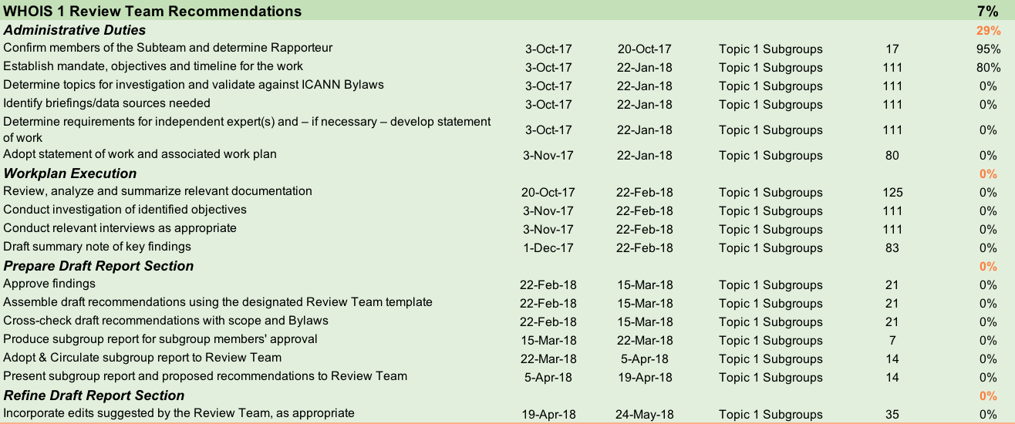
Subgroups – Next Steps

Slide 7
Subgroups - WHOIS1 Rec #4: Compliance
Meeting with Compliance Management at ICANN – Los Angeles Offfice
Date: February 2018
17:00 – 18:00 PT
Room: Spruce Goose Conference Room
Adobe room and bridge available
Members: Susan Kawaguchi, Erika Mann, Carlton Samuels, Chris Disspain, Thomas Walden
Set of questions prepared in anticipation of meeting

Slide 8
WHOIS1 Recommendation Briefings
ICANN org estimated that it would take approximately 8 weeks to fulfill the request.
ICANN org suggests having Review Team prioritize topics so materials can be sent, as completed.

Slide 9
Face-to-Face Meeting
Face-to-Face Meeting #2 in Brussels on 16, 17, 18 of April.
ICANN62 : 27 February thru 27 March – Deadline to submit request for face-to-face meeting

Slide 10
Review of Milestones/Review Team Progress
Review and Approval needed from leadership on Fact Sheet milestones.

Slide 11
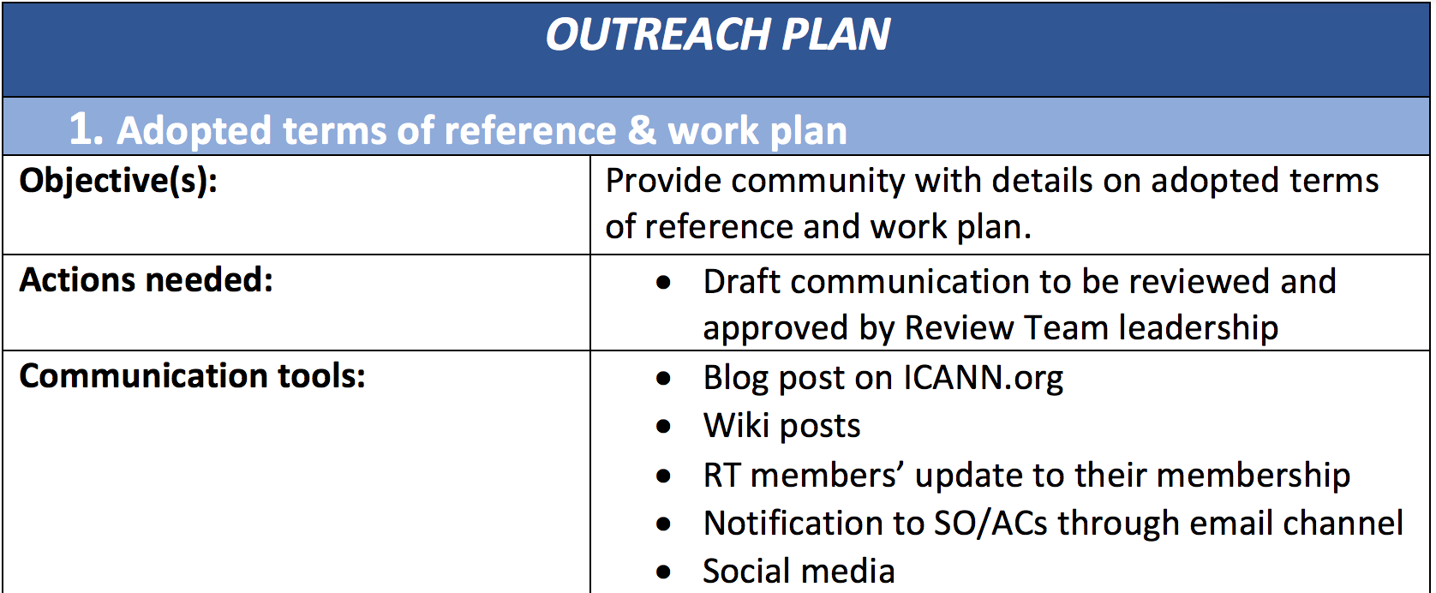
Outreach Plan
No comments were received, please confirm approval.
Blog post will be shared for your review.

Slide 12
Scheduling
Plenary Call #17 Suggested Agenda – Friday 2 February 13:30 UTC
1. Welcome, roll-call, SoI updates
2. Terms of Reference & Work plan
3. Subgroup status update & next steps
Required action: Review of final subgroup first pass documents, and next steps.
Two subgroups have still not submitted their first pass planning documents:
WHOIS Rec #11: Common Interface (Volker)
Anything New (Stephanie)
4. Confirm request for written implementation briefings
5. Face-to-Face Meeting #2
6. Schedule Subgroups calls (if any)
7. A.O.B.

Slide 13
Scheduling
Plenary Call #18 Suggested Agenda – Monday 5 February 14:30 UTC
1. Welcome, roll-call, SoI updates
…
4. A.O.B.

Slide 14
A.O.B.
Confirm Decisions Reached and Action Items

