Slide 1
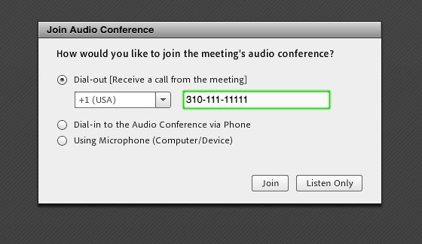
For Best Audio: Join via Telephone Using Dial-Out
Connecting via the audio bridge is always preferable to the AC audio connection.
Upon logging into Adobe Connect, a pop-up window will appear for the AC to call your phone. This preferred method will assure the best audio for the meeting.
After two failed attempts to speak over the audio, participants will be invited to type their comments in the chat or take them to the mailing list.
After 2 background noise occurrences, staff will mute the offending line (either Telephone or Adobe Connect).
PLEASE ALWAYS MUTE WHEN NOT SPEAKING!
*6 to mute and *6 to unmute
For any questions, dial out requests, apologies, please email: mssi-secretariat@icann.org

Slide 2
RDS-WHOIS2-RT
Plenary Call #46
14 January 2019

Slide 3
RDS/WHOIS2-RT Plenary Call Agenda
Welcome, roll-call, SoI
Draft Report Updates review:
  WHOIS1 Rec #1 - Strategic Priority
  Subgroup 3 - Law Enforcement Needs
  WHOIS1 Rec #11: Common Interface
  Recommendations Numbering
  WHOIS1 Rec #4: Compliance
A.O.B.

Slide 4
Draft Report Updates
Agenda Item #2

Slide 5
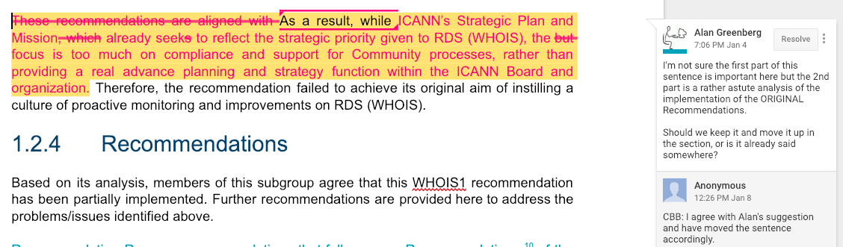
Draft Report Updates
WHOIS1 Rec #1 - Strategic Priority – see Google doc
Decision Reached: Do a rewording/reaffirmation of strategic priority, in the implementation note: reference to stakeholders is there. Work should be interactive and Board should not act unilaterally.
Action item: Since the former Board WG was dissolved, the recommendation should be reformatted to say any WG that is focusing on RDS issues should be made public and not make specific reference to a particular WG.
Action item: As per Dmitry’s note, Cathrin to report for this recommendation that “legislative efforts are not enough”.

Slide 6
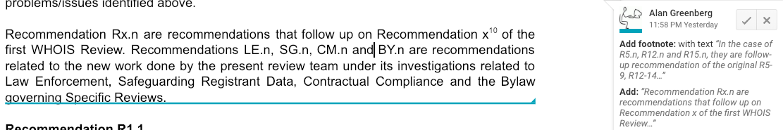
Draft Report Updates

Slide 7
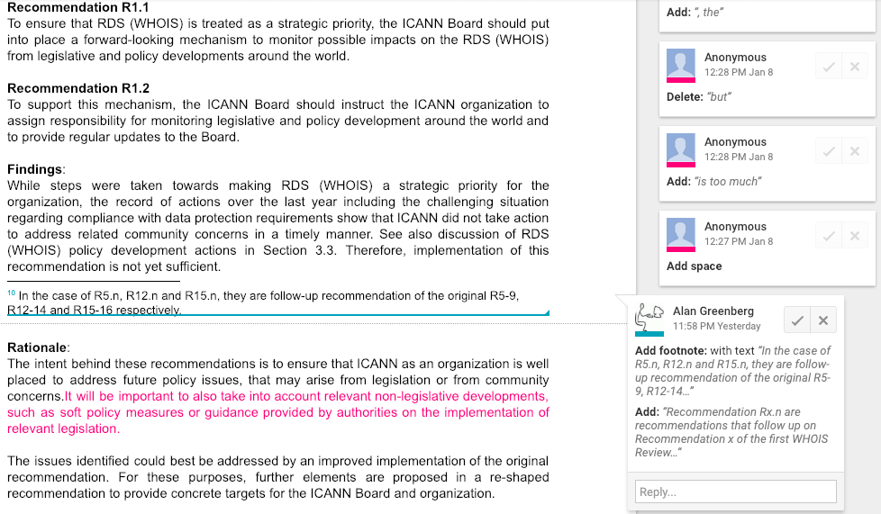
Draft Report Updates
Action item: As per Dmitry’s note, Cathrin to report for this recommendation that “legislative efforts are not enough”.

Slide 8
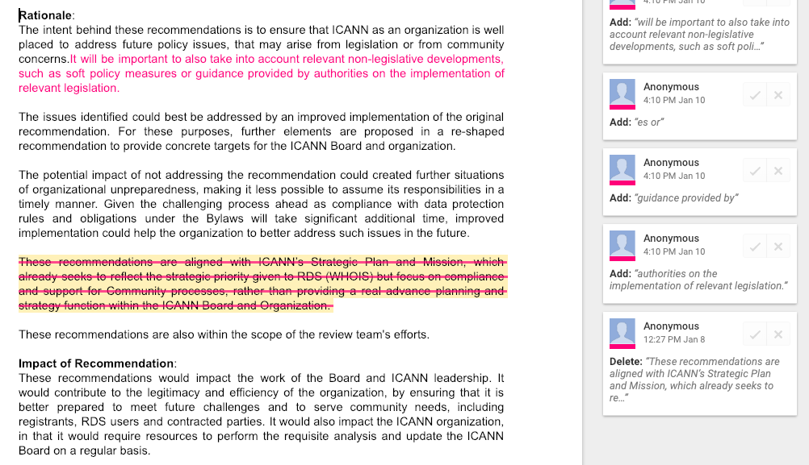
Draft Report Updates

Slide 9
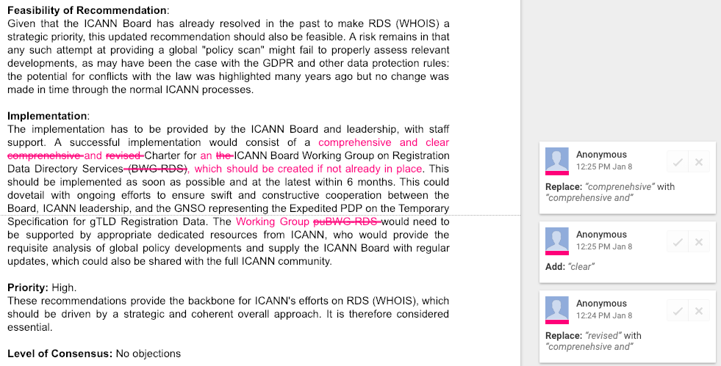
Draft Report Updates

Slide 10
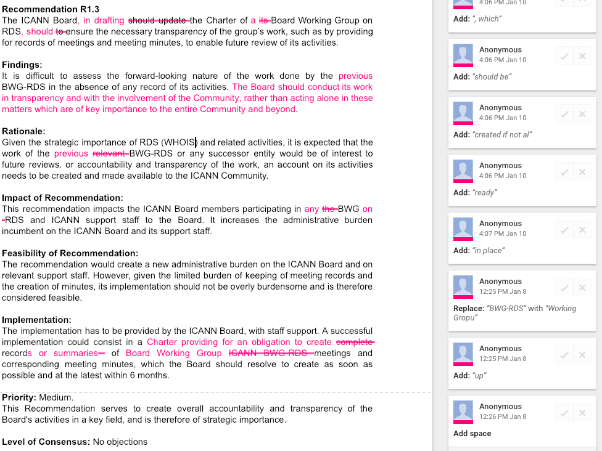
Draft Report Updates
Action item: Since the former Board WG was dissolved, the recommendation should be reformatted to say any WG that is focusing on RDS issues should be made public and not make specific reference to a particular WG.

Slide 11
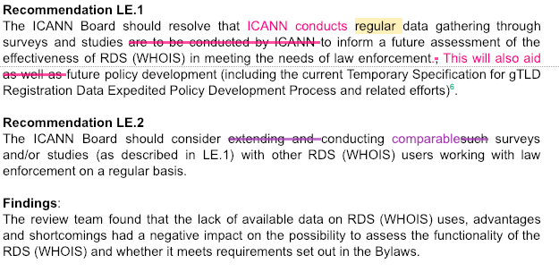
Draft Report Updates
Subgroup 3 - Law Enforcement Needs – See Google doc.
Action item: Clarify what “regular” means and include rationale: 1) ex-ante impact assessment 2) evaluate new policies once there are in place.

Slide 12
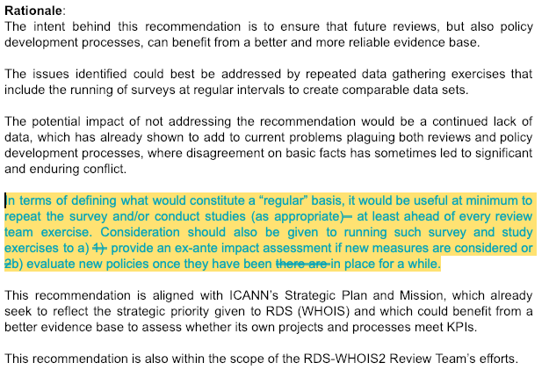
Draft Report Updates

Slide 13
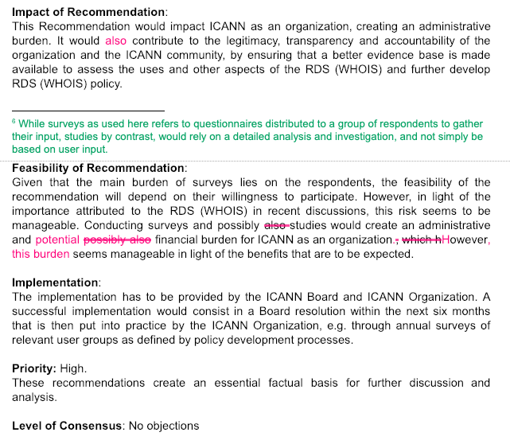
Draft Report Updates

Slide 14
Draft Report Updates
WHOIS1 Rec #11 – Common Interface
R11.2: The ICANN Board should direct the ICANN org to continue to maintain the common interface o keep up to date with new policy developments or contractual changes for contracted parties to ensure that the common interface will display all publicly-available RDS (WHOIS) output for each gTLD domain name registration available from contracted parties, i.e., when they differ, both the registry and registrar RDS (WHOIS) output could be shown in parallel.
The revised version is:
R11.2: The ICANN Board should direct the ICANN organization to ensure
that the common interface displays all applicable output for each gTLD domain name registration as available from contracted parties, including multiple versions when the output from registry and registrar differ. The common interface should be updated to address any policy or contractual changes to maintain full functionality.

Slide 15
Draft Report Updates
Recommendation Numbering

Slide 16
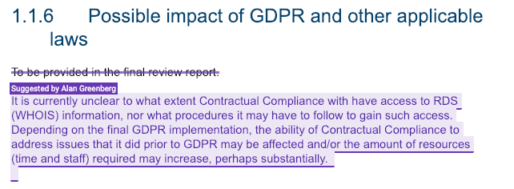
Draft Report Updates
WHOIS1 Rec.4 Compliance

Slide 17
A.O.B.
Agenda item #3

Slide 18
A.O.B.

Slide 19
Confirm
Decisions Reached
&
Action Items

Slide 20
Appendix
Open Action Items

Slide 21
Final Report Open Action Items
Level of priorities
Action item: Susan to evaluate each recommendation and Define priority level for each recommendation with some quick description. E.g. High, to be implemented by…
Action item: Susan to include brief statement that refers to timing envisioned for recommendations while highlighting some of the dependencies. Agreement to consider the six-month Bylaw window in assessments.
Report
Action item: Susan will listen to the meeting recording for conversation regarding language “The board should negotiate”, and update the wording through the report consistently.
Executive Summary
Action item: RT needs to evaluate recommendation numbering, potential explanation in ES.
Action item: History of WHOIS on ICANN’s website. Erika to provide Jackie with the right content/references link so introduction section can be properly updated.

Slide 22
Final Report Open Action Items
Background Section
Action item: Alan and Jackie review and modify the WHOIS Background section (in reference to the last bullet on slide # 40 of Day # 3 of F2F meeting)
WHOIS1 Rec #2: Single WHOIS Policy (Carlton)
Action item: Jackie to work with Alan to mention the problems of the policy development process regarding a single RDS (WHOIS), to be placed in the Executive Summary.
WHOIS1 Rec #3: Outreach (Alan)
Action item: DNRC comment on section: Alan to update language.
R3.1: Action item: Alan to clarify what specific improvements we are looking for.
R3.2:
Action item: NCSG comment: Alan to work with Jackie on rewording of the recommendations to clearly articulate the need for outreach before and after RDS changes are finalized.
Action item: Add implementation note, that the RT does not have any input on ICANN budget.

Slide 23
Final Report Open Action Items
WHOIS1 Rec #4: Compliance (Susan)
Action item: Susan to clarify that ICANN will not go on fact-finding missions, but use the information they currently have on hand (input received).
Susan to clarify that Compliance enforces Registrars to enforce data accuracy for registrants.
R4.1
Action item: Volker to provide language to update recommendation 4.1 based on RrSG and NCSG comments.
Action item: Susan to delete the portion of the recommendation that refers to sanctions and make a reference to it in the report text.
R4.2
Action item: Volker and Alan work on rewording R4.2 and add some metrics in for measurability and success of implementation.

Slide 24
Final Report Open Action Items
WHOIS1 Recs #5-9: Data Accuracy (Lili/Cathrin)
R5.1:
Action item: ICANN org to double-check the recommendation numbering to ensure comment was in response to recommendation 5-9 and adjust as needed.
WHOIS1 Rec #10: Privacy/Proxy Services (Volker)
R10.1
Action item: Lili to adress Alan's comment, or confirm whether Alan/Jackie should address it
WHOIS1 Rec #11: Common Interface (Susan/Volker)
Action item: Susan/Volker to clarify that this recommendation was not specifically aimed at compliance.
Objective 3: Law Enforcement Needs (Cathrin)
LE.1
Action item: MSSI to estimate number of hours spent on the LE survey in response to NCSG request for estimated cost associated with conducting the survey.
Action item: Cathrin to bring this recommendation to GAC’s attention, Alan to EPDP’s

Slide 25
Final Report Open Action Items
Objective 4: Consumer Trust (Alan/Erika)
Action item: Alan and Erika to update section.
Objective 5: Safeguarding Registrant Data (Alan)
Action item: Alan to update recommendation:
Agreement to add: “ICANN Board should consider whether and to what extent notifications of breaches should be publicly disclosed.”
Action item: Alan to clarify recommendation in light of section
Objective 6: ICANN Contractual Compliance: Actions, Structure and Processes (Susan, Cathrin, Alan)
CM1:
Action item: Alan to reword CM.1 so that it does not say “the Board should negotiate …”. The goal is to ensure the recommendation is not dictating a PDP but suggesting a change somehow.

Slide 26
Final Report Open Action Items
CM2:
Action item: Alan and Volker to add more details to CM.2 to clarify the registrant fields being addressed in the recommendation. Additionally, the whole recommendation should be reworded to better convey intent.
Update as of 11 December 2018: Based on the updated recommendation and rationale language Volker provided on 11 December (Day # 2), Susan is to take the pen and update the relevant sections of the report accordingly.
Jackie to add in introduction, to the extent that their deliberations so far impact areas in our review.
CM3:
Action item: Recommendation to be deleted. Add this as a more targeted outreach in the relevant recommendation.
Cathrin to clarify Board options in a footnote.
CM4:
Action item: Alan to write to ICANN org Compliance and negotiate language to be added to relevant page(s). If successful, recommendation will be deleted.

Slide 27
Final Report Open Action Items
Objective 7: ICANN Bylaws (Carlton/Alan)
BY.1
Action item: Carlton to amend the recommendation to incorporate the words “safeguarding the registrant data” and provide clarification that the suggestion is meant to postpone the topic to future reviews.

