Slide 1
RDS-WHOIS2-RT Brussels Face-to-Face Meeting
26-27 July 2018

Slide 2
RDS-WHOIS2-RT Brussels Face-to-Face Meeting
DAY 1 – 26 July 2018

Slide 3
Welcome
Agenda Item #1
Time: 09:00-09:15
Presenters: Review Team Leadership & ICANN org

Slide 4
Welcome
• Roll-call
• Call for Statement of Interests updates
• Housekeeping
• Opening remarks and day 1 objectives
• Work plan
• Update on gap assessments

Slide 5
SoI Updates, Roll-Call, Administrative Items
Roll-Call
Apologies: Dmitry Belyavsky, Thomas Walden, Jean-Baptiste Deroulez
Any Statements of Interests Updates?
Housekeeping
Raise your hand if you wish to be added to the queue
Session is recorded:
Always use your microphone
State your name before speaking
Limit use of your laptop
Breaks:
Reception desk/area for coffee breaks
Kitchen area for lunch
Badges

Slide 6
Day 1 – Morning Program
08:30-09:00 – Breakfast
09:00-09:15 – Welcome
09:15-09:20 – Overview of draft report
09:20-09:30 – Approve draft report background section
09:30-10:00 – Subgroup 2: Anything New
10:00-10:30 – WHOIS1 Rec #1: Strategic Priority
10:30-10:45 – Break
10:45-11:00 – Subgroup 3: Law Enforcement Needs
11:00-12:30 – WHOIS1 Rec #4: Compliance
12:30-13:30 – Lunch

Slide 7
Day 1 – Afternoon Program
13:30-14:00 – WHOIS1 Rec #5-9: Data Accuracy
14:00-15:00 – WHOIS1 Rec #10: Privacy/Proxy Services
15:00-15:30 – Subgroup 5 – Safeguarding Registrant Data
15:30-15:45 – Break
15:45-16:45 – WHOIS1 Rec #11: Common Interface
16:45-17:30 – Day 1 wrap up
19:30-21:30 – Dinner (offsite)

Slide 8
Subgroups - Overview
# | Subgroup | Rapporteur | Day of FtoF Meeting | Time Allocated
1 | WHOIS1 Rec #1 - Strategic Priority | Cathrin | 1 | 30 min
 | WHOIS1 Rec #2: Single WHOIS Policy | Carlton | 2 | 30 min
 | WHOIS1 Rec #3: Outreach | Alan | 2 | 30 min
 | WHOIS1 Rec #4: Compliance | Susan | 1 | 90 min
 | WHOIS Rec #5-9: Data Accuracy | Lili | 1 | 30 min
 | WHOIS Rec #10: Privacy/Proxy Services | Volker | 1 | 60 min
 | WHOIS Rec #11: Common Interface | Volker | 1 | 60 min
 | WHOIS Rec #12-14: Internationalized Domain Names | Dmitry (Alan) | 2 | 30 min
 | WHOIS Rec #15-16: Plan & Annual Reports | Lili | 2 | 30 min
2 | Anything New | Stephanie | 1 | 30 min
3 | Law Enforcement Needs | Thomas (Cathrin) | 1 | 30 min
4 | Consumer Trust | Erika | 2 | 60 min
5 | Safeguarding Registrant Data | Alan | 1 | 30 min

Slide 9
Opening Remarks & Day 1 Objectives
Meeting Outputs
Reach consensus on recommendations and findings
Review draft report
- Approve background section
- Make adjustments to report structure (as needed)
Determine adjustments needed to work plan
Define roadmap to publish draft report for public comment
Day 1 Objectives
Reach consensus on recommendations and findings
Approve background section

Slide 10
Opening Remarks & Day 1 Objectives
Points to consider throughout Day 1
Do you have any concerns with the findings and recommendations produced by subgroups?
Do you agree with the subgroup’s recommendations?
Are those recommendations S.M.A.R.T?
What (if any) open issues require further discussion?
Is the subgroup’s output clear enough? Concise enough?
Did subgroups fully-address their assigned review objectives?
Should any further specific measurable steps be recommended?

Slide 11
Current Work Plan & Deliverables
DATE * | DELIVERABLE*
By 31 July | Approve draft report for public comment
7 August – 5 October | Public comment on Draft Report
By 26 October | Adopt public comment summary for publication
By 30 November | Update recommendations and report based on public comment
By 21 December | Approve final findings and recommendations for submission to ICANN Board
*Per work plan submitted to ICANN Board on 9 February 2018 and reconfirmed at Brussels face-to-face meeting #2
NOTE: Dedicated agenda item to review work plan and determine if adjustments are needed on day 2 @ 16:00-16:15

Slide 12
Update on Gap Assessments
Refer to:
Recommendation assessment tool (circulated on 24 July)
Subgroup report gap assessment tool (circulated on 24 July)

Slide 13
Overview of Draft Report
Agenda Item #2
Time: 09:15-09:20
Presenters: ICANN org
Draft Report on Wiki Page: https://community.icann.org/x/cyQFBQ

Slide 14
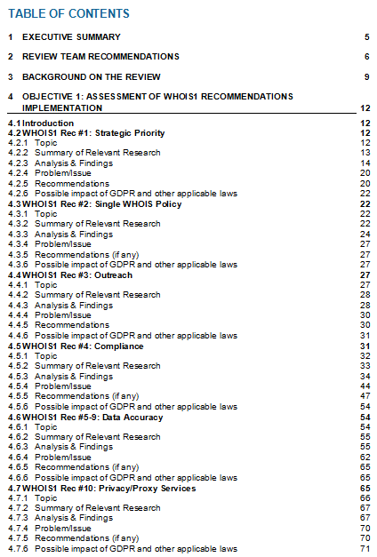
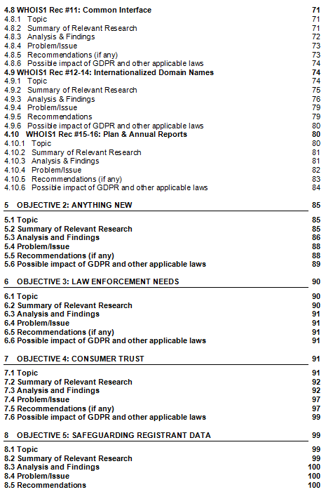
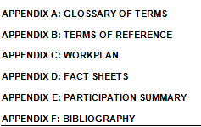
Overview of Draft Report
Refer to:
Draft Report (23 July)

Slide 15
Approve Draft Report Background Section
Agenda Item #3
Time: 09:20-09:30
Presenters: Review Team Leadership
Draft Report on Wiki Page: https://community.icann.org/x/cyQFBQ

Slide 16
Approve Draft Report Background Section
Refer to:
Draft Report (circulated on 23 July)

Slide 17
Subgroup 2 – Anything New
Agenda Item #4
Time: 09:30-10:00
Presenter: Stephanie Perrin
Subgroup Members: Stephanie, Alan, Susan
Subgroup Wiki: https://community.icann.org/x/_5lEB

Slide 18
Subgroup 2 – Anything New
Findings
Upon review of an inventory of new and changed WHOIS Policies and Procedures since the WHOIS1 completed its work in 2012, there are a lot of policies and procedures that have been worked on since 2012.
There are not clear metrics for some of them.
Several items are already covered by WHOIS1 Rec subgroups.
Reseller lack of transparency to be covered by the Consumer Trust subgroup.
There is community dissatisfaction with handling of conflicts with privacy law.
The impact of GDPR cannot yet be addressed in this review.

Slide 19
Subgroup 2 – Anything New
Issues
The subgroup concluded that no recommendations are needed at this time with respect to this objective. However:
Recommendations appropriate for each new or updated WHOIS policy or procedure have been formulated by other subgroups.
The review team’s report will note that, overall, the impact of GDPR has not yet been comprehensively addressed in this review.
Recommendations
The subgroup concluded that no recommendations are needed at this time with respect to this objective. However:
Recommendations appropriate for each new or updated WHOIS policy or procedure have been formulated by other subgroups.
The review team’s report will note that, overall, the impact of GDPR has not yet been comprehensively addressed in this review.

Slide 20
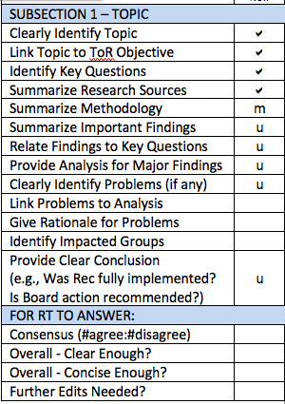
Subgroup 2 – Anything New
Gap Assessment
Draft report to be updated to include material presented on ICANN62 slides for this Subgroup
Subsection 1: Contains methodology which should be moved to Subsection 2.
Subsection 3: Table needs to be updated to reflect ICANN62 slide.
Center column and “main findings” list should be fleshed out to tie back to key questions currently listed in Subsection 1.
Subsection 4: Template text/action item to be replaced with text from ICANN62 slide
Subsection 5: Template text to be deleted and replaced with Subgroup’s overall conclusion

Slide 21
WHOIS1 Rec #1 – Strategic Priority
Agenda item #5
Time: 10:00-10:30
Presenter: Cathrin Bauer-Bulst
Subgroup Members: Cathrin, Carlton, Volker
Subgroup Wiki: https://community.icann.org/x/3plEB

Slide 22
WHOIS1 Rec #1 – Strategic Priority
Findings
The ICANN organization and Board have clearly taken a number of steps to work towards implementation of the recommendation.
A key element - the creation of a dedicated Board committee including the CEO - was only put into place very late in the process but did eventually take place.
The record of actions over the last year and in particular the challenging situation as concerns compliance with data protection requirements show that implementation of this recommendation is not yet sufficient.
Based on its analysis, members of this subgroup agree that this WHOIS1 recommendation has been partially implemented
The implementation failed to achieve the recommendation’s original aim of instilling a culture of proactive monitoring and improvements on WHOIS

Slide 23
WHOIS1 Rec #1 – Strategic Priority
Issues
From the mandate of the Board Working Group on RDS (BWG-RDS), feedback in response to questions, and documentation available, a clear picture emerges as to ICANN's understanding of the nature of the strategic priority
These actions were interpreted as making sure that the recommendation was implemented, and to launch the policy development process and support other Community actions related to the WHOIS.
While these actions went a long way towards achieving the intended aim, they could not replace a strategic outlook and advance planning for issues not yet explicitly addressed in specific community actions, as became evident in the issues surrounding compliance with GDPR.

Slide 24
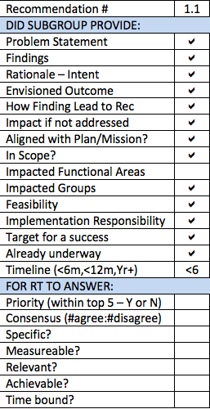
WHOIS1 Rec #1 – Strategic Priority
Recommendation R1.1
The ICANN Board should update the Charter of its BWG-RDS to include forward-looking planning, based on a regular assessment of the RDS' fitness to meet legal requirements and legitimate user needs as outlined in the Bylaws.

Slide 25
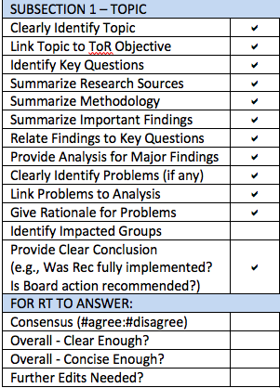
WHOIS1 Rec #1 – Strategic Priority
Gap Assessment
Section 5 lacks ‘problem statement’ flowing from identification of issues
What specific, measurable outcome is envisioned for this Recommendation?

Slide 26
Break
Time: 10:30-10:45
What’s Next?
10:45-11:00 – Subgroup 3: Law Enforcement Needs
11:00-12:30 – WHOIS1 Rec #4: Compliance

Slide 27
Subgroup 3 – Law Enforcement Needs
Agenda item #6
Time: 10:45-11:00
Presenter: Cathrin Bauer-Bulst
Subgroup Members: Cathrin, Thomas, Chris
Subgroup Wiki: https://community.icann.org/x/-plEB

Slide 28
Subgroup 3 – Law Enforcement Needs
Update & Work Plan
The subgroup expects that results will provide
Insights concerning participants’ usage of WHOIS,
some insights into the impact of the current WHOIS status quo, and
means that might be utilized if WHOIS is no longer available.
Survey issued on 16 July
Closed on 25 July at 23:59 UTC
See questions https://community.icann.org/download/attachments/71604734/Law%20Enforcement%20Survey%20FINAL.pdf?version=1&modificationDate=1531920388000&api=v2
# of respondents: xx

Slide 29
WHOIS1 Rec #4: Compliance
Agenda item #7
Time: 11:00-12:30
Presenter: Susan Kawaguchi
Subgroup Members: Susan, Erika, Carlton, Chris, Thomas
Subgroup Wiki: https://community.icann.org/x/55lEB

Slide 30
WHOIS1 Rec #4: Compliance
WHOIS1 Rec #4 Implementation - Findings
The Compliance team has made significant progress in reporting metrics and data in their annual report.
It appears that the Compliance team has all the necessary resources to manage compliance activities.
However, there is no indication that the WHOIS1-recommended reporting structure was implemented.
Based on its analysis, members of this subgroup agree that this WHOIS1 recommendation has been partially-implemented
The intention of the WHOIS1 recommendation was to ensure this role had the independence needed to perform the compliance function without restriction from the rest of the organization. We do not believe this intention was fulfilled.

Slide 31
WHOIS1 Rec #4: Compliance
WHOIS1 Rec #4 Implementation - Issues
Additional review is needed to determine whether or not it is feasible to adhere to the intentions of the WHOIS1-recommended reporting structure.
WHOIS inaccuracy report data provided by the Compliance team is not clear on several points.
The Compliance team does not utilize available information for proactive assessment and enforcement.

Slide 32
WHOIS1 Rec #4: Compliance
Additional Objective - Findings
Of the sample of the October 2017 Accuracy Reporting System (ARS) report cycle domain names, over one third (4,681) required a ticket to be created. Over half of those tickets (2,498) were closed before a 1st notice was sent out.
40% of the WHOIS ARS domain names that are sampled for this program are grandfathered domain names and are not required to adhere to the 2013 RAA.
In reviewing the additional information in the dashboard report it appears that many inaccuracy reports are not valid reports.
Only 10 users are approved to use the bulk submission tool for reporting inaccuracies; last year, only 3 actually used it.
It appears that the Compliance team does little in proactive actions to discover and remediate issues with WHOIS data.
For at least one new policy (RDS Consistent Labeling and Display Policy), there were no statistics we could gather from the Compliance team.

Slide 33
WHOIS1 Rec #4: Compliance
Additional Objective - Issues
The registrar can choose to unsuspend a suspended domain name at any moment, with inaccurate data remaining in WHOIS.
There are many reasons a domain name could be suspended that do not relate to inaccuracy. However, when inaccurate data is displayed with only a suspended designation, this does not accurately represent the history of the domain name.
If we can extrapolate from the ARS sample, 30-40% of domain names registered before 2013 MAY not have all registrant data collected and displayed in WHOIS.
Africa and Latin America appear to be underrepresented in the number of inaccuracy submissions.
Users who might benefit from the Bulk Submission tool may not be aware of it.
By only reacting to reported compliance issues, opportunities are missed to find systemic issues.
There may policies that are implemented but not audited or tracked.
Should any issue(s) be identified for Across-Field Validation?

Slide 34
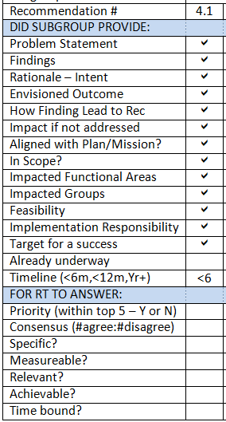
WHOIS1 Rec #4: Compliance
Recommendation R4.1
Require all new policies implemented to be measured, audited, tracked and enforced as required by the compliance team. Policy should integrate metrics, measurements, and reporting to ensure that the policy is effective in addressing the issue, and when metrics are defined, compliance would audit, track, report, and enforce as applicable for the policy.

Slide 35
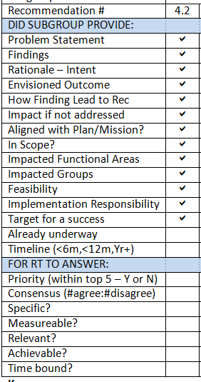
WHOIS1 Rec #4: Compliance
Recommendation R4.2
Require all domain name registrations to adhere to the WHOIS requirements in the 2013 Registrar Accreditation Agreement or the latest implemented policy for WHOIS. Once a policy is implemented all gTLD registrations must adhere to the new rules within a 12 month period. Assess the grandfathered domain names to determine if information is missing from the registrant field. If statistically significant number of domain name registrations lack registrant data then a new policy should be created to ensure all gTLDs adhere to the requirements of registrant data collection in the 2013 RAA.

Slide 36
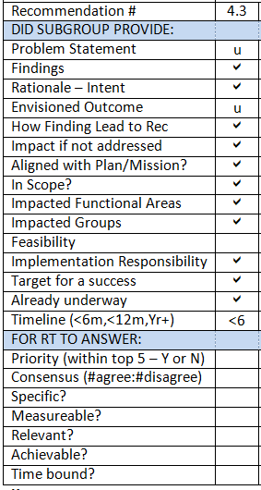
WHOIS1 Rec #4: Compliance
Recommendation R4.3
Domain names suspended due to inaccurate information and remain in that state until it is due for renewal the WHOIS record should be updated to a new status and the inaccurate data removed, as further described below.
Policy or contracts should require that WHOIS indicate whether a domain is on hold due to inaccurate data.
Domains on serverHold due to inaccurate data in WHOIS should not be unsuspended without inaccurate data being remedied.

Slide 37
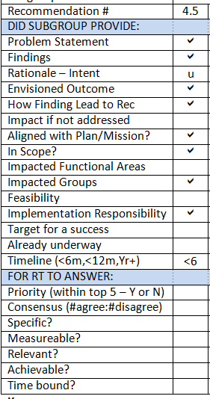
WHOIS1 Rec #4: Compliance
Recommendation R4.5
Publicize and encourage use of the Bulk WHOIS inaccuracy reporting tool.

Slide 38
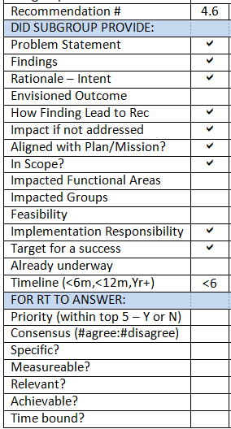
WHOIS1 Rec #4: Compliance
Recommendation R4.6
Review the WHOIS ARS domain names sampled for each region to determine whether or not low submission rates to the WHOIS inaccuracy reporting tool are due to the lack of knowledge of the tool or other critical factors.

Slide 39
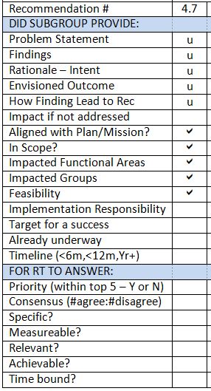
WHOIS1 Rec #4: Compliance
Recommendation R4.7
Following a valid WHOIS ARS ticket, or WHOIS inaccuracy complaint and where there is a pattern of failure to validate as required by the RAA, a full audit targeting the relating registrar should be initiated, to check if the registrar follows the contractual obligations, the consensus policies, etc. Sanctions should be applied if deficiencies identified.

Slide 40
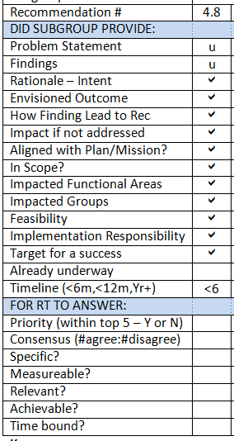
WHOIS1 Rec #4: Compliance
Recommendation R4.8
Direct contractual compliance to proactively monitor and enforce as required to address systemic issues. A risk based approach should be executed to assess, and understand inaccuracy issues and then take the appropriate compliance actions to mitigate risk in systemic complaints.

Slide 41
WHOIS1 Rec #4: Compliance
Possible Recommendation R4.X
The following is from the PPSAI final report and may help in the discussion:
P/P service providers should be required to inform the P/P service customer annually of his/her requirement to provide accurate and up to date contact information to the P/P service provider.
If the P/P service provider has any information suggesting that the P/P service customer information is incorrect (such as the provider receiving a bounced email notification or non-delivery notification message in connection with compliance with data reminder notices or otherwise) for any P/P service customer, the provider must verify or re-verify, as applicable, the email address(es).
If, within fifteen (15) calendar days after receiving any such information, the P/P service provider does not receive an affirmative response from the P/P service customer providing the required verification, the P/P service provider shall verify the applicable contact information manually.
Privacy and Proxy registration data providers must adhere to the current RAA requirements for verification and validation of the underlying registrant data.

Slide 42
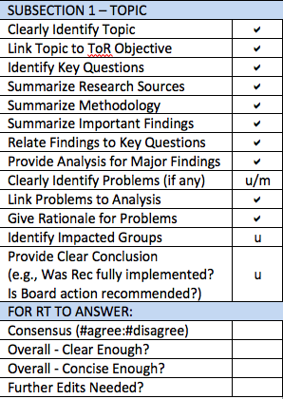
WHOIS1 Rec #4: Compliance
Gap Assessment
Subsection 3 should become more concise. Some Problems/Issues need to be moved/summarized in Subsection 4.
Flesh out all Recommendations, phrasing all as recommended actions with specific, measurable outcomes.

Slide 43
Lunch
Time: 12:30-13:30
What’s Next?
13:30-14:00 – WHOIS1 Recs #5-9: Data Accuracy
14:00-15:00 – WHOIS1 Rec #10: Privacy/Proxy Services
15:00-15:30 – Subgroup 5: Safeguarding Registrant Data

Slide 44
WHOIS1 Recs #5-9: Data Accuracy
Agenda item #8
Time: 13:30-14:00
Presenter: Lili Sun
Subgroup Members: Lili, Cathrin, Dmitry, Erika
Subgroup Wiki: https://community.icann.org/x/6plEB

Slide 45
WHOIS1 Recs #5-9: Data Accuracy
Findings
A WHOIS Informational Website has been established as a policy document, to educate registrants on WHOIS, their rights and responsibilities, and to allow Internet users to submit complaints on WHOIS inaccuracy.
The 2013 RAA introduced contractual obligations for registrars to validate and verify WHOIS data upon registration.
ICANN is in the midst of developing an accuracy reporting system (the WHOIS ARS), proactively identify potentially inaccurate gTLD registration data; explore using automated tools, and forward potentially inaccurate records to gTLD registrars for action.

Slide 46
WHOIS1 Recs #5-9: Data Accuracy
Findings
WHOIS1 | Has Been | Rationale
Rec # 5 | Fully-implemented | However, effectiveness still needs to be assessed
Rec # 6 | Partially-implemented | Because Accuracy Reporting System implementation is on-going
Rec # 7 | Partially-implemented | Because Substantial Failure and Full Failure rates are missing from reports
Rec # 8 | Fully-implemented
Rec # 9 | Not implemented | Because there has been no measurable assessment of WHOIS data quality improvement either through WDRP or other alternative policies

Slide 47
WHOIS1 Recs #5-9: Data Accuracy
Issues
The objective of reliable WHOIS data has not been achieved
WHOIS inaccuracy is believed to be largely under-reported
Contractual obligations for registrant to provide accurate WHOIS data and for registrars to validate and verify WHOIS data are not properly enforced
The WHOIS accuracy of domain names that utilize Privacy and Proxy Services is unknown
The Action Plan indicated that ICANN Board offered an alternative approach rather than WDRP to achieve the intended result of Rec #9, which referred back to the implementation of Rec #5-7. However, the analysis of implementation of Rec #5-7 showed no assessment of improving data quality in a measurable way.
The measures taken so far are not sufficient to reduce WHOIS inaccuracy.

Slide 48
WHOIS1 Recs #5-9: Data Accuracy
Recommendations – Provided by other Subgroups
To address these issues, the subgroup drafted recommendations which can be found in Compliance and Privacy/Proxy subgroup reports.

Slide 49
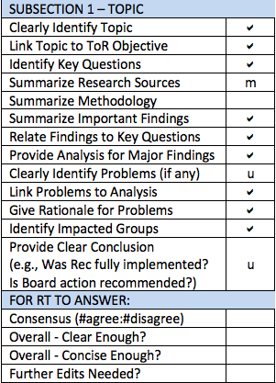
WHOIS1 Recs #5-9: Data Accuracy
Gap Assessment
Draft report to be updated to address ICANN62 feedback (aligned with Rec4 Compliance report)
Subsection 1: A very brief summary of WHOIS1 Recs 5-9 would be helpful
Subsection 2: Add methodology and specific list of research materials
Subsections 3 and 4: Could be made more concise and clear.
For example, cite data sources instead of copying in data tables, simplify lengthy sentences, delete template instructions.
Subsection 5: Add conclusion specifically linking each identified Problem to any new recommendation(s)

Slide 50
Addressing Stephanie’s Concern
Stephanie’s concern raised in response to the Brussels face-to-face meeting #2 conclusions
The drive to accuracy may have unintended consequences, namely ID theft to get solid data. We need to examine that risk, or instruct ICANN compliance to measure it.

Slide 51
WHOIS1 Rec #10: Privacy/Proxy Services
Agenda item #9
Time: 14:00-15:00
Presenter: Volker Greimann
Subgroup Members: Volker, Susan, Cathrin, Stephanie
Subgroup Wiki: https://community.icann.org/x/7ZlEB

Slide 52
WHOIS1 Rec #10: Privacy/Proxy Services
Findings
The 2013 RAA introduced a specification on privacy and proxy registrations requiring registrars to comply with certain requirements regarding such registrations through affiliated Privacy/Proxy Service Providers as a first step towards implementing this recommendation
The Privacy/Proxy Services Accreditation Issues (PPSAI) Implementation Review Team (IRT) is currently working on an implementation of this recommendation that will also include unaffiliated providers of such services
WHOIS1 Rec #10 advises that consideration be given to several specific objectives. The subgroup finds that these objectives are reflected in the Privacy/Proxy Services Accreditation Final Report.
Based on its analysis, members of this subgroup agree that this WHOIS1 recommendation has been fully-implemented
Between the RAA 2013 Spec and this policy, the original recommendation seems to have been addressed. Anything not addressed was clearly not deemed to be important for inclusion by the community, the GNSO and the board who all approved the PPSAI PDP Final Report.

Slide 53
WHOIS1 Rec #10: Privacy/Proxy Services
Issues
The subgroup is unable to assess the exact impact of GDPR data redaction requirements on privacy services at this time. However, we note:
Creating a cost barrier next to the new policy requirements at a time that the use of such services is expected to decline due to GDPR is likely to cause low provider adoption.
We currently see no urgency or need to delay the implementation of the accreditation program due to the GDPR.
WHOIS1 Rec #10 suggests a mix of incentives and sanctions to encourage and enforce this policy once implemented. The IRT should be encouraged to also discuss incentives, as the current focus seems to solely rely on sanctions.
The subgroup addressed potential abuse of privacy and proxy services by registered name holders, but was unable to determine whether domain names using such services had a higher propensity for abusive registrations.
A future review of the impact of privacy/proxy on abuse may be beneficial.
Such a review should take into account PPSA program impact on abusive registrations.
Such a review would depend on the proper collection of data to track over time any trends of abusive use of domain names using privacy/proxy services.

Slide 54
WHOIS1 Rec #10: Privacy/Proxy Services
Recommendations - None
The subgroup proposes no new recommendations at this time specific to the prior RT's Recommendation #10.
However, the subgroup intends to track PPSAI Implementation Review Team (IRT) progress and consider recommendation(s) if necessary.

Slide 55
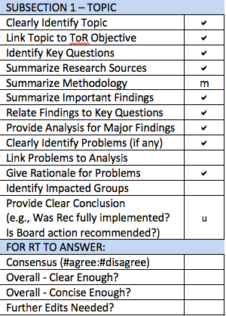
WHOIS1 Rec #10: Privacy/Proxy Services
Gap Assessment
Draft report to be updated to address ICANN62 and possibly Subgroup feedback
Subsection 3: Move key questions and methodology to Subsections 1 & 2.
Subsection 4: Would benefit from a structure such as:
Bolded problem statement. Why it is a problem. Who it affects.
It is unclear how Findings/Analysis led to the Issues listed in Subsection 4.
Subsection 5 needs further explanation – for example, how can the WHOIS1 Recommendation be fully implemented if the PPSAI-defined policy has not yet been implemented?

Slide 56
Subgroup 5 – Safeguarding Registrant Data
Agenda item #10
Time: 15:00-15:30
Presenter: Alan Greenberg
Subgroup Members: Alan, Dmitry, Stephanie, Volker
Subgroup Wiki: https://community.icann.org/x/BJpEB

Slide 57
Subgroup 5 – Safeguarding Registrant Data
Findings
No effort is made to "protect" registrant-supplied WHOIS data from viewing. That may change as WHOIS policies adapt to GDPR and other legislation.
“Safeguarded” includes ensuring that data is not lost in the case of a registrar/registry failure, and not unknowingly changed.
Neither Registry Agreements nor the RAA makes any explicit demands on Registries and Registrars with regard to data protection or actions that must be taken in the case of a discovered data breach.
Escrow provider agreements do require “commercially reasonable efforts and industry standard safeguards to protect the integrity and confidentiality of Deposits“ but not timely breach notification.

Slide 58
Subgroup 5 – Safeguarding Registrant Data
Issues
Traditionally, all WHOIS data is public. Under GDPR and similar legislation, some or all of that data may no longer be collected or publicly available. Exactly what data may be subject to these new rules is under discussion elsewhere and will not be addressed by the RDS-WHOIS2-RT.
Registries and registrars are not explicitly required to use commercially reasonable and industry standard safeguards, nor are any parties (registries, registrars, or escrow providers) required to notify ICANN in the event that a breach is discovered.

Slide 59
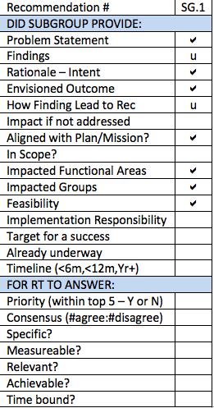
Subgroup 5 – Safeguarding Registrant Data
Recommendation SG.1
ICANN should consult with data security expert(s) to identify reasonable and justifiable requirements to place on registrars and in relation to how data is protected from unauthorized access or alteration while under their control. ICANN should similarly consider whether [or require?] any such breaches that are discovered must be reported to ICANN, and in the case of escrow providers, reported to the registrar/registry that provided the data.
[ICANN should similarly consider whether contractual requirement are needed to require registrars, registries and escrow provides to notify registrants in the even of data breaches.]
In carrying out this review, the external consultants should consider whether requirements within the GDPR could be used as a model, as many ICANN contracted parties must already adhere to those.
If changes are deemed to be required based on the results of the above-recommended studies, ICANN must either negotiate appropriate contractual changes or initiate a GNSO PDP to consider effecting such changes.

Slide 60
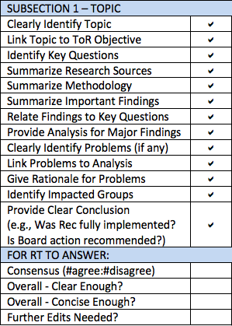
Subgroup 5 – Safeguarding Registrant Data
Gap Assessment
Recommendations in Subsection 5 need to be fleshed out and made specific & measurable.
Tighten up first part of “Recommendation” if possible – for example, by moving bracketed text

Slide 61
Break
Time: 15:30-15:45
What’s Next?
15:45-16:45 – WHOIS1 Rec #11: Common Interface
16:45-17:30 – Day 1 wrap-up
Confirm approved recommendations/findings
Review day 2 agenda

Slide 62
WHOIS1 Rec #11: Common Interface
Agenda Item #11
Time: 15:45-16:45
Presenter: Volker Greimann
Subgroup Members: Volker, Susan, Alan
Subgroup Wiki: https://community.icann.org/x/8JlEB

Slide 63
WHOIS1 Rec #11: Common Interface
Findings
The common interface recommendation was intended to ensure that anyone looking up a WHOIS record could do that easily and from one source. The InterNIC was not overhauled, but a common interface was provided.
Over 4 million queries were made through the common interface - whois.icann.org - over a 6 month period in 2017.
There has been a 99.9% up time for the common interface but other statistics on usage or failure rate are not tracked.
Users are encouraged to file a contractual complaint ticket if they identify any issues with the WHOIS record. A link to file a ticket is provided on the page where results are displayed.
Based on its analysis, members of this subgroup agree that this WHOIS1 recommendation has been fully-implemented

Slide 64
WHOIS1 Rec #11: Common Interface
Issues
The common interface has no metrics that can be used to determine its effectiveness.
Metrics and SLAs could be used to address this and also to proactively spot non-compliance.
Service level agreements could be put in place to ensure the interface works reliably.
New issues raised by Compliance subgroup for discussion:
(1) As a result of GDPR implementation, RR and Ry interpretations may result in different registration data returned by WHOIS for the same domain name (e.g., the Ry may redact data that the RR displays)
(2) WHOIS access through the common interface has become less reliable (e.g., timeouts more frequent)
References that may be helpful: SAC101: WHOIS Rate Limit Testing Results
SAC101 Advisory

Slide 65
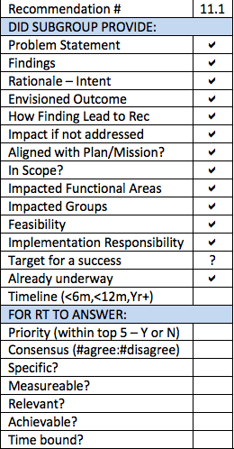
WHOIS1 Rec #11: Common Interface
Recommendation R11.1
Define metrics or SLAs to be tracked and evaluated to determine consistency of results of queries and use of any common interface (existing or future) used to provide one-stop access to registration data across all gTLDs and registrars/resellers. Specific metrics that should be tracked for any such common interface include:
How often are fields returned blank?
How often is data displayed inconsistently overall and per gTLD?
How often does the tool not return results overall and for specific gTLDs?

Slide 66
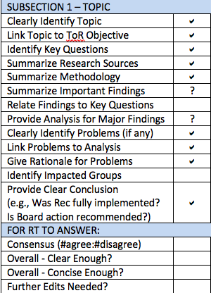
WHOIS1 Rec #11: Common Interface
Gap Assessment
Subsection 3: Focuses on details about the common interface without first giving an overview of how the recommendation was implemented. Add a brief description of the microsite and how that addresses Rec 11.
Subsection 3’s analysis needs to be more explicitly linked to the key questions listed in Subsection 1.

Slide 67
Day 1 Wrap-Up
Agenda item #13
Time: 16:45-17:30
Presenters: Review Team Leadership

Slide 68
Day 1 Wrap-Up
Confirm approved recommendations/findings
Review day 2 agenda

Slide 69
Day 2 Agenda
08:30-09:00 – Breakfast
09:00-09:15 – Welcome
09:15-09:45 – WHOIS1 Recs#15-16: Plan & Annual Reports
09:45-10:15 – WHOIS1 Rec #2: Single WHOIS Policy
10:15-10:30 – Break
10:30-11:30 – Subgroup 4 – Consumer Trust
11:30-12:30 – Parking lot for items that require further discussion
12:30-13:30 – Lunch

Slide 70
Day 2 Agenda
13:30-14:00 – WHOIS1 Rec #3: Outreach
14:00-14:30 – WHOIS1 Recs #12-14: Internationalized Domain Names
14:30-15:30 – Brainstorming on content of executive summary
15:30-15:45 – Break
15:45-16:00 – Adjust (as needed) structure of report
16:00-16:15 – Review work plan
16:15-16:30 – Parking lot for items that require further discussion
16:30-17:30 – Face-to-face meeting #3 wrap-up

Slide 71
RDS-WHOIS2-RT Brussels Face-to-Face Meeting
DAY 2 – 27 July 2018

Slide 72
Welcome
Agenda Item #1
Time: 09:00-09:45
Presenters: Review Team Leadership

Slide 73
Welcome
Day 1 Takeaways
ICANN org to complete on 26 July
Day 2 Objectives
Complete the approval of subgroup findings and recommendations
Critical assessment of current status, the report structure and the need for any strategic changes
Consider the review team’s work plan in light of progress made and identify next steps to complete and consolidate the draft report
Determine adjustments needed to work plan

Slide 74
Opening Remarks & Day 2 Objectives
Points to consider throughout Day 2
Do you have any concerns with the findings and recommendations produced by subgroups?
Do you agree with the subgroup’s recommendations?
Are those recommendations S.M.A.R.T?
What (if any) open issues require further discussion?
Is the subgroup’s output clear enough? Concise enough?
Did subgroups fully-address their assigned review objectives?
Should any further specific measurable steps be recommended?
Is our current work plan feasible?

Slide 75
Day 2 Agenda
08:30-09:00 – Breakfast
09:00-09:15 – Welcome
09:15-09:45 – WHOIS1 Recs #15-16: Plan & Annual Reports
09:45-10:15 – WHOIS1 Rec #2: Single WHOIS Policy
10:15-10:30 – Break
10:30-11:30 – Subgroup 4 – Consumer Trust
11:30-12:30 – Parking lot for items that require further discussion
12:30-13:30 – Lunch

Slide 76
Day 2 Agenda
13:30-14:00 – WHOIS1 Rec #3: Outreach
14:00-14:30 – WHOIS1 Recs #12-14: Internationalized Domain Names
14:30-15:30 – Brainstorming on content of executive summary
15:30-15:45 – Break
15:45-16:00 – Adjust (as needed) structure of report
16:00-16:15 – Review work plan
16:15-16:30 – Parking lot for items that require further discussion
16:30-17:30 – Face-to-face meeting #3 wrap-up

Slide 77
WHOIS1 Recs #15-16: Plan & Annual Reports
Agenda Item #2
Time: 09:15-09:45
Presenter: Lili Sun
Subgroup Members: Lili, Alan, Chris
Subgroup Wiki: https://community.icann.org/x/9plEB

Slide 78
WHOIS1 Recs #15-16: Plan & Annual Reports
Findings
The Board agreed that gTLD WHOIS should be a strategic priority and directed the CEO to incorporate a work plan for the improvement of WHOIS into the operating plan.
However, the work plan, deliverables and reports with regards to implementation have been scattered among different action items, e.g. WHOIS ARS project, and some have been incorporated into other WHOIS initiatives and policy developments.
WHOIS Improvements Annual Reports provide an overview of WHOIS policy development, but are activity-based rather than outcome-based, and do not include figures and analyses as recommended by Rec #16.
Based on its analysis, members of this subgroup agree that these WHOIS1 recommendations have been partially-implemented
Taking into account of Subgroup 1 findings, the plan and report of ICANN in implementing WHOIS1 Recs #15-16 was not organized in a methodical way

Slide 79
WHOIS1 Recs #15-16: Plan & Annual Reports
Issues
The action items outlined in the Action Plan went into different implementation tracks, and the annual status reports were generated from different tracks as well. The annual status reports were more activity-based, without efficient underlying facts, figures and analyses as recommended by Rec #16.
The overseeing of the different implementation tracks [place holder, pending ICANN Org's reply on the additional question raised during the subgroup call on 19 July]
Taking into account of Subgroup 1 key findings on WHOIS1 Recommendations 1-14, to this subgroup, the plan and annual report were not organized in a methodical and coordinated way.
There has been no effectiveness review and measurable outcomes of the implementation.

Slide 80
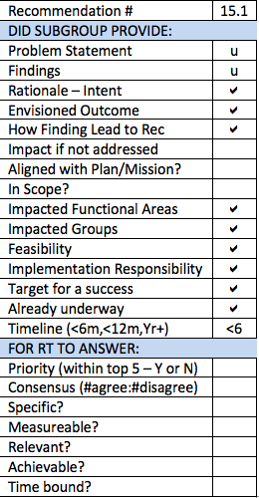
WHOIS1 Recs #15-16: Plan & Annual Reports
Recommendation R15.1
ICANN should conduct plan and reports in a measurable way. Metrics should be developed to track the effectiveness of the implementation of each recommendation. And impact evaluation of implementation should be included in the annual report.

Slide 81
WHOIS1 Recs #15-16: Plan & Annual Reports
Gap Assessment
Section 5 lacks ‘problem statement’ flowing from identification of issues
What specific, measurable outcome is envisioned for this Recommendation?

Slide 82
WHOIS1 Rec #2: Single WHOIS Policy
Agenda item #3
Time: 09:45-10:15
Presenter: Carlton Samuels
Subgroup Members: Carlton, Cathrin, Thomas
Subgroup Wiki: https://community.icann.org/x/4ZlEB

Slide 83
WHOIS1 Rec #2: Single WHOIS Policy
Findings
That the web page is a good and sufficient substitute for the single authoritative WHOIS policy document but with navigational improvements and further organization of content could be better
The GNSO ePDP chartered to address the next generation Registration Data Directory Services is in progress and guided by the Board-developed Temporary Specification for Registration Data, will likely report a single fit-for-purpose gTLD registration data service (WHOIS) policy for the first time, at last.
When a single fit-for-purpose consensus gTLD registration data policy has emerged, The WHOIS website will be superseded by another digital artefact documenting this policy.

Slide 84
WHOIS1 Rec #2: Single WHOIS Policy
Issues
The organization of the website content could be further optimized for navigation and readability.
However, in the event that the Temporary Specification takes hold and is affirmed by the ePDP, then the existing website and its contents become archival artefacts.
We would expect the affirmed Temporary Specification will exist as a digital artefact and will be the new base for a single documented source of all things pertaining gTLD Registration Data.

Slide 85
WHOIS1 Rec #2: Single WHOIS Policy
Conclusions
There are no further recommendations. However, the team:
Accepts that WHOIS1 RT Recommendation 2 is fully implemented.
That the adoption of the EWG’s Final Report and development of the framework for the Board-initiated GNSO RDS PDP[s] is intended to deliver a holistic next generation WHOIS policy framework that would address current set of fragmented and decentralized WHOIS policies.
Notwithstanding its temporary nature – to be sunsetted in one (1) year - that the Temporary Specification for WHOIS promoted by the Board in May 2018 constitutes for the first time the framework for a single WHOIS policy.
That the expedited policy development process (ePDP) raised by the GNSO to address the adoption or adaption of the temporary specification will, likely affirm a single WHOIS policy at the end of its work.

Slide 86
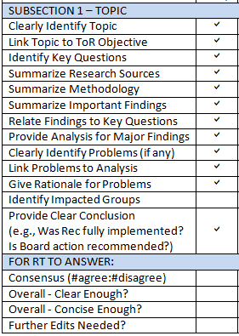
WHOIS1 Rec #2: Single WHOIS Policy
Gap Assessment
Subsection 4: Add impacted groups.

Slide 87
Break
Time: 10:15-10:30
What’s Next?
10:30-11:30 – Subgroup 4 – Consumer Trust
11:30-12:30 – Parking lot for items that require further discussion

Slide 88
Subgroup 4 – Consumer Trust
Agenda item #4
Time: 10:30-11:30
Presenter: Erika Mann
Subgroup Members: Erika, Carlton, Dmitry, Stephanie, Susan
Subgroup Wiki: https://community.icann.org/x/AZpEB

Slide 89
Subgroup 4 – Consumer Trust
Findings
Using the 2012 report as a foundation, the subgroup plans to examine the findings and analysis of other subgroups assessing WHOIS1 Rec implementation:
This examination will produce a gap analysis which identifies areas of WHOIS which may need to be further enhanced to promote consumer trust.
The gap analysis will need to be repeated after WHOIS evolves to comply with GDPR – at least for access to data that impacts WHOIS data from European users.
The definition of “consumer” to be addressed in this review must be broad and include Internet users. Users are potential domain name owners and insofar, it’s important to approach and address all users, whenever appropriate.

Slide 90
Subgroup 4 – Consumer Trust
Issues
The basic idea is that WHOIS contributes to consumer trust, mostly indirectly. The subgroup notes that here are different opinions about whether the visibility of WHOIS data contributes to trust.
The subgroup reviewed websites from well-known and less well-known resellers. Based on this research, it is clear that many of the well-known resellers have little information for 'consumers' and, if they do, the information is often very hard to find.
The subgroup notes a lack of Reseller transparency in WHOIS as a potential gap, to be addressed through policy and/or contractual changes. Gaps include lack of easy identifiable information about data privacy/data protection practices and redress contact point.

Slide 91
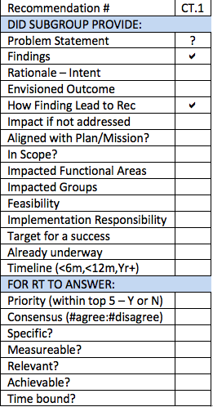
Subgroup 4 – Consumer Trust
Recommendation CT.1
ICANN should request from resellers more clear information, including the recommendation to include relevant information on their websites.
A good location for ICANN to make such a recommendation would be RAA (e.g., Sections 3.7.10, 3.12.2, 3.12.15).
ICANN must ensure that RAA provides updated information concerning relevant topics relate to consumers and WHOIS Obligations.
ICANN should recommend general policy and website/communication guidelines for resellers.

Slide 92
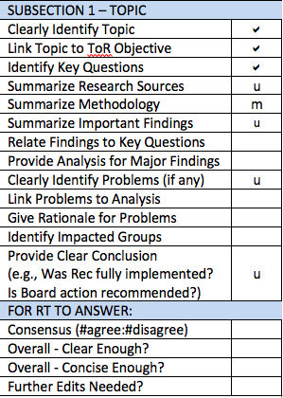
Subgroup 4 – Consumer Trust
Gap Assessment
Draft report to be updated to address ICANN62 feedback (new materials, associated findings)
Subsection 4: Contains excerpts from documents (Findings) but little Analysis. Needs Analysis text to tie Findings back to key questions currently listed in Subsection 1.
Subsection 5 (Problem/Issue): Needs more concise Problem statement for Reseller Transparency, tied back to Analysis. Currently, Findings and Analysis do not tie at all to the identified Problem/Issue.
Recommendation in Subsection 6 needs to be fleshed out and made specific & measurable.

Slide 93
Parking Lot for Items that Require Further Discussion
Agenda item #5
Time: 11:30-12:30
Presenters: Review Team Leadership

Slide 94
Lunch
Time: 12:30-13:30
What’s Next?
13:30-15:15 – WHOIS Rec#3 – Outreach
14:00-14:30 – WHOIS Recs#12-14 – Internationalized Domain Names
14:30-15:30 – Brainstorming on content of executive summary

Slide 95
WHOIS1 Rec #3: Outreach
Agenda item #6
Time: 13:30-14:00
Presenter: Alan Greenberg
Subgroup Members: Alan, Carlton, Erika
Subgroup Wiki: https://community.icann.org/x/5JlEB

Slide 96
WHOIS1 Rec #3: Outreach
Findings
ICANN has implemented a wide variety of documents and resources designed to educate various communities on issues related to WHOIS.
The WHOIS Portal is well organized and the level of information is reasonable, but it is less than clear how it should be used.
The other material available on the ICANN website generally pre-dates the Portal, and no attempt was made to update this material, or integrate it.
The review of contractual compliance issues noted that there was a particular problem related to filing WHOIS inaccuracy reports and this will be addressed as well.
Registrant education videos are on a completely separate part of the ICANN site dedicated to Registrars (not Registrants).
Significant outreach to communities within ICANN has been carried out, but there is little evidence of substantive outreach to non-ICANN groups.
Based on its analysis, members of this subgroup agree that this WHOIS1 recommendation has been partially-implemented

Slide 97
WHOIS1 Rec #3: Outreach
Issues
A typical user or registrant will not be able to readily identify where they need to look for information.
The problem is exacerbated by the introduction of the terms RDS (and at times RDDS) to replace WHOIS.
There is little strong evidence that any outreach targeted at non-ICANN audiences was contemplated or carried out.

Slide 98
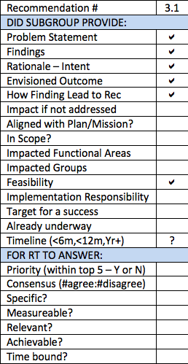
WHOIS1 Rec #3: Outreach
Recommendation R3.1
All of the information related to WHOIS and by implication to other information related to the registration of 2nd level gTLD Domains needs to be revised with the intent of making the information readily accessible and understandable, and should provide details of when and how to interact with ICANN or contracted parties. Although not the sole focus interactions with Contractual Compliance, such as when filing WHOIS inaccuracy reports, should be a particular focus. This should be done post-GDPR implementation and consideration should be given to deferring this until we have a stable permanent GDPR implementation. The revision of this web documentation and instructional material should not be undertaken as a purely internal operation but should include users and potentially focus groups to ensure that the final result fully meets the requirements.

Slide 99
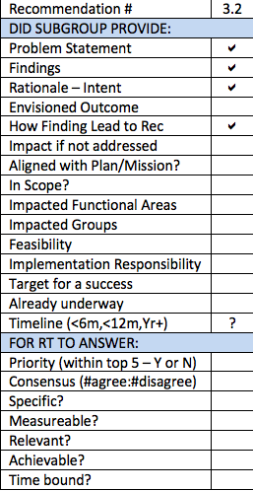
WHOIS1 Rec #3: Outreach
Recommendation R3.2
With community input, ICANN should decide to what extent there is a need to carry out outreach to groups outside of the normal ICANN participant, and should such outreach be deemed necessary, a plan should be developed to carry this out and document it. WHOIS inaccuracy reported was previously an issue requiring additional education and outreach and may require a particular focus. The need for and details of the outreach may vary depending on the ultimate GDPR implementation and cannot be detailed at this point.

Slide 100
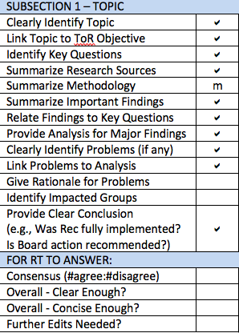
WHOIS1 Rec #3: Outreach
Gap Assessment
Subsection 1: Move methodology to Subsection 2.
Subsection 4: Would benefit from a structure such as:
Bolded problem statement.
Why it is a problem.
Who does it affect.
For example, Why is lack of outreach to non-ICANN audiences a problem? Who might benefit from outreach?

Slide 101
WHOIS1 Recs #12-14: Internationalized Domain Names
Agenda Item #7
Time: 14:00-14:30
Presenter: Alan Greenberg
Subgroup Members: Alan, Dmitry, Lili
Subgroup Wiki: https://community.icann.org/x/85lEB

Slide 102
WHOIS1 Recs #12-14: Internationalized Domain Names
Findings
A set of related efforts implemented WHOIS1 Rec #12:
An expert working group to determine the requirements for the submission and display of internationalized registration data.
A commissioned study to evaluate available solutions for internationalized registration data.
A Policy Development Process (PDP) to determine whether translation or transliteration of contact information is needed. If so, specify who should bear the burden of the transformation.
As requirements for the translation and transliteration of registration data were not finalized in time for the 2013 RAA, placeholders can be found both in Registry Agreement (RA) and Registrar Accreditation Agreement (RAA). However, implementation of WHOIS1 Rec #13 depends on RDAP progress.
WHOIS1 Rec #14 is currently being performed as part of the Accuracy Reporting System (ARS). The metrics and measures developed by ARS are suitable when internationalized registration data become available for studying.

Slide 103
WHOIS1 Recs #12-14: Internationalized Domain Names
Findings continued
Based on its analysis, members of this subgroup agree that these WHOIS1 recommendations have been fully-implemented
Work was done to the extent it can be done without an RDAP-based WHOIS system.
Issues
The commercial feasibility loophole in the current contracts allows registrars and registries to not implement RDAP.

Slide 104
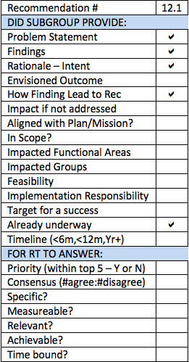
WHOIS1 Recs #12-14: Internationalized Domain Names
Recommendation R12.1
The implementation of Rec #12-14 should be reviewed again after RDAP is implemented, and the translation and transliteration of the registration data launches.

Slide 105
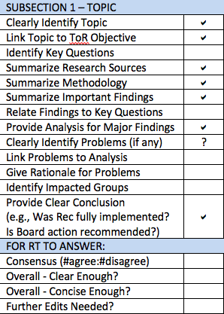
WHOIS1 Recs #12-14: Internationalized Domain Names
Gap Assessment
Subsection 2 (Topic) does not appear to define key questions that the Subgroup tried to answer
As such Subsection 4 (Findings/Analysis) cannot tie back to key questions
Subsection 5 (Problem/Issue) states a finding but does not really explain the problem caused by that finding. Expand to briefly state the problem, explain why it is a problem, and identify who is affected.
Recommendation in Subsection 6 needs to be fleshed out and made specific & measurable

Slide 106
Brainstorming on Content of Executive Summary
Agenda Item #8
Time: 14:30-15:30
Presenters: Review Team Leadership & ICANN org

Slide 107
Break
Time: 15:30-15:45
What’s Next?
15:45-16:00 – Adjust (as needed) structure of report (e.g. merge sections etc.)
16:00-16:15 – Review work plan
16:15-16:30 – Parking lot for items that require further discussion
16:30-17:30 – Face-to-face meeting wrap-up

Slide 108
Adjust (as Needed) Structure of Report (e.g. Merge Sections etc.)
Agenda item #9
Time: 15:45-16:00
Presenters: Review Team Leadership
Draft Report on Wiki Page: https://community.icann.org/x/cyQFBQ

Slide 109
Adjust (as Needed) Structure of Report
Refer to:
Draft Report Table of Contents

Slide 110
Review Work Plan
Agenda Item #10
Time: 16:00-16:15
Presenters: Review Team Leadership

Slide 111
Current Work Plan & Deliverables
DATE * | DELIVERABLE*
By 31 July | Approve draft report for public comment
7 August – 5 October | Public comment on Draft Report
By 26 October | Adopt public comment summary for publication
By 30 November | Update recommendations and report based on public comment
By 21 December | Approve final findings and recommendations for submission to ICANN Board
*Per work plan submitted to ICANN Board on 9 February 2018 and reconfirmed at Brussels face-to-face meeting #2
Any adjustments needed?

Slide 112
Parking Lot for Items that Require Further Discussion
Agenda item #11
Time: 16:15-16:30
Presenters: Review Team Leadership

Slide 113
Face-to-Face Meeting #3 Wrap-Up
Agenda item #12
Time: 16:30-17:30
Presenters: Review Team Leadership & ICANN org

Slide 114
Face-to-Face Meeting #3 Wrap-Up
Roadmap to publication of Draft Report for Public Comment:
Set deadlines for completing outstanding actions and gaps
Identify penholders, etc.
Confirm consensus level and remaining gaps for
Each Subgroup’s findings overall
Each Recommendation
See next slide
Confirm action items
Any other Business
Closing remarks

Slide 115
Confirm Consensus Level
Refer to:
Gap Assessment Tools and Appendix A (S.M.A.R.T. Criteria)
Confirm for each Subgroup Report | R1 Strat Priority | R2 Single Policy | R3 Out reach | R4 Comp | R5 Accur | R10 P/P | R11 Comm I/F | R12 IDN | R15 Plans & Reports | 2 Any New | 3 LE Need | 4 Cons Trust | 5 Safe Data
Consensus (#agree:#disagree)
Overall - Clear Enough?
Overall - Concise Enough?
Further Edits Needed?
Confirm for each Recommendation | R1 Strat | R2 Policy | R3 Outreach |  | R4 Compliance |  |  |  |  |  |  |  | R11 I/F | R12 IDN | R15 Plan | Cons Trust | Safe Data
Recommendation # | 1.1 | 2.1 | 3.1 | 3.2 | 4.1 | 4.2 | 4.3 |  | 4.5 | 4.6 | 4.7 | 4.8 | 11.1 | 12.1 | 15.1 | CT.1 | SG.1
Priority (within top 5?)
Consensus (#agree:#disagree)
Specific?
Measureable?
Relevant?
Achievable?
Time bound?

Slide 116
Appendix A
S.M.A.R.T. Recommendations

Slide 117
Criteria for S.M.A.R.T. Recommendations
S
M
A R T
PECIFIC
EASURABLE
CHIEVABLE
ELEVANT
IME-BOUND
Evaluate results:
what is expected, how to get it done and what the target is?

Slide 118
Criteria for S.M.A.R.T. Recommendations
11 questions to encourage discussion and consideration to result in clear, useful and implementable recommendations:
What observed fact-based issue is the recommendation intending to solve? What is the “problem statement”?
What are the findings that support the recommendation?
How significant would the impact be if not addressed:
Very significant
Moderately significant
Impacted areas (for example, security, transparency, legitimacy, efficiency, diversity, etc.)
What is the intent of the recommendation?
What outcome is the Review Team seeking? How will the effectiveness of implemented improvements be measured? What is the target for a successful implementation?
Notes:
[1] Findings are based on comprehensive and objective gathering of facts through appropriate means of research and data collection. Review Team should summarize supporting evidence.
[2] The Review Team should consult with relevant subject matter experts on ICANN staff to help with high-level scoping of resources required for the implementation.

Slide 119
Criteria for S.M.A.R.T. Recommendations
Does the Review Team envision[2] the implementation to be:
Short-term: implemented within 6 months
Mid-term: implemented within 12 months
Longer-term: implemented in more than 12 months
Is the recommendation aligned with ICANN’s strategic plan and ICANN mission? If yes, how?
Does this recommendation require new policies to be adopted? If yes, what stakeholders need to be engaged in the policy development process to support successful implementation of this recommendation?
Is related work already underway? If so, what is it and who is carrying it out?

Slide 120
S.M.A.R.T. Recommendations
Who are the (responsible) parties that need to be involved in the implementation work for this recommendation?
Community
ICANN org
Board
Combination of the above
If only 5 recommendations can be implemented due to community bandwidth and other resource constraints, would this recommendation be one of the top 5? Why or why not?

Slide 121
Suggested Recommendations Format
Recommendation:
Findings:
Rationale:
Impact of Recommendation:
Feasibility of Recommendation:
Implementation:
Priority:
Level of Consensus:
Included in your subgroup report template

