Slide 1
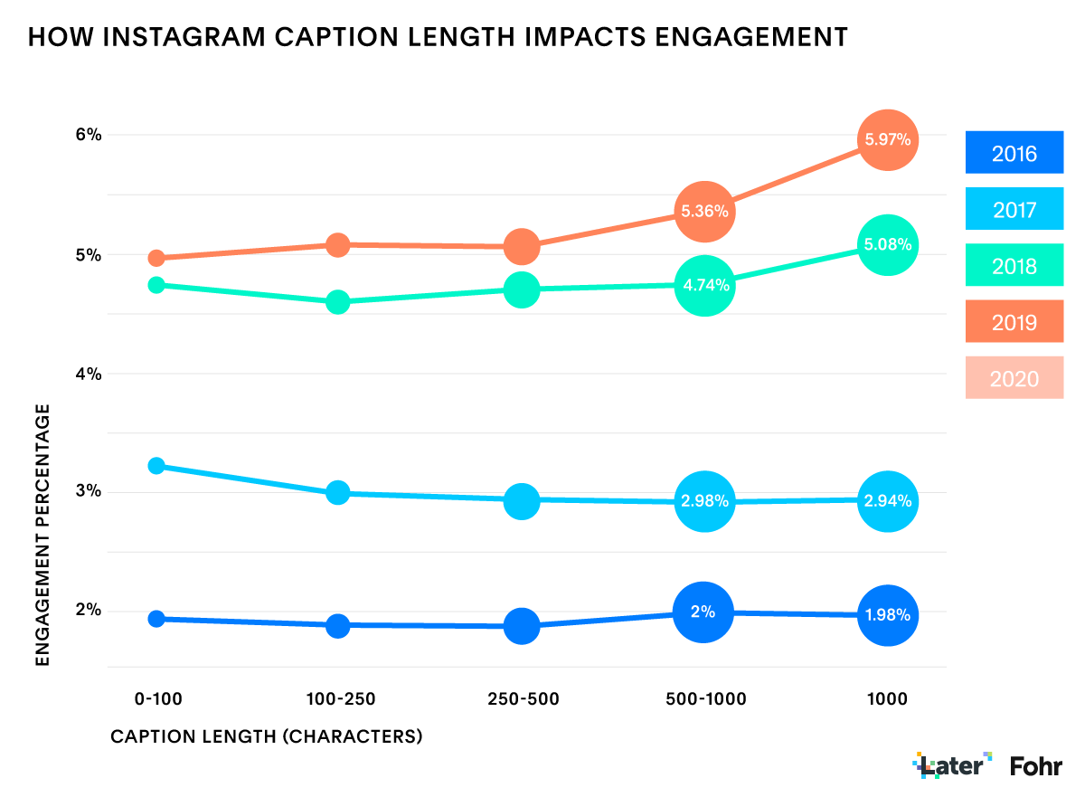
Why Instagram ?
Proposal by Adebunmi Adeola Akinbo

Slide 2
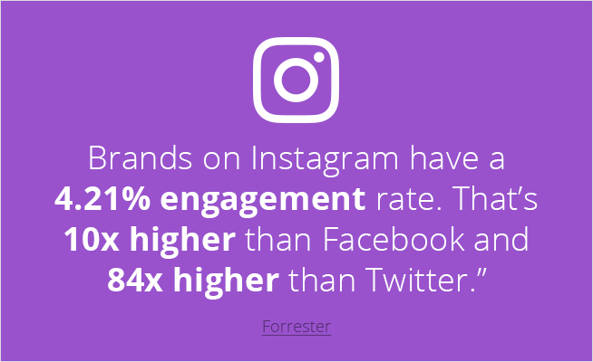
Instagram is an entirely visual platform.
Instagram's sole purpose is to enable users to share images or videos with their audience.

Slide 3
Assumption
Instagram will allow you to create great content quickly and easily, while Twitter is great for engaging with your audience and even providing Customer Support. But the sheer volume of users and high levels of engagement on Instagram make it the best Social Media platform currently to promote your brand!

Slide 4
Reality Check 1
 | EndUsers | 25 - 34 | Source
 | Twitter | 28.9% | https://www.statista.com/topics/737/twitter/
 | Instagram | 33.1% | https://www.statista.com/topics/1882/instagram/

Slide 5
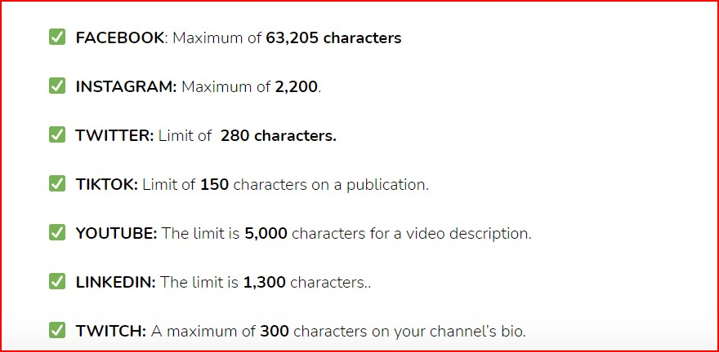
Reality Check 2
Its glaring in the crowd…allows for more character.

Slide 6
Opportunities
Instagram is considered to be the best social media platform for engagement or your ability as a brand to connect with your followers. ... It's visual, simple and it's attracting the younger generations more than other social media platforms.

Slide 7
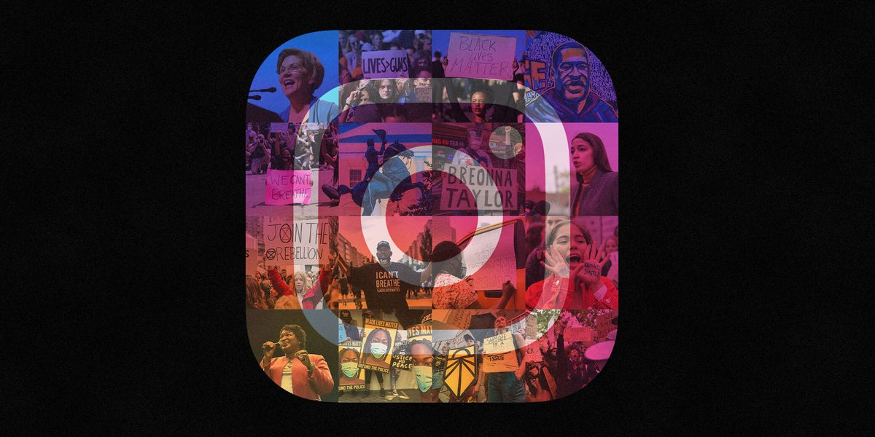
Engagement
Engage With Netizens where They Spend Their Time;
Understanding Your Demographics.

Slide 8
Strategy
Define the content with a graphics;
Chose your hastags and handles;
Insert link in bio;
Send approved post.

Slide 14
Outreach

Slide 15
Orientation

Slide 16
Reporting

Slide 17
Better Target Market Penetration
What better place than Instagram to post a high-resolution picture or a short video of your product and lead the customers to your website?

Slide 18
Better Content Display
Instagram allows you to build your brand image through pictures and videos far more effectively than Facebook or Twitter or any other social media website.
Instagram, despite having a website, is mainly accessed through the official mobile app by 700 million users all over the world. They see only images and videos. It is a completely clutter free User Interface and thus, as a social media marketer you enjoy better customer engagement.

Slide 19
Instagram users are active and they spend a lot of time
A study has revealed that Instagram users are fifty-eight times more likely to comment, like or share a picture compared to Facebook. That is the ultimate level of consumer engagement. The more your content gets shared and the more comments you get, the better it is for you’re the organization.

Slide 20
Finally…
Engagement on social media can not be seen as too much; as long as it promotes the focal engagement of the organization.
One can easily make reference for orientation, educative and informative engagements.

Slide 21
proposed

Slide 22
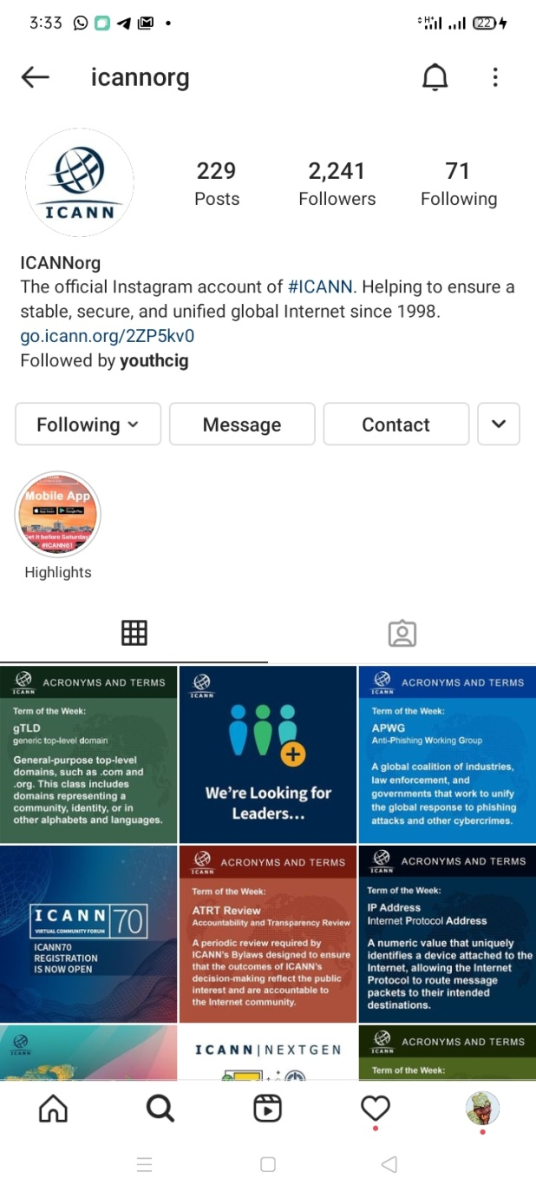
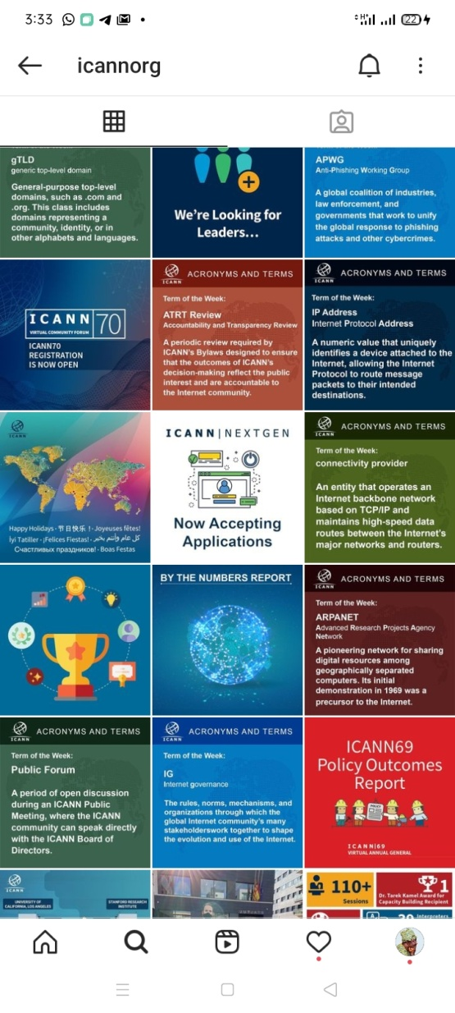
Algorithms

Slide 23
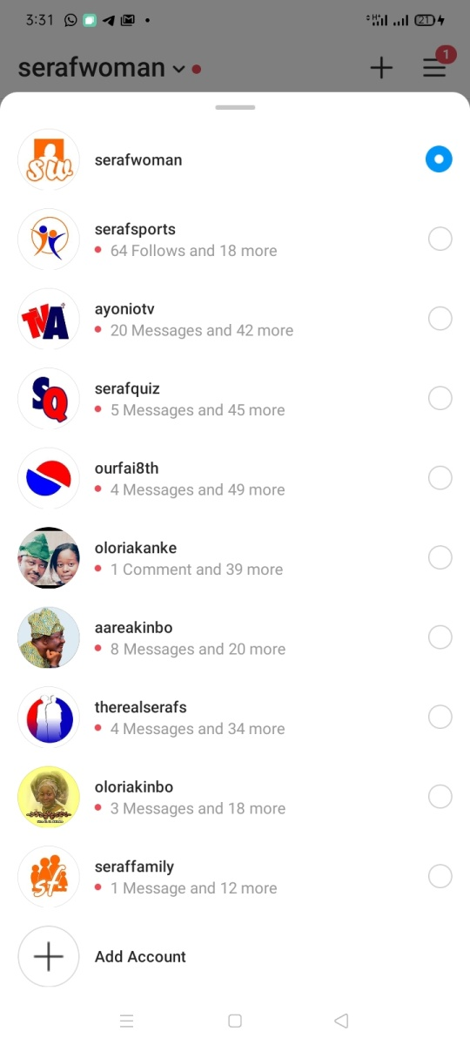
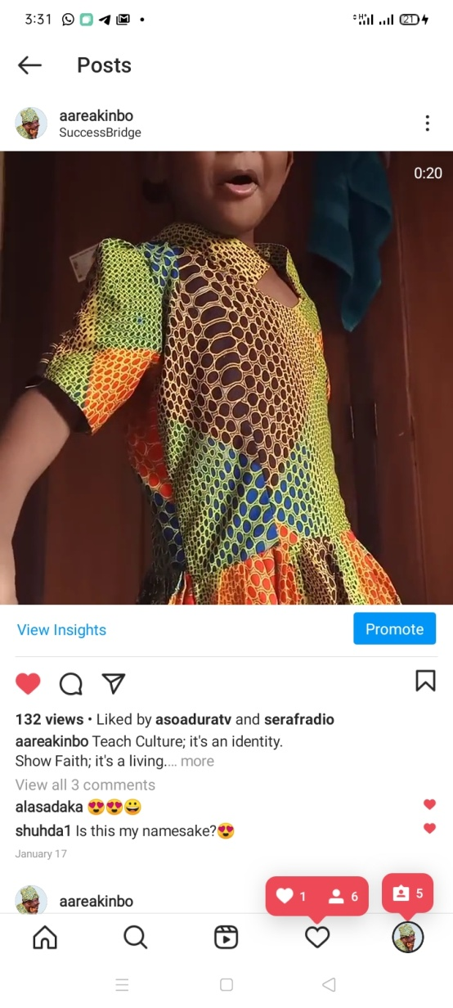
Algorithms

Slide 25
Thanks for your time.

