Slide 1
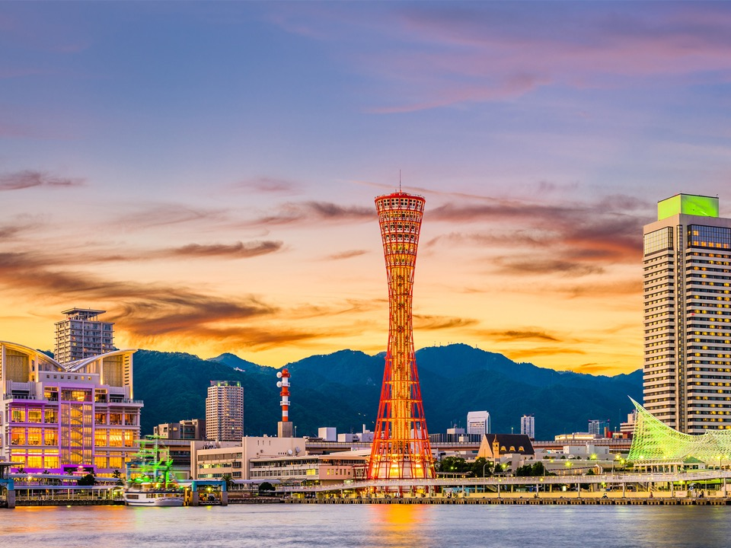

Slide 2
Second Security, Stability, and Resiliency of the Domain Name System (SSR2) Review Team
Draft for RT input
Engagement Session @ ICANN64
11 March 2019

Slide 3
Agenda
1
2
3
Where We Are Today
Our Work
Our Current Timeline
4
5
6
Outreach & Your Input Requested
Thank You & Questions
Background
Notes:
This is a stylized agenda slide for your presentation.
To delete a box, if there are too many boxes, click the edge of the box, ensure the entire box is highlighted, then DELETE.
To update the numbers and text, click inside the circle for the numbers or in the box for the text, revise the text.

Slide 4
Where We Are Today
Completed our assessment of ICANN's implementation of SSR1 recommendations from 2012
Drafted summary of key findings and assembled draft recommendations
Detailed the scope items for our remaining areas of focus, as guided by ICANN's Bylaws
Identified additional information needed to advance our work and documented questions for the ICANN organization on each topic
At ICANN64:
Conduct further information gathering as necessary
Continue drafting key findings
Report drafting sessions

Slide 5
Our Work
We are addressing relevant mandates of ICANN’s Bylaws as they relate to the following key areas. All considerations will be investigated and analyzed with a clear intent to produce specific, measurable, attainable, relevant, and time-based (SMART) recommendations that fall within ICANN’s purview:
1
ICANN's implementation of 28 SSR1 recommendations from 2012
2
ICANN’s key security, stability, and resiliency activities
3
Activities that impact the SSR of the Domain Name System (that ICANN contributes to/facilitates)
4
Challenges to the secure and resilient operation of the unique identifiers system

Slide 6
Workstream 2 Scope Items
ICANN’s key security, stability, and resiliency activities
ICANN's Information Security Management System
ICANN's Business Continuity Management System
ICANN's Risk Management Methodology and Framework
How effectively has ICANN implemented its Security Incident Management and Response Processes to reduce (pro-active and reactive) the probability of DNS-related incidents
How effectively has ICANN implemented its processes around vetting registry operators and services concerning the New gTLD Delegation and Transition process
Internal security, stability and resiliency of ICANN's operation processes and services
How effectively ICANN has implemented its processes to ensure compliance regarding registrar agreements and the consensus policies

Slide 7
Workstream 3 Scope Items
Activities that impact the SSR of the Domain Name System
(that ICANN contributes to/facilitates)
Root zone management
Root server system (eg. l-root)
Alternate root deployment and co-existence
SSR measurements
Namespace abuse
Software interoperability

Slide 8
Workstream 4 Scope Items
Challenges to the secure and resilient operation of the
unique identifiers system
Coalescence of registrars/registry/backend operators for multiple TLDs
Access to data, info, research on important abuse/attack vectors
New crypto systems in DNSSEC
New uses for DNS (IoT, etc.)
Alternate naming systems (interactions, conflicts, etc).
Root server system protection: assess the threatscape of top threats (e.g. DDoS to the root system)
Privacy protections

Slide 9
Our Current Timeline
By
ICANN64
May
2019
August 2019
ICANN64
ICANN65
ICANN66
Updated scope/ToR,Work plan, Outreach plan, gathering & assessing facts
Gathering & assessing facts, begin creation of draft report, engagement with community & Board
F2F meeting, assemble draft findings and rec’s
F2F meeting, presentation of draft findings and rec’s, engagement with community
Publish draft report for public comment period (40 days),
Presentation of final report, community engagement, final delivery of report to Board

Slide 10
Your engagement requested
This is a community review team, please share your views
Send input via email to input-to-ssr2rt@icann.org (publically archived)
Provide comments at engagement sessions and online
Become an observer to our regular meetings - send an email to mssi-secretariat@icann.org to sign up
Bookmark our wiki to follow our work and view meeting records: https://community.icann.org/display/SSR/SSR2+Review

Slide 11
Background

Slide 12
Our Scope, Terms of Reference & Work Plan
Adopted updated work plan in November 2018:
Shared with the community, Board & on wiki: https://community.icann.org/x/O7jRAw
Serves as a guide for our work
Evolves with our work and is updated as the work progresses
Adopted updated scope/Terms of Reference in September 2018:
Shared with the community, Board & on wiki: https://community.icann.org/display/SSR/Terms+of+Reference?preview=/66061139/93129027/SSR2-Terms%20of%20Reference-Final%202018-Sep-1%5B2%5D.docx
Describes focus of our work, guided by ICANN’s mission and requirements of its Bylaws, Article 4, Section 4.6 (c)
Includes:
Timeline of the review milestones
Leadership & membership responsibilities
How we make decisions and conduct our work
Our commitment & plan for outreach
Work follows Bylaws: “ICANN's execution of its commitment to enhance the operational stability, reliability, resiliency, security, and global interoperability of the systems and processes, both internal and external, that directly affect and/or are affected by the Internet's system of unique identifiers that ICANN coordinates.”

Slide 13
Our Outreach Plan
Posted to our wiki here: https://community.icann.org/pages/viewpage.action?pageId=64076120&preview=/64076120/95093400/Draft%20SSR2%20Communications%20%26%20Outreach%20Plan%20v2.docx
Key Milestone: | Objective(s)
1. Adopted Terms of Reference & work plan | Provide community with details on adopted Terms of Reference and work plan. Invite input.
2. Fact finding & ongoing work | Provide community with overview of work plan, information received/requested. Initial fact finding, as appropriate. Seek input.
3. Initial findings | Provide community with overview of information received/requested, results of analysis, and set of initial findings. Seek input.
4. Draft recommendations | Seek input from community, Board, org on draft recommendations.
5. Final recommendations | Present final recommendations to community, Board, org.

Slide 14
Our Team
RT Member | SO / AC Affiliation | Region
Alain Aina | ccNSO | AF
Noorul Ameen | GAC | AP
Kerry-Ann Barrett | GAC | LAC
KC Claffy | SSAC | NA
Russ Housley (Chair) | SSAC | NA
Žarko Kecić | ccNSO | EUR
Boban Krsic | ccNSO | EUR
Jabhera Matogoro | ALAC | AF
Scott McCormick | GNSO | NA
Denise Michel (Vice-Chair) | GNSO | NA
Eric Osterweil (Vice-Chair) | RSSAC | NA
Ramkrishna Pariyar | ALAC | AP
Rao Naveed bin Rais | GNSO | AP
Kaveh Ranjbar | Board | EUR
Norm Ritchie | GNSO | NA
Laurin Weissinger (Vice-Chair) | ALAC | EUR

Slide 15
Thank You & Questions

