Slide 1
Prioritization Methods

Slide 2
Prioritization Methods
SSAC’s methodology: Risk Rating approach + Individual Vote for top-5 + qualitative analysis
Other tools:
Value vs. Complexity matrix
Scorecard
All methods rely on:
An agreed-upon set of criteria
Clear definitions of scales

Slide 3
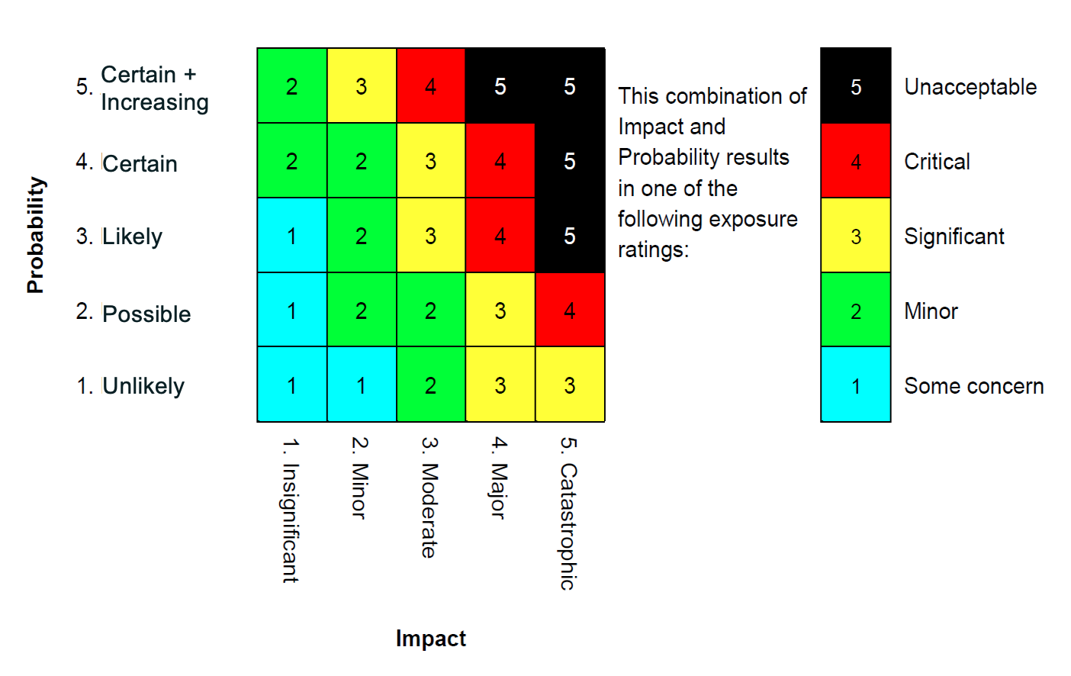
Risk Rating (used by SSAC as 1st step)

Slide 4
SSAC’s Probability Definition
Probability | Description | In % terms
1 – Unlikely | Not expected, but there's a slight possibility it may occur at some time. | 0 to 25%
2 – Possible | The event might occur at some time. There may be a history of infrequent occurrence. | 25 to 75%
3 – Likely | There is a strong possibility that the event will occur. There is a history of frequent occurrence. | 75 to 95%
4 – Certain | There is a near certainty or certainty that the event will occur. A history of common occurrence exists. | 95 to 100%
5 – Certain and Increasing Frequency | There is a near certainty or certainty that the event will occur. A history of common occurrence exists and the frequency of occurrence is likely to increase. | 95 to 100% + Increasing Frequency

Slide 5
SSAC’s Impact Definition
Impacted Entities | 1 - Insignificant Processes are intact, but slightly affecting parties adversely | 2 - Minor Not significant in its impact. Processes are operating and causing some intermittent disruption. | 3 - Moderate Significant, but intermittent disruption to entities and the internet. Counter measures effective. | 4 - Major Significant, continuing disruption to entities and the internet. Counter measures are weak | 5 - Catastrophic Widespread, continuing disruption to entities and the internet. Counter measures are not effective
ICANN Org
Name & Number Provisioners
DNS and Routing Infrastructure/ Service Providers
End Users and Registrants
↓
OVERALL SECURITY AND STABILITY

Slide 6
Vote for top-5 after initial ranking + qualitative analysis (used by SSAC)
Issues Areas | SSAC Initial Ranking | SSAC Member Votes | Timing/Urgency/Dependency | Previous advice | Breadth/Number of entities impacted | What action can SSAC take with respect to this issue? / What form of Advisory SSAC can write?
7.2 | 4 - Critical | 15 | No dependency | None | Primary: DNS and Routing Infrastructure Service Providers, end users Secondary: name and number provisioners, ICANN Org
5.2.5 | 5 - Unacceptable | 13 | DoT/DoH dependency | None | Primary: DNS and routing infrastructure service providers
5.1.6 | 4 - Critical | 12 |  | SSAC Past work on name collision, NCAP project | End users and registrants

Slide 7
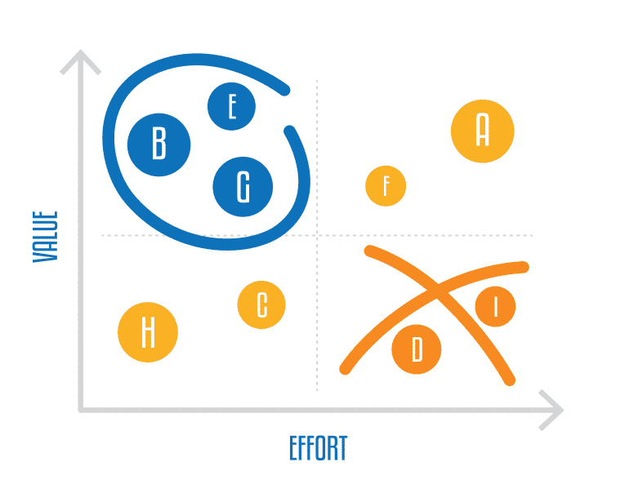
Value vs. Complexity matrix
The value vs. complexity model can be a helpful strategy for teams trying to turn a long list of items into a strategically sound list of priorities.
Start with high-value, low-cost items, and later move on to high-value, high-cost items.
Low-value and low-cost items should be balanced throughout the development cycles, as these might represent smaller improvements and nice-to-have items.

Slide 8
Scorecard
Define a set of criteria and weights for scoring
Agree on scaling and definition of scale
Go over all recommendations and assign a score (e.g. from 1 to 100, or 1 to 5) on their respective impact for each criterion.
 | Criterion 1 | Criterion 2 | Criterion 3 | Criterion 4 | Score | Rank
weigh | 20% | 30% | 10% | 40% | 100%
Rec 1 | 40 | 90 | 10 | 60 | 60 | 2
Rec 2 | 100 | 80 | 60 | 80 | 82 | 1
Rec 3 | 50 | 50 | 50 | 50 | 50 | 3

